Slide 1
REVITALIZATION OF ALTERNATIVE LIBRARY: case study at asakura Rumah Asa Community Reading Park
OKKY RIZKYANTHA, HADIRA LATIAR, FUAD WAHYU PRABOWO
LIS UIN SUNAN KALIJAGA YOGYAKARTA, INDONESIA
Notes:
Good afternoon everyone.
My name is Okky Rizkyantha,
I am a student of Library and Information Science of UIN Sunan Kalijaga Yogyakarta.
Actually there must be 3 of us stand here, but they can’t make it because of their own reasons.
So it’s really great to meet you all.
In this great occasional, let me presenting my paper entitle “Revitalization of Alternative Library: case study at asakura Rumah Asa Community Reading Park.
First of all, let me tell what alternative library is

Slide 2
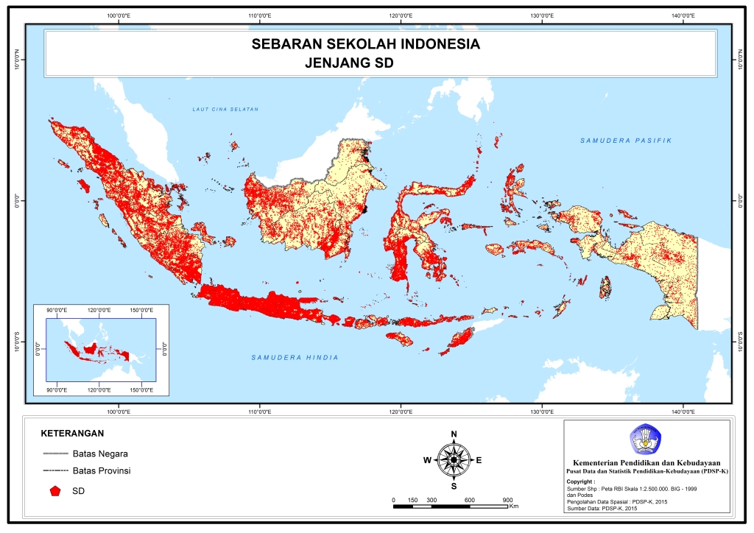

Slide 3
ALTERNATIVE LIBRARY
Alternative Library is also known as Community reading park, TBM, and Community Library. As its name, alternative library is a substitute of the library. While library can not reach certain community in terms of spreading knowledge, alternative library attends to take care of that role for the community. And this is a place which is established and managed both society and the government to provide access to reading material and services for the surrounding community as a means of lifelong learning in order to improve the quality of life around it.
They consist of all walks of life regardless of their social background, economy, culture, religion, customs, education level, age and others.
Notes:
1. As its name, Alternative Library is a substitute of the library. While library can not reach certain community in terms of spreading knowledge, alternative library attends to take care of that role for the community. And this is also known as Community reading park, TBM, and Community Library.
To make easier, I would like to mention Alternative library as a TBM.

Slide 4
PROGRAM OF GOVERNMENT OF SPECIAL REGION OF YOGYAKARTA
Development of TBM in Yogyakarta City, particularly in Special Region of Yogyakarta has the same historical roots as TBM was born originally because of a public awareness of the level of literacy or the extent of illiteracy in the surrounding community. That's why there are some people who are moved and maximize the potential and network to create a TBM.
Before 2012, According Muhsin, Chairman of TBM Forum DIY province recorded there are 190 TBM in all over special Region of Yogyakarta (DIY).
Interesting phenomenon emerged in 2012, in accordance with the Decree of the Mayor of Yogyakarta, then the TBMs that do not have legal force are notarized or obtained the opportunity to obtain a notarial deed to obtain funds from the government
Notes:
In 2012 the DIY Government began to give its attention to TBM spread in its area by providing funding for development and empowerment of TMB. So the TBM that was formed personally. And now it got the deed of notary and to facilitate in funding. The logical consequence of the policy is also on the development of human resources, the management of TBM with the system requires a qualified human resources manager so as to develop and achieve the objectives which is to increase the interest of reading of community

Slide 5
STATISTICS OF ALTERNATIVE LIBRARY
2012 = 190 unit
2017 = 213 unit
Notes:
Statistics show that every district in Yogyakarta strives to provide the best quality in generating public interest. Yogyakarta city has the most TBM among others, this is because Yogyakarta city has various advantages from other regions. Data above is a fact that at that time there is still a gap in good society
in big cities or in areas. With the large number of TBMs in the DIY. this also needs extra effort to maintain its existence. But in reality, some TBMs have been stagnant and unproductive and leave only the nameplate.
based on the author's interview with some TBM managers, many TBMs are in decline. Until now there has been no recent statistical data related to TBM that still survive and operate well.

Slide 6





ALTERNATIVE LIBRARY’S PROBLEMS
Lack of Government’s Attention
Insufficient Funding
Static Program
Lack of Enthusiasm from Public
The limited of Information Technology
Notes:
Over time many TBMs are lost and inactive due to several things, such as:
The government is a major advocate of TBM, many TBMs are not yet self-sufficient and still dependent on government assistance. If the government is reluctant to participate in success, providing proper monitoring then TBM will remain in place.
This is a major obstacle for every TBM, the absence of funds for employees and the activities of making some TBMs stagnate. But I think they can overcome this by having a creative soul and entrepreneurship.
Most TBMs are comfortable with literacy, and their outreach is only for Primary school-aged children. It also becomes a problem why TBMs do not dare to provide other activities and expand their market share, such as activities for parents, teenagers.
This is also a problem in itself. Because if the low interest of society to TBM can make TBM not enthusiastic in giving its service to society. The low reading interest of the community to the book, and the increasing number of people who are comfortable just by holding the mobile a little affect the interest of reading the community.
They do not take advantage of the internet and social media available. And if you use it they can promote TBM more broadly. Most TBMs are not built by heart, meaning they only participate in government programs in a perfunctory manner. Not occupied properly.
At the same time, we strive to provide new insights into the problems I have mentioned by giving a new view of modern and contemporary TBM. Independent of activities. Associate well with the community. That is TBM Rumahasa Asakura.

Slide 7
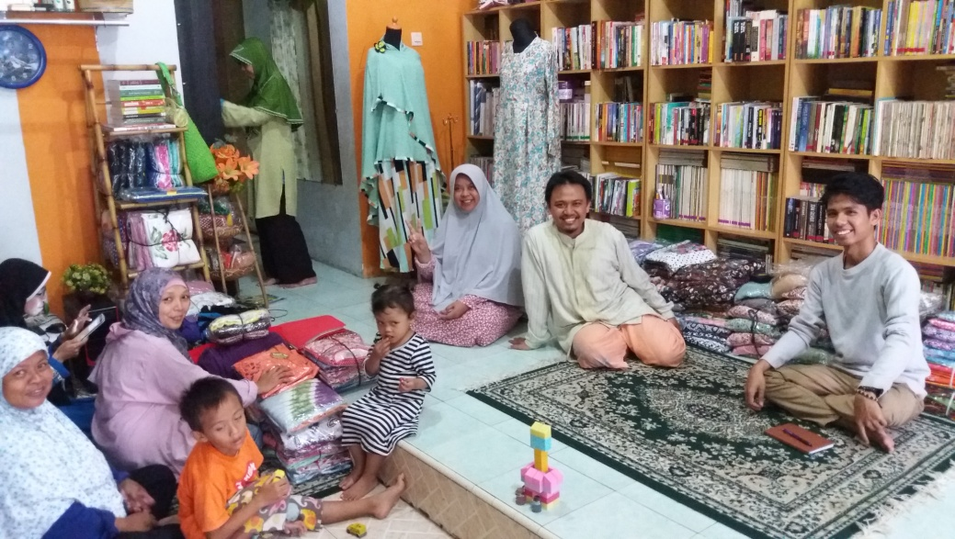
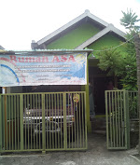

ASAKURA RUMAH ASA COMMUNITY READING PARK
Notes:
TBM Asakura Rumah Asa is one of the best TBM in Yogyakarta that has variety of excellent programs that can be of benefit to the local community. This TBM initiated by local communities who develop interests in reading and empower communities through reading materials. Karangkajen is known as batik industry, as well as printing. TBM Rumah Asa engaged in the field of literacy and the empowerment of local community basis. The slogan is Read, and Strong Together. TBM Rumah Asa was born on 23 April 2009 on Day of Folktale World. At first, it was named Rumah Asa Dunia-Q and renamed in May 2011 after managers did visitation on December 2010. Now it is used as a home-based business initiative and basecamp of TBM Rumah Asa. The TBM space activities and fused with a home business manager owned business in the form of creativity and fashion products. Reqiremenet of material fulfilled by purchasing and supporting of the publisher, society, and donors. The collection comprises 17,000 titles of books, mostly collections of fiction, lifeskill, novels, comics, magazines, religious books and children's books. To facilitate users browse through collections, the manager provides color-lebelling on the collection. Monday-Friday from 4:00 PM to 5:45 PM. Each person may borrow two books and must be returned within one week. There is manga corner which contains a wide variety of comics that used to be the reading of the children who visit the TBM.

Slide 8
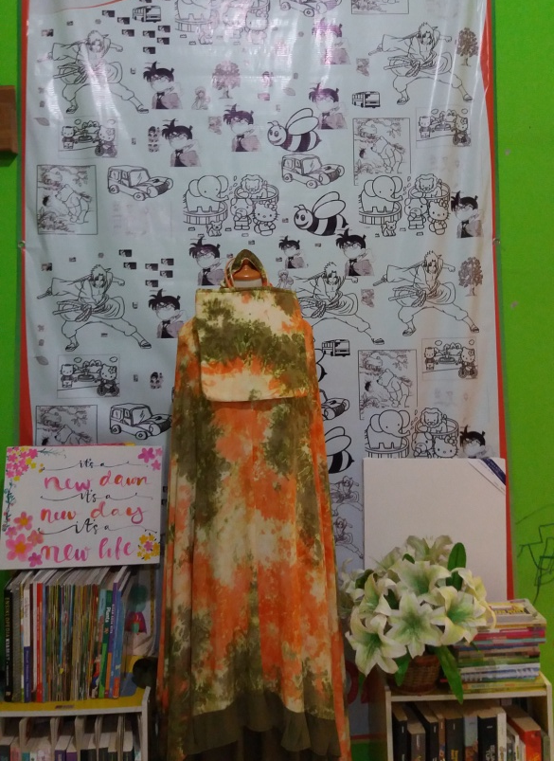
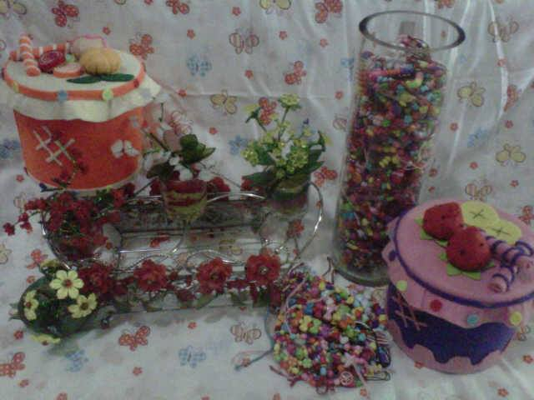
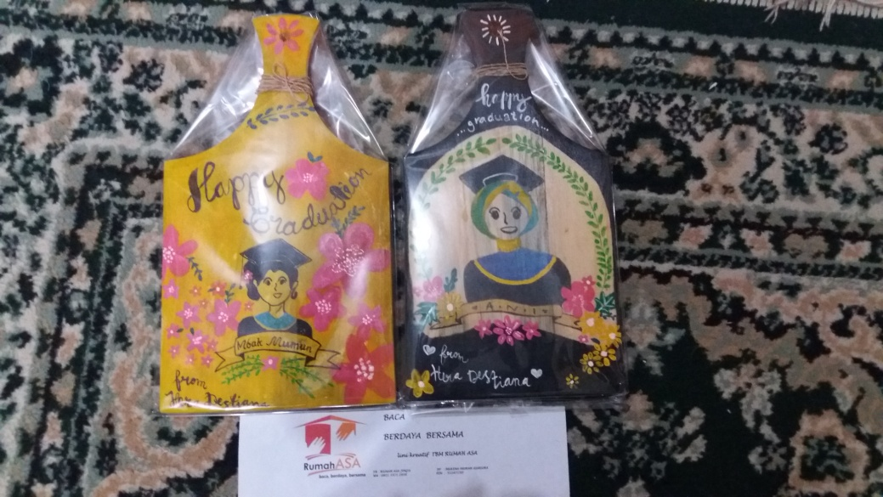
TBM ASAKURA RUMAH ASA’S PROGRAMS
Entrepreneurial Activities
CREATIVITY IS AN INVALUABLE SUCCESS
- Kalida -
Notes:
The orientation of the library is a service of social. TBM can develop himself to be more productive by making some effort and crafts. The flagship program of Community Reading Park Rumah Asa is an activity which has result product-result and can be enjoyed by the members of community. All the result-products sell via offline and online. The place of the TBM is combined with Rumah Asa Store. So besides doing basic activities such as information literacy, the TBM can empower local communities to produce quality products and has a sale value. Its boutique store named Asakura Rumah Asa, selling a variety of crafts society such as women's clothing, brooches, flowers, bags, souvenirs, and container tissue. Funds obtained from the boutique considers as major funding of the organization. Besides the Reading Garden also start selling paintings which is sold via online. The entrepreneurial activity directly organized by TBM leaders and staffs. The effort required to perform the manager/leadership who have a high sense of business. From this orientation will be obtained advantages, both material and non-material that can enhance the image library.

Slide 9
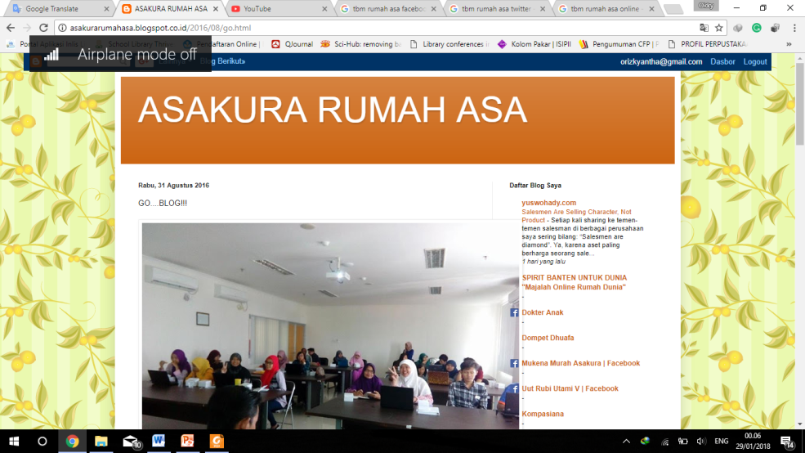
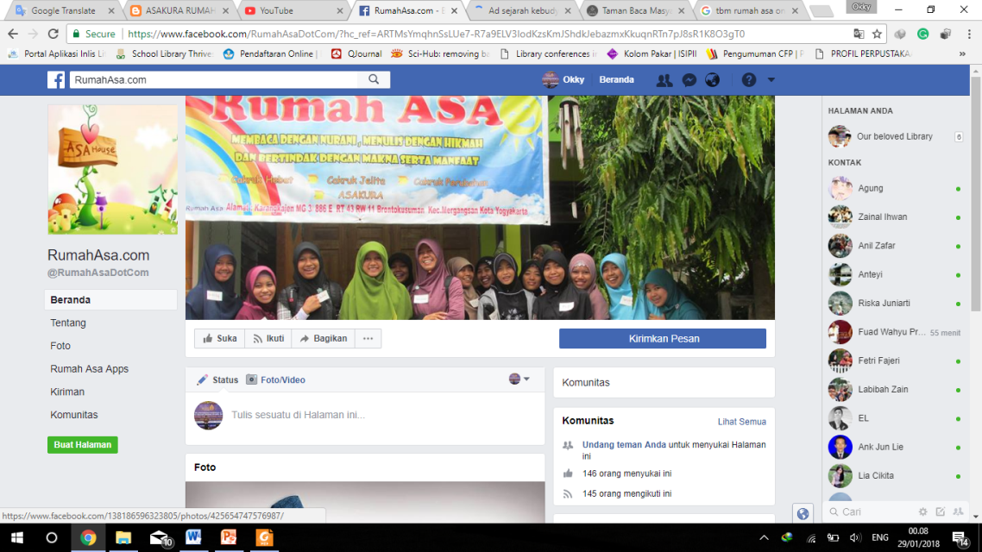
Implementing Technology and Information
Notes:
Technology developed at this time have a positive impact on the organizations. With the application of technology in TBM activities can accelerate the delivery of information to the public. Technology as a device can introduce the TBM to the general public without having to come to the site. Modern technology can accelerate the delivery of information, and convert the form of collections is also a major concern collections library technology use. The use of social media and websites are used by the TBM Rumah Asa to disseminate information about its activities. With the implementation of this technology, communication links with the wider community can be done quickly. If anybody wants to do some research to make observations, visits, and provide assistance, they can contact the manager easily. As for the media campaign of the reading park, it uses Facebook (Facebook.com/TBM Rumah Asa). Website (www.rumahasa.com), Facebook Boutique (Facebook.com/mukena.asakura), email(cunila13@yahoo.com). Information technology is widely used for the management of work because of their effectiveness and efficiency that has been proven to increase profits or turnover that comes in, either financially or network. The information is uploaded and published on the website or internet reaches a wide audience quickly.

Slide 10
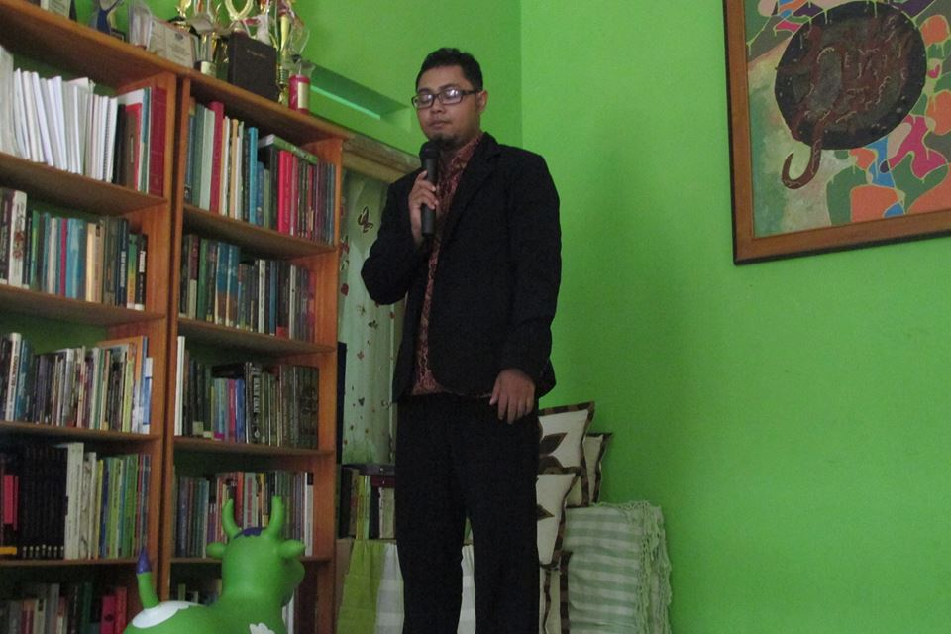
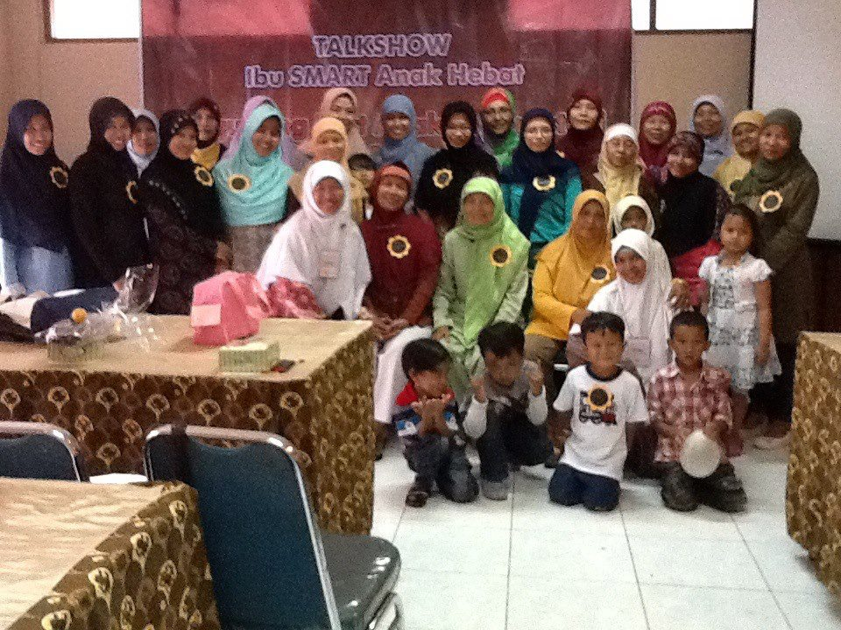
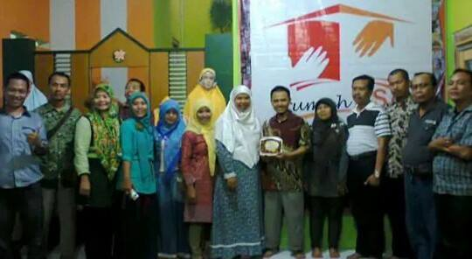
Organizing Training And Parenting Activities
The family is one of nature’s masterpieces
- George Santayana -
Notes:
Untuk TIARA, pengelola TBM Rumah Asa gelar pada beberapa chapterRumah Asa, sebagai bentuk apresiasi Rumah Asa kepada para pembaca terbanyak di suatu kampung. Misalnya, mengadakan pelatihan membuat “bros” di daerah Sindurejan, di mana ada 20 orang pembaca ibu-ibu yang aktif membaca dan berwirausaha. Lokasi Sindurejan itu sendiri yaitu 4 KM dari Rumah Asa. Selain juga di chapter Rumah Asa di daerah Karanganyar yang berlokasi 1 KM dari Rumah Asa yang terdiri dari ibu-ibu aktifis PAUD RW dan berwirausaha di bidang kuliner.
Gowes Kampung Jogja Istimewa atau GONG JOGIS untuk usia 8-15 tahun yang merupakan hal kreatif dan baru dilakukan oleh Rumah Asa dalam menggunakan metode historiografi.
Ta’lim Asakura yang merupakan pengembangan program Cakruk Jelita untuk Anak SMA sampai Perguruan Tinggi, rutin setiap Senin malam, tampat bergantian di lingkungan kecamatan. Melatih kreatifias dengan memberi materi bergantian.
Cakruk Perubahan di angkringan untuk para bapak, semuanya berbasis buku bacaan. Hal tersebut didiskusikan di angkringan, dengan menu-menu rakyat jelata yang eksotik yaitu nasi kucing dalam remang-remang cahaya lampu teplok.

Slide 11
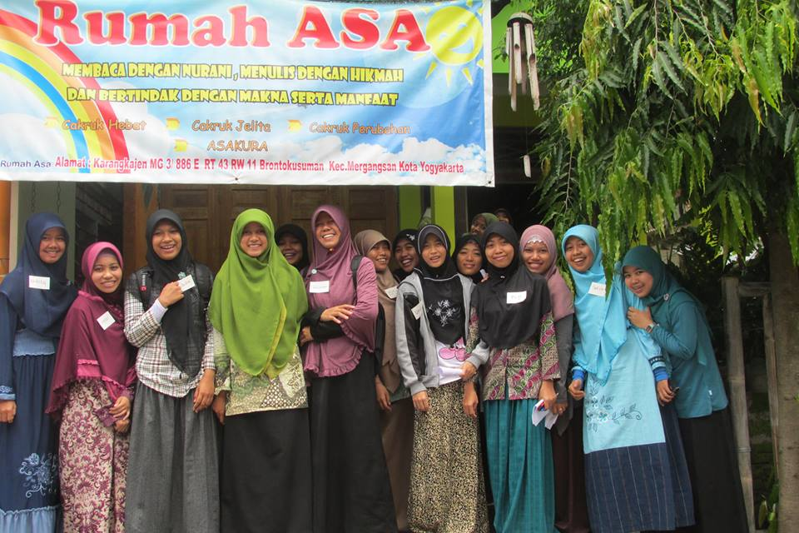
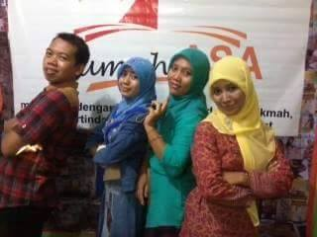
Cooperation with Librarians and Students.
Student
Researcher
Other library communities
Librarian
Notes:
Collaboration is two or more people to carry out joint activities in an integrated manner or synergies geared toward a specific target or goal. Cooperation form is such as volunteer activity. Many librarians and students has come not only to conduct research, but also help the management of the library and its activities. It has been many articles and scientific studies that have been published discussing about TBM Rumah Asa. In addition, they also expand your network by conducting cooperation with libraries in the city of Yogyakarta. The volunteers also contribute and have the skills to create gorgeous mukena-mukena. They make mukena bercerita, combined with cotton, rayon, and felt. And the manager often invited to attend the training held by major libraries in the city of Yogyakarta.

Slide 12
Creativity in TBM
Fluency of thinking, ability to generate many ideas that come out of the thinking quickly. In general, this thinking smoothly is oriented to the results in quantity.
Flexibility, able to produce a number of different works or different models, find alternatives and be able to use various approaches and ways of thinking.
Elaboration, the ability to develop ideas, adds, breaks down ideas or situations, making them more interesting.
Originality has the ability to spark original and original ideas.

Slide 13
NEW INSIGHT OF ALTERNATIVE LIBRARY
TBM must work hard in Giving full attention to the quality of TBM. To give real service you must add something which cannot be bought or measured with money, that is sincerity and integrity. (Douglas Adams)
Regular activities and certain event activities need to be held in a self-representative effort to the social. Don’t stand with static activities. Now days, people more interest with more than just it should be. People expects more and need something interesting.
The government needs to provide professionals in TBM management.
The government provides sufficient funding to each TBM and provides on-going assistance.
TBM must be more creative again in showing itself
TBM will not move if there is no good coordination between various related parties such as managers, surrounding communities, government, library and information practitioners, and book publishers in DIY.
Alternative library would be become the center of community in term of improving life skill. If it can not be used as its ideality then I would be just left as it is.

Slide 14
THANK YOU…

