Slide 1
BETWEEN IMAGING POLITICS AND PROFESSIONAL CULTURE IN MANAGING ISLAMIC UNIVERSITY LIBRARIES IN YOGYAKARTA - INDONESIA
An Analytical Study of Inclusive Leadership
-------------------------------------------
ICRL: Emerging Global Technologies and Trends
February 1-3, 2018 Jaipur, Rajasthan - India
Dr. Nurdin Laugu
Lecturer of LIS Department
Faculty of Adab and Humanities,
UIN Sunan Kalijaga Yogyakarta
Email: nurdin@uin-suka.ac.ic; n.laugu@gmail.com

Slide 2
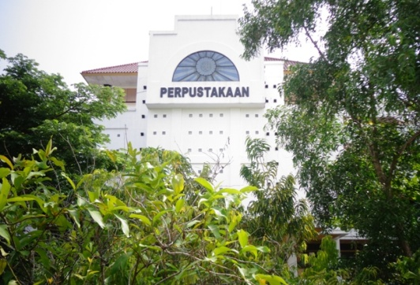
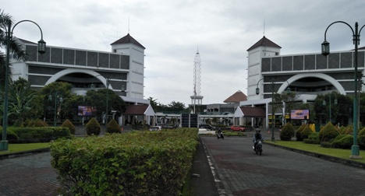
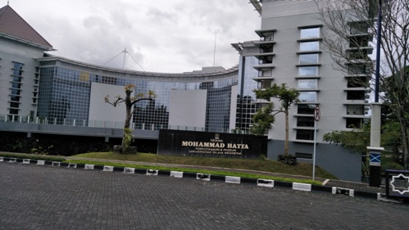
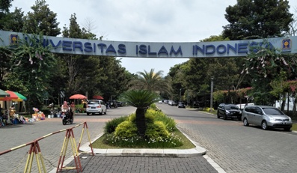
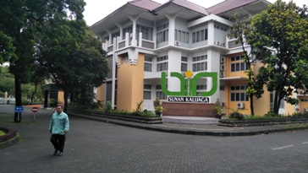
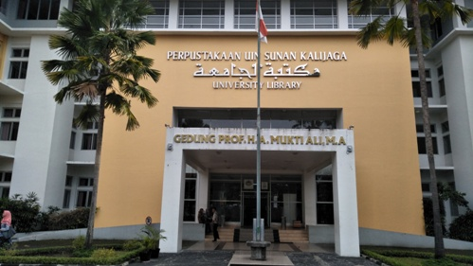
BACKGROUNDS
UMY Library
Three university libraries: UII_UIN_UMY
UII Library
UIN Library

Slide 3
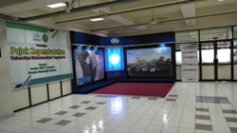
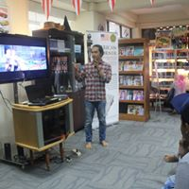
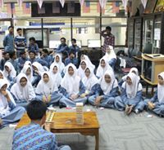
BACKGROUNDS
Public Space
Urgencies and effects of libraries amongst communities
Libraries as a public sphere
Programs offered
Importance for lives
Familiarities
Imaging politics
Student Programs
Socialization to students

Slide 4
CONCEPTUAL APPARATUS
Imaging politics as going out
Mirror, map, simulacrum (Stocchetti, 2011)
Professional culture as going in
people exchange three types of information: conceptual information, indexical information, interaction-management information (Kachru, 2008)
Leadership capabilities as meeting point
two-way relationship that depends on respect, recognition, responsiveness, and responsibility (Hollander, 2009; Landells, 2017)

Slide 5
A Map of Analytical Framework
Imaging Politics
  As Mirror
  As Map
  As Simulacrum
Corporate Behavior
Programs of Libraries
Inclusive Leadership
Professional Culture

Slide 6
METHOD
As qualitative research, its Paradigm:
interpretive, constructive, and critical
Data collection:
observation, interview, and documentation
Validity:
triangulation, i.e. Source, technique, and time
Analysis:
reduction, display, and verification/conclusion

Slide 7

OVERVIEW
Working hour and overtime services
Universities | Working hours |  | Overtime service
 | Start | End | Start | End
Monday to Friday
UIN Sunan Kalijaga | 08.00 | 16.00 | 16.00 | 19.00
UII Yogyakarta | 08.00 | 16.00 | 16.00 | 22.00
UMY Yogyakarta | 08.00 | 15.00 | 15.00 | 16.00
Saturday
UIN Sunan Kalijaga | - | - | 08.00 | 14.00
UII Yogyakarta | - | - | 08.00 | 16.00
UMY Yogyakarta | - | - | - | -
Source: Library documentation, 2017
Number of yearly budget
Source: Library documentation, 2017

Slide 8
Number of librarians, users, collection, and building in three colleges
Universities | Librarians | Library users | Book titles | Building (m²)
UIN Sunan Kalijaga | 45 | 28.000 | 48.309 | 6.730,96
UII Yogyakarta | 23 | 26.000 | 205.191 | 4.189
UMY Yogyakarta | 31 | 21.576 | 134.146 | 1.970
Source: Library documentation, 2017
Number of monthly visitors, books transaction, and books used inside
Universities | Visitors |  | Book circulation
 | Traditional | Online | Transaction | Used inside
UIN Sunan Kalijaga | 24.750 | 270.008 | 26.023 | 51.000
UII Yogyakarta | 29.799 | 197.799 | 214.009 | 410.000
UMY Yogyakarta | 4.862 | 21.695 | 13.381 | 20.000
Source: Library documentation, 2017

Slide 9
DISCUSSION
Three programs to be discussed
Improving librarians’ qualification
Accessibility of users
Institutional governance

Slide 10
IMPROVING LIBRARIANS’ QUALIFICATION (FORMAL)
Degree/Title for Diploma to Doctor
UMY and UII libraries with institutional budgets, beside of national competition & self funds
Different with a state university, UIN Sunan Kalijaga library with, only for national competition or self funds

Slide 11
IMPROVING... (NONFORMAL)
Trainings and workshops, the three are similar
librarians are selected for training based on certain evaluation
Those who are selected are provided with financial support for accommodation, transportation, and even daily lump sum

Slide 12
Continue...
Sharing knowledge, call for paper, both national and international
UMY library provides twenty quotas of paper presenters
UIN and UII have no special funds for such programs

Slide 13
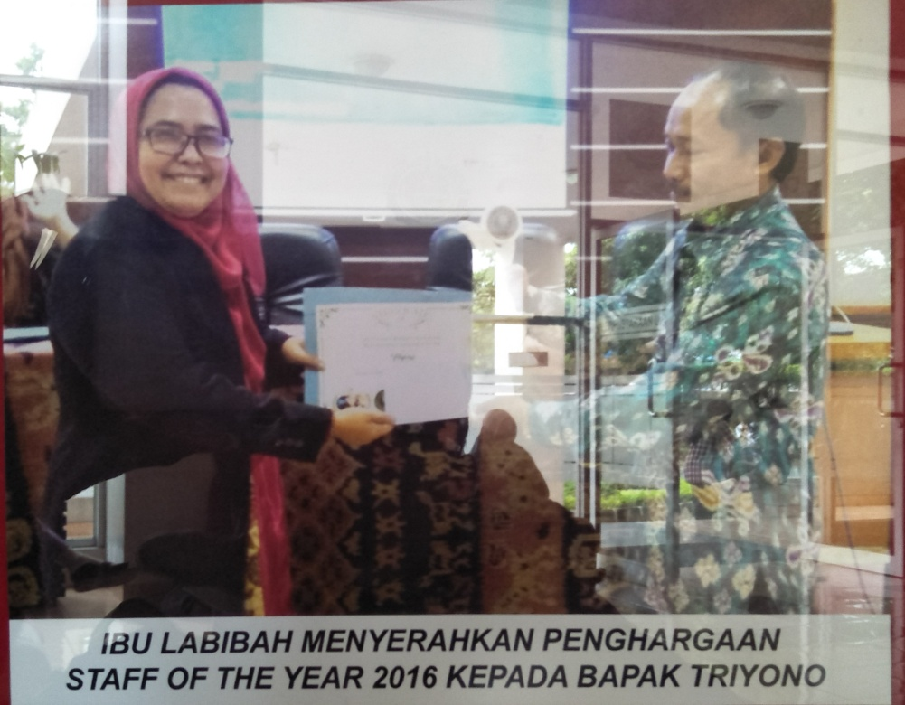
Continue...
Selection for best librarians
Pilgrimage at UMY and UII libraries
Certificate
Some number of financial support

Slide 14
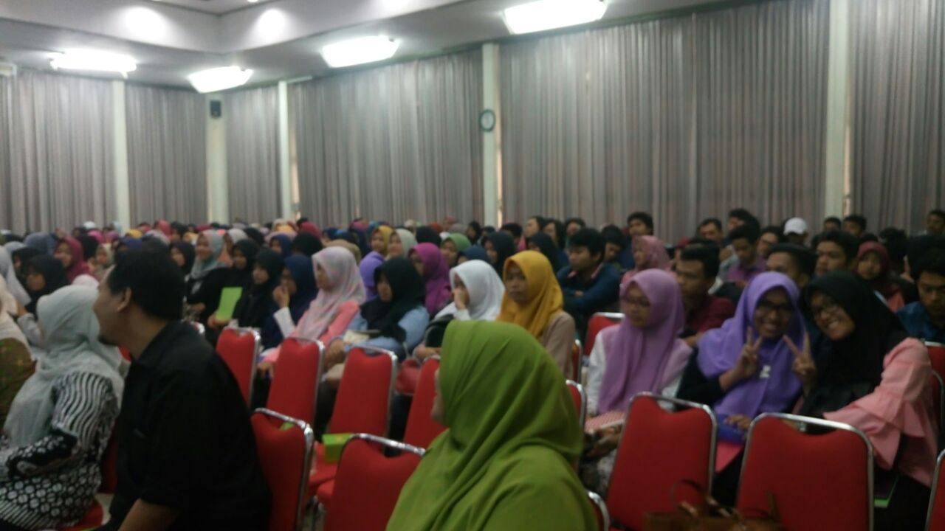
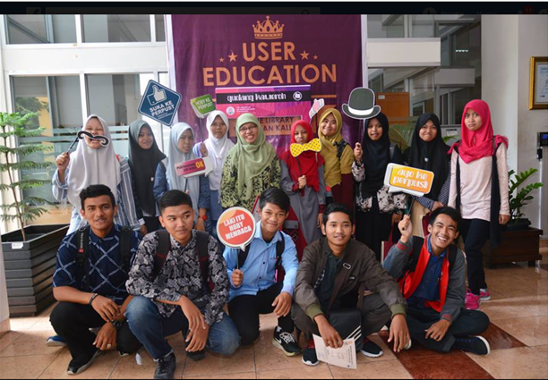
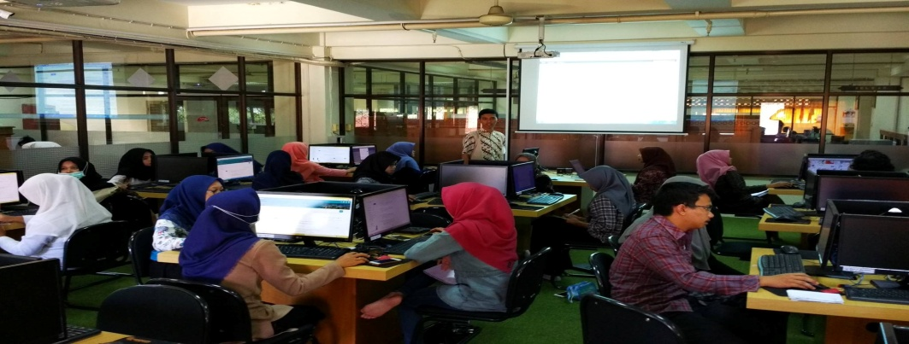
ACCESSIBILITY OF USERS
Regular program:
User education
Information literacy

Slide 15
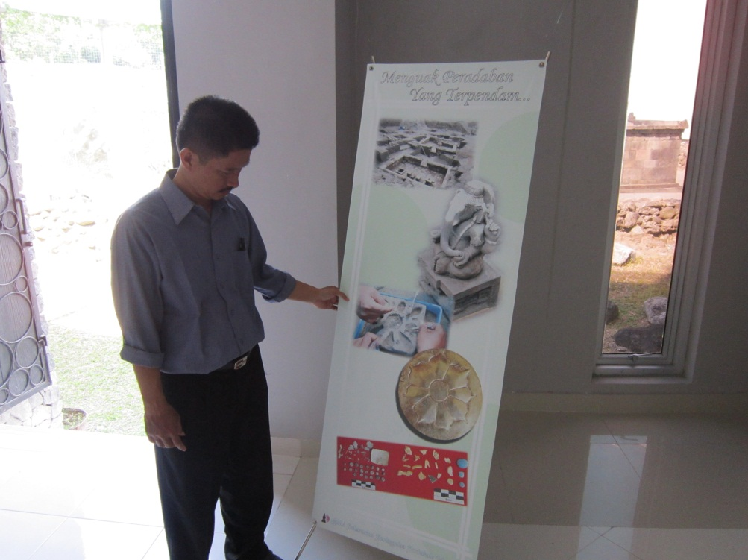
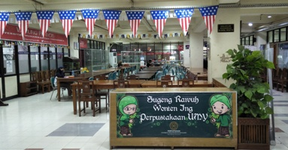
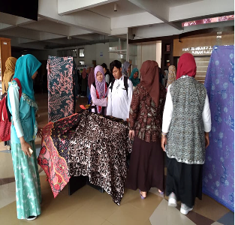
Irregular programs
UIN library with celebration of library visit day, santri day, and national batik day
UII and UMY libraries with exhibitions and correspondences

Slide 16
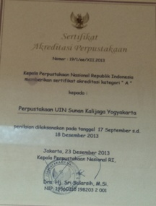
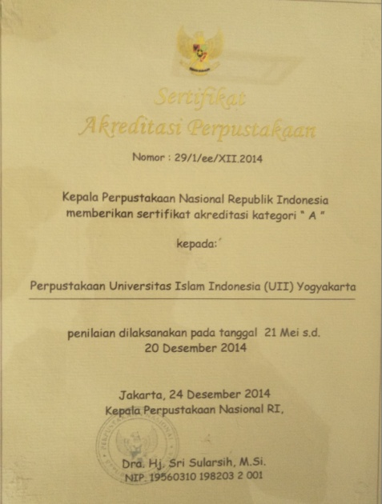
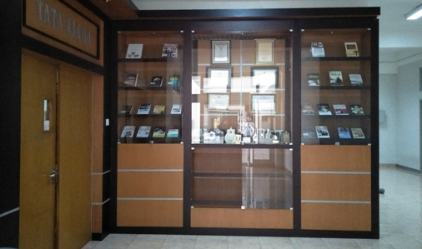
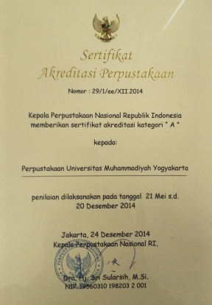
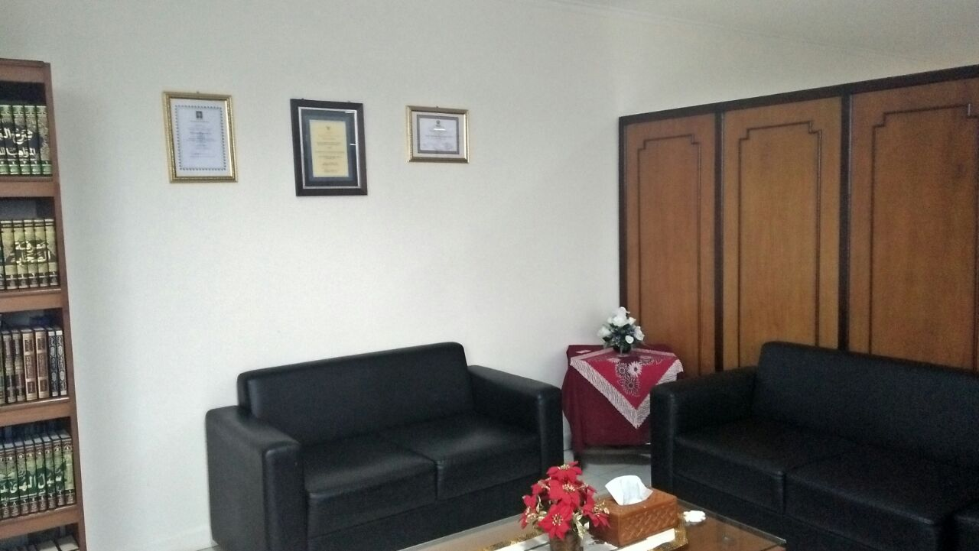
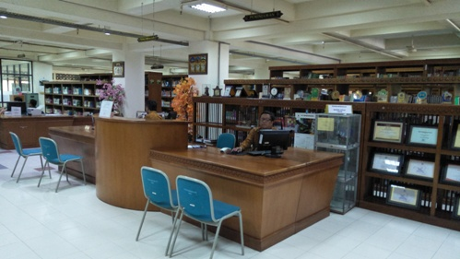
INSTITUTIONAL GOVERNANCE
Accreditation

Slide 17
ANALYSIS
The inclusive leadership, a pattern that involves subordinates equal to the involvement of the leaders through respect, recognition, responsiveness, and responsibility
It is an oppositional pattern of analysis between imaging politics and professional culture in building professional libraries

Slide 18
The basic points for the analysis, i.e.
1) Imaging as a mirror of reality
Librarians’ qualification, in titles or degrees, Diploma (A.Md.), Undergraduate (S.IP), Master (M.A.), and Doctor (Ph.D)
A strategy to show how libraries are managed by deserved and professional people
A symbol of communication
A build for public perception

Slide 19
2) Imaging as a map of reality
Image of titles describing the condition and nature of science and intellectuality as a power that the libraries possess
Accreditation in a map image telling a recognition for institution as highly performanced institutions
“A” level of Accreditation signifies that the three libraries have good institutional governance

Slide 20
3) Imaging as a simulacrum
Simulacrum issue seems to be controlled by professional culture
Professional culture influences corporate behaviour to build up a balancing element against imaging phenomena that may lead to the simulacrum

Slide 21
CONCLUSION
Imaging politics and professional culture have been interacted in the frame of inclusive leadership
The programs of the three libraries are found to have differences in the improvement of librarian qualifications, but the results of the improvement are used similarly as a mirror as well as a map of reality, and no simulacrum
The same happens in the user accessibility, where the three libraries have a big difference in designing their programs as mentioned in the discussion, such as correspondences, information literacy, exhibition, nasional santri day, national batik, etc.

Slide 22
It is found that institutional governance among the three libraries have the same points in which these libraries treat their accreditation level
For instance, they put or install the certificate of accreditation in the room where a lot of people can see as above
This point shows that the certificate is also used as imaging in terms of the mirror and the map that were provided at the libraries

Slide 23
THANKS YOU

