Slide 1

COMMUNICATING OUR VALUE AS HEALTH INFORMATION PROFESSIONALS: ARE WE WORTH IT?
Presented by
Nalini Mahajan
Medical Library, Director & Webmaster
Marianjoy Rehabilitation Hospital
Notes:
Speaker introduction Jan A
Class introduction Jan S

Slide 2

Trends
Healthcare industry and hospital libraries operating within it are going through tremendous changes. Soaring cost of U.S. health care, Downsizing, reorganization, and budget cuts have adversely affected the hospital libraries. Expansion of digital content, information technology, and Internet has impacted the way the libraries are perceived.

Slide 3
Trends
Downsizing, reorganization, and budget cuts
Expansion of digital information technology and Internet
Glass ceiling for librarians
Notes:
These are some of the biggest challenges that we face.
1.We do not generate any revenues except where we are providing fee based services.
We are considered as over head or come under Support services.
2. Libraries are closing and facing big budget cuts
3. Everyone thinks that all information is free on the Internet and very easily accessible
4. Still seen as stereo type, we are to be partially blamed for it. We are professional but do not act as professionals
Example: photocopying, why can’t we justify that we may be able to hire some one at a much lower salary to do the photocopying.
What are some of the challenges that you face at your institutions? Jan how about writing them down?

Slide 4
Challanges
Measuring the library’s value
Even though medical librarians continue to provide vital expertise in retrieving, evaluating, and disseminating critical information for improved patient outcomes, the greatest challenge lies in demonstrating the library’s value across the organization.

Slide 5
Some Solutions
In today’s competitive environment the information professionals must:
Understand the corporate culture
Seek new ways to increase their visibility
Explore new and innovative methods to become an important part of the management
Notes:
Here are some things that we can do.
1.Know the Organization’s vision & mission and rapidly changing corporate environment
Show correlation between the organization’s strategic planning and library’s business objectives
Reduce costs/Budget cuts
Find a solution and convey it to the management in a positive and concrete way
Translate your strategy into financial benefits Jan will expand on all this later
see the two articles searched through google and add in the notes field
Example journal subscriptions electronic access through the consortium reduces the cost
2.extend our influence beyond the traditional library walls
Become a member of the management team
If not possible, try to team with the core people
Innovative methods
Team with marketing, IT ( Web design, database design),

Slide 6
Some Solutions
Play a pivotal role in the organization's knowledge culture
Adopt a higher management profile
Gain clout and expand their influence
Notes:
We need to play a change agent role.
Look at the library’s position with a critical eye
How can it be repositioned to serve a broader corporate more proactively

Slide 7
Changing Roles…..
According to SLA, special librarians are “information source experts dedicated to putting knowledge to work”
Knowledge management
Information management
Value added services
Evaluation of company information software and sources prior to purchase
Internal data base development
Intranet and web site development
Competitive Intelligence
Notes:
Find the difference between the two

Slide 8
What is COMPETITIVE INTELLIGENCE?
Cutting edge information which allows an organization to stay ahead in Today’s global competition
Competitors: their strengths, weaknesses, market share, mergers & acquisitions, new products, and intellectual property

Slide 9
MORE SOLUTIONS
Return on Investment (ROI)
Notes:
I am Sure that all of you have heard the phrase Return on Investment many a times. What is it actually? Jan is going to talk about ROI

Slide 10
Return on Investment (ROI)
What is ROI?
Why is it important?
How can we estimate ROI for information services?

Slide 11
What is ROI?
Estimate of money we will make or save by investing in something
(Financial payback)

Slide 12
What is ROI?
Incurred costs + related expenses
Cost Reduction
or
Incurred costs + related expenses
Revenue Increase
%
%

Slide 13
Why is ROI important?
Set priorities
Quantify success
Assess outcomes
(“we’ve been so busy rolling things out, we have not had time or resources to sit down and evaluate what we have done”)

Slide 14
Why is ROI important?
Obtain project funding
Justify expenditures
Counter perceptions of “free” information
Eliminate speculation on value of investments in information resources
General accountability

Slide 15
ROI
What is the most important short-term benefit you might achieve by calculating ROI for information services in your organization?

Slide 16
How can we measure ROI for information services?
Determine business drivers
Determine appropriate metrics

Slide 17
Business Drivers
Patient care
Capitalizing on emerging technologies
Customer satisfaction
Cost reduction
Improved shareholder value

Slide 18
Business Drivers
Innovation
Employee retention
Safety
Quality

Slide 19
Business Drivers
PATIENT FIRST Provide information when & where needed At the Point of Care At the Point of Need

Slide 20
What is the principal cause of failure to achieve ROI?
Lack of focus on need of users in selection and deployment of resources or services.

Slide 21
No single ROI formula because:
No single metric captures the financial contribution of the work performed by information professionals in mission critical areas of the business.
Motivation for buying and using information resources varies from one organization to the next, and varies by departments and individuals

Slide 22
Because there is no single, simple ROI formula…
Information and knowledge professionals must construct the framework for meaningful ROI discussions based on their understanding of business objectives, value systems, and reward structures of an organization.

Slide 23
Metrics
Soft Metrics
Hard Metrics

Slide 24
How can we estimate ROI for information services?
Scenario 1:
Persons with access to desktop information resources report average savings of 2 hours/week due to having appropriate information when needed.

Slide 25
Assumptions (Scenario 1):
$70K average annual salary
3,000 persons subscribe to information service
Annual cost for subscription to this information resource is $350K

Slide 26
Calculation of Cost Savings (Scenario 1):
$70,000 ÷ 52 weeks ÷ 40 hours/week x 2 hours/week x 3,000

Slide 27
Estimated Savings/Value—Scenario 1
$201,920/week or almost $1,050,000/year minus $350,000 for subscription fee*
= $700,000
*Consider any other expenses as well, e.g. training, interface design, IT costs

Slide 28
ROI Estimates--Scenario 2
A health care company passes on an acquisition, for which discussions were already underway, based on facts uncovered in background/due diligence research.
The acquisition was valued at $260M, but the acquiring company withdrew from discussions because of red flags raised in publicly-available information resources.
Cost for the research was several hundred dollars; the impact to the company was huge!

Slide 29
What would be the most convincing metric to convey the value of the information center to your management?
+ Time saved
+ Cost reductions
+ Improved patient care
+ More informed decision making
+ Faster uptake of new technology
+ New business

Slide 30
Presentation of ROI data
Know frame of reference of person/group to whom you are presenting
Double check facts and numbers
Present conservative estimates for return
Be able to defend assumptions

Slide 31
Marianjoy: Case Study
Embedded Librarian Impact of online searching on patient Care
Presentations at medical conferences
Published in Medical journals
Partnerships with physicians, IS, Marketing & other dept.
Grant writing
Website development
Consumer Health Information initiatives

Slide 32
Marianjoy: Case Study
ILL for staff Justification

Slide 33
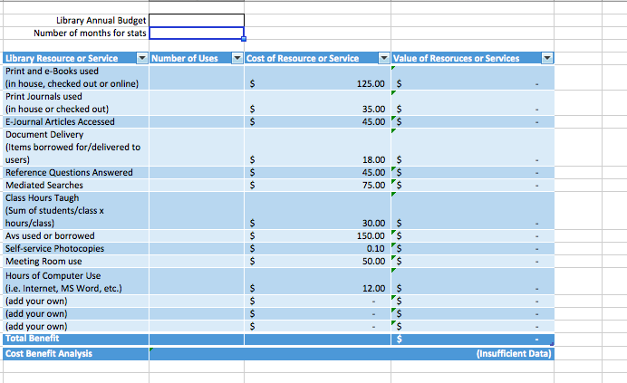
ROI Calculators

Slide 34


Slide 35
Questions???

