Slide 1


Education in Library and Information Science (LIS) Results of Case Studies for the Special Field of Informetrics
Bernd Markscheffel Technische Universität Ilmenau Faculty of Economics and Media Dept. of Business Informatics P.O. Box 100565, 98684 Ilmenau (Germany)
Yuan Sun,
Masaki Nishizawa,
National Institute of Informatics, 2-1-2 Hitotsubashi, Chiyoda-ku Tokyo 101-8430, Japan yuan@nii.ac.jp, nisizawa@nii.ac.jp

Slide 2


Structure of the Talk
I
Introduction
II
Education in Informetrics in Germany
III
Education in Informetrics in Japan
IV
Summary and Future Work
Notes:
In this paper I will give an overview of the situation in the field of education in Bibliometrics| Scientometrics| Informetrics in Germany.
After an short introduction, where the importance of this Information Science discipline is reflected, I will explore the educational situation in Germany in a double verified survey.
After a proposal of several approaches for teaching in Informetrics I will show an approach in an Information Retrieval context, which is based on an analysis of Alternative Search Engines

Slide 3
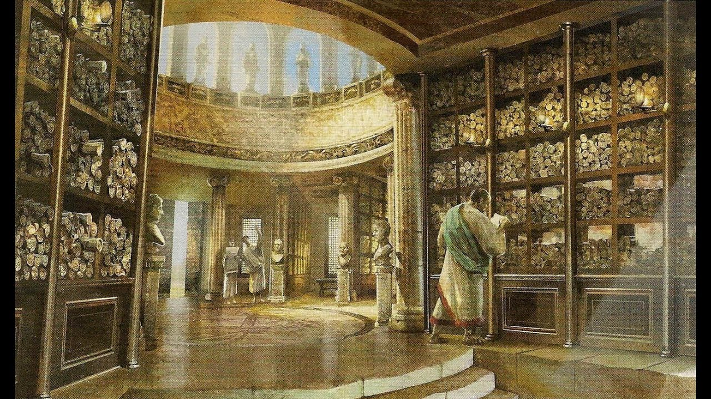
I Introduction
History of Librarians education = history of libraries
Library of Alexandria founded by the Greek scientist Ptolemy in 288 BC
had a collection of 400,000 scrolls in middle of the 3rd century BC
was considered the spiritual centre of the ancient world, where philosophers, scholars and scientists met and researched
Source: https://i.ytimg.com/vi/dgVyR3aeEl4/maxresdefault.jpg
Notes:
I Introduction
History of Librarians education = history of libraries
I will present only a few milestones in Library history to motivate the changing role of librarians
Ptolemy and son Demetrios founded the Alexandrian Museum and Library
Purpose was to collect the entirety of Greek literature
Zenodotus ca 325 BCE-260 BCE along with being a Greek grammarian and literary critic, was the first librarian at Alexandria as well as the first critical editor of Homer. In addition to other scholarly work,
Zenodotus is noted as having introduced an organization system on the materials in the Library of Alexandria.
In his system, texts were placed in different rooms based on their subject matter.
Then he organized the materials in each room alphabetically by the first letter of the last name of the author, so we have him to thank for our modern day system.
Also small tags were attached to each scroll with pertinent information in order for library users easy access to the desired documents. This is considered to be the first use of metadata and therefore a landmark in library history.
Following conquest of Greece, libraries were plundered by the Roman Empire
Romans considered possession of a library as a symbol of status, rank & personal pride
1st century AD - numerous private libraries i.e. Aristotle, Cicero, Lucullus & other aristocrats
Julius Caesar had major works in Greek & Latin, believing literature should be made public
Planned & began construction of a major library
Passed away before library was completed
Emperor Augustus, built two additional libraries

Slide 4

I Introduction
1st revolution: Printing machine by Johannes Gutenberg
Gutenberg Bible
Pre-Gutenberg: the acquisition and production of new books involved considerable costs (copying rate ~ 1 – 3 pages per day, or a book per year)
Gutenberg Printing Press technology made it possible to put over 500000 books into circulation before 1500
Source: http://uk.phaidon.com/resource/469-the-gutenberg-bible.jpg
Notes:
The Gutenberg Bible (better called Gutenberg-Fust Bible), the first large-scale production of the newly developed system of typographic printing, was completed in Mainz in 1455. Perhaps 180 copies were printed of this Latin Bible, available for purchase in either vellum copies (about a quarter of the edition run) or paper.
. The three-volume Gutenberg Bible was organized into two 42-line columns per page. In the later stages of production, six people worked simultaneously on composing the type. About 40 Gutenberg Bibles are still in existence, including perfect copies in the U.S. Library of Congress, the French Bibliothèque Nationale, and the British Library.
Printing press and moveable type invented by Johannes Gutenberg (c. 1398-1468) Re-useable, moveable type.
-Paper money became widespread
-Fed into the information revolution of the renaissance
-Increased literacy and provided cheaper texts
-Gutenberg printed the first bible
Printing sped up book production by 1000 -2000 x
Printing impacts
Standardized Bibles: Allowed challenge to church authority
Standardized language: Helped form nation-state
Amplified new information and ideas
Printing spurred the exploration of physical and mental horizons
News of Columbus’ voyages spread rapidly with printing in the 1490s, making him one of the first international heroes C
Christopher Columbus, Martin Luther become famous overnight
Printing amplified Martin Luther’s dissent in a way that had never happened before.
His 95 Theses, published in Germany in 1517, circulated across Europe in less than a month.
Astronomical observatory of Tycho Brahe (1546–1601) included a printing shop to help spread new scientific knowledge – and prevent repression by the church
Each purchaser received the sheets of an intrinsically two-volume work in what is called Royal folio format, with leaf dimensions of roughly 40-41 cm in height and 29 cm
in width: 324 leaves for the first volume, 319 for the second. Before they could be used, these Bible sheets had to be finished with hand rubrication supplying book, prologue
and psalm tituli, initial letters, chapter numbers, and headlines; and then had to be bound. If purchasers wanted to pay extra they could further commission illuminated initials and borders

Slide 5
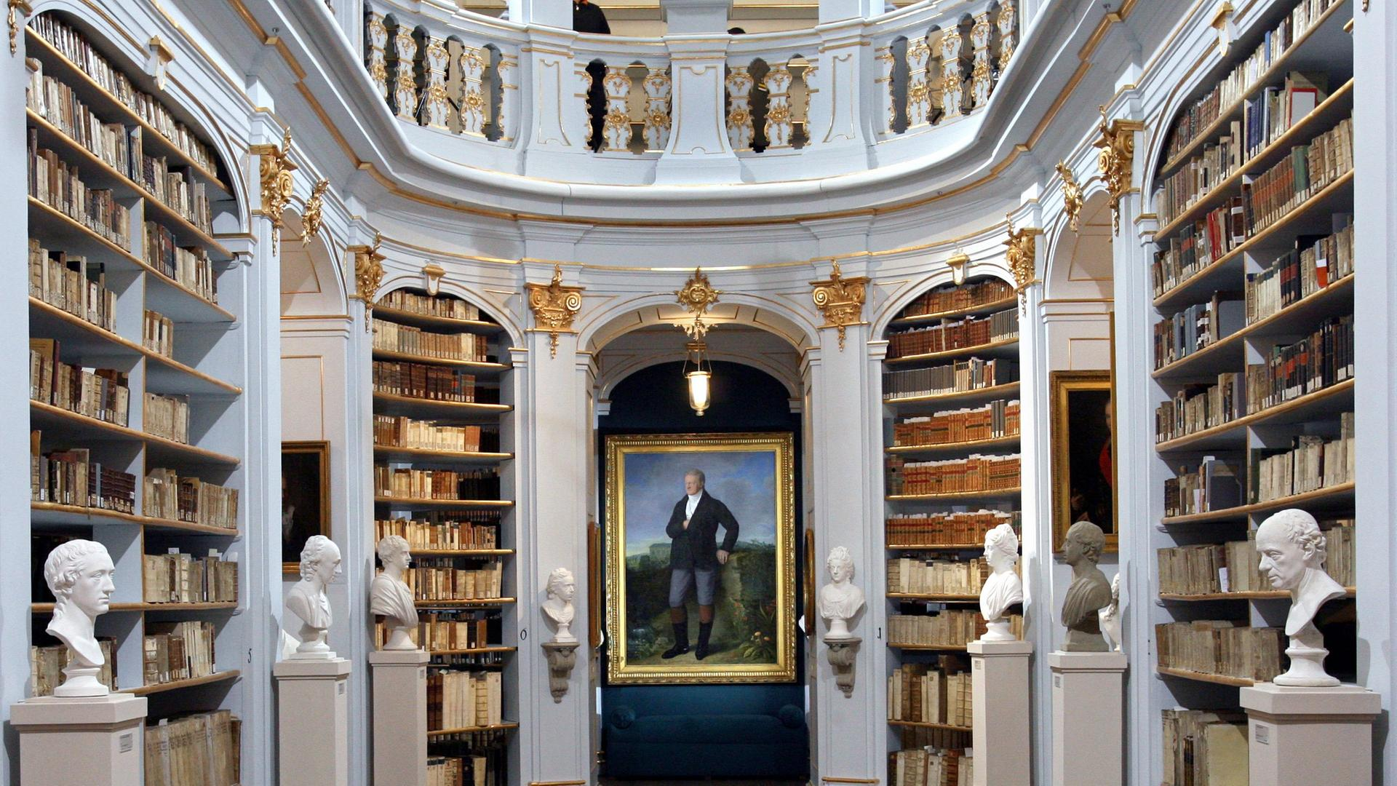
I Introduction
Romanesque, Baroque & Industrialization Era
Anna Amalia library in Weimar (Thuringia)
Libraries serve the global educational goal "the harmonious penetration of the person into moral and spiritual freedom"
Source: https://www.zdf.de/assets/170330-sonntag-mim-100~1920x1080?cb= 1490873430930
Notes:
Especially in the Romanesque and Baroque era a lot of magnificent libraries were built by princes and aristocratics and presented themselves as patrons of scientists, poets and artists.
So, Goethe managed the Anna Amalia library in Weimar, Lessing the Bibliotheca Augusta in Wolfenbüttel.
From 1800 onwards, the influence of the bourgeoisie increases, especially with regard to book production and the library sector.
In France, England and the USA the government initiates
the construction of national libraries in the 19th century.
In Germany the foundation of the National library was privately financed.
Since the end of the 19th century, the model of the American Public Library has been theoretically accepted in Germany.
Such a public library should have the following characteristics:
ideological neutrality, professional management and good financial resources,
favourable opening hours and accessibility for everyone,
a well-assorted range of books for adults and children that convey knowledge, but also entertain and distract.
National libraries had a special mission of preserving the cultural heritage by developing a comprehensive collection of materials by & about their respective countries through books, documents, manuscripts & other records
Librarians are

Slide 6

I Introduction
2nd Revolution: Cross-industry Breakthrough of the Internet
Internet Use in Leeds Library
Digitization, interlinking and connectivity have a lasting effect on how we access information.
Internet entails fundamental changes in the concept of document and the basic cultural techniques based on it, such as reading, writing, quoting and publishing.
Source: Ian Forsyth / Getty Images
Notes:
The second revolution in libraries was driven by the worldwide cross-industry breakthrough of the internet.
Digitization, interlinking and connectivity have a lasting effect on how we access information.
It entails fundamental changes in the concept of document and the basic cultural techniques based on it, such as reading, writing, quoting and publishing.
Information is no longer restricted to the form of a book or, to put it in more generally, a physically bounded linear document;
information is available digitally in many different media formats,
is ubiquitous available and is more and more personalized and context sensitive delivered.
This makes information easier, more convenient and cheaper to access. Although libraries have been tasked with hosting and making printed texts accessible for thousands of years, it is also the –
core task today to open up access to digital information
Libraries as preservers of knowledge & multipliers for reproducible science had to move beyond text: the had to deal with
Software , scientific films, research- simulation (big-) data, 3D-objects
Libraries provide access to digital media, support the publication of research data and enable their long term preservation.
New Skills:
Retrieval of scientific content
long-term preservation of scientific media
Provide DOI service for referencing digital objects
Support Research and development processes with Informetrics bibliometrics, webometrics analysis

Slide 7
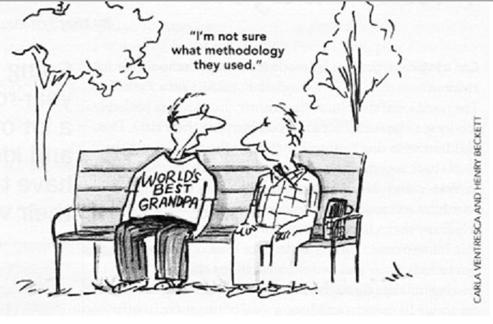
I Introduction
Education in LIS
Need for Specialists in Empirical Information Science
in measuring and assessing the performance or better the impact of research(ers) in various levels of granularity
importance of evaluating scientific research performance is well recognized and though, the growing interests on specialists in Informetrics is a proven fact
it is necessary to take a clear-eyed look at the educational foundations if it will fit the requirements of governmental institutions, universities or the broad range of other employers for Informetrics specialists
Notes:
Bibliometric analysis are becoming an increasingly important way in measuring and assessing the performance or better the impact of research(ers) in various levels of granularity, from
Macrolevel studies, which are concerning the research activities of a country or a region to
Mesolevel approaches of institutions like universities or research groups to
Microlevel analytics, where the scientific work of individuals is evaluated.
However, it has become an important, proven and accepted instrument for e.g.
demonstrating the impact of someone’s own research or
to support tenure track or grants decisions as well as for identifying areas of research strength and weaknesses
to make decisions for future research priorities for an institution.
Generally speaking, it has become an accepted instrument for the evaluation of research in a more objective way which helps decision-makers to build also long-term strategic plans, e.g.
which research directions should be built in future or
which ongoing research activities should be supported in accordance with the economic and political objectives of a region or a country.
A study (Hargens 1990) reported that approximately 35 percent of biochemistry departments and nearly 60 percent of sociology departments had used citation data for hiring, as well as for tenure, promotion, and salary.
As we can see, the importance of evaluating scientific research performance is well recognized and though, the growing interests on Informetrics skills for Librarians is a proven fact.
So it is necessary to take a clear-eyed look at the educational foundations if it will fit the requirements of governmental institutions, universities or the broad range of other employers for Informetrics specialists.

Slide 8
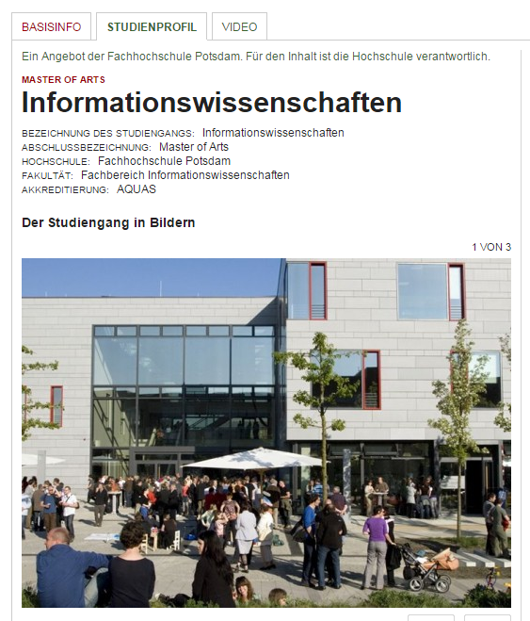
II Education in Informetrics
A Snapshot of the Situation in Germany
Mostly in context of LIS Education
Search for Studies in Information and
Library Science in Germany
One of the most up-to-date list:
http://studiengaenge.zeit.de/studiengang/w34756/informationswissenschaften
Notes:
Education in the field of Informetrics is often closely related to Information and/or Library Science Education
To get an idea of the Informetrics education we analysed the LIS courses in German (Applied) Universities. I used the latest course list from the weekly “Die ZEIT” to get an up-to-date reflection.

Slide 9
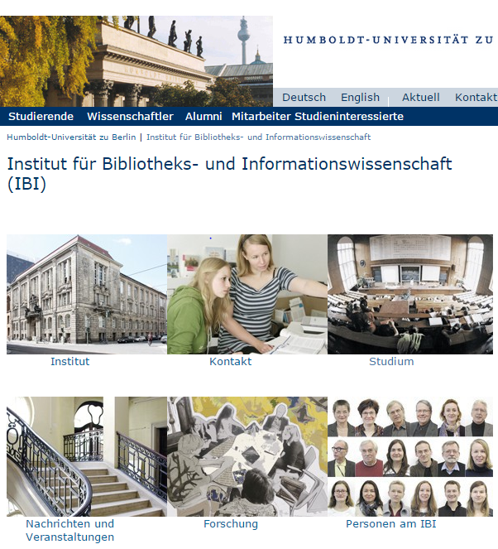
II Education in Informetrics
Results of the Survey
41 Bachelor and Master courses exists in Germany in the field of Library and Information Science (LIS)
Bachelor
Master
Notes:
I found in total a number of 41 courses in 20 institutions. Figure 1 shows the distribution according to the kind of institution and according to the type of course.

Slide 10
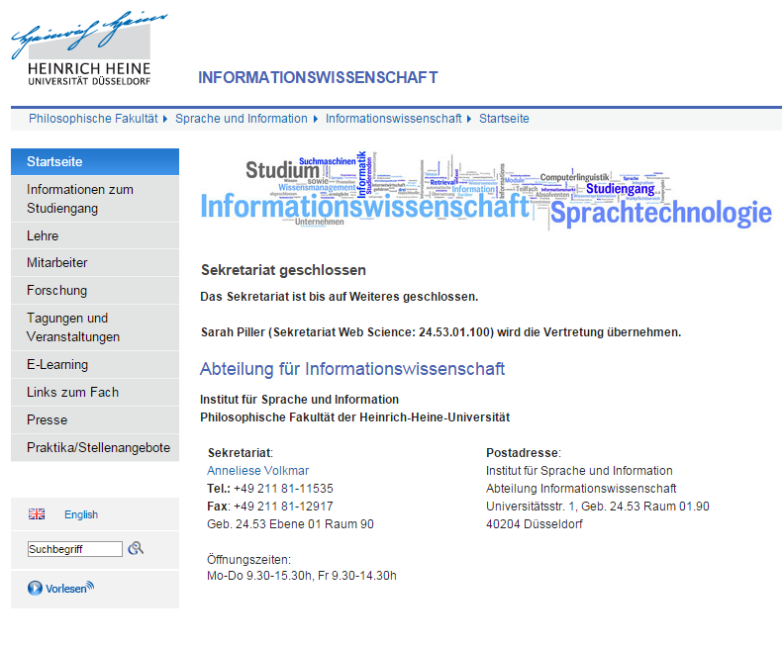
II Education in Informetrics
Results of the Survey
41 Bachelor and master courses exists in germany in the field of Library and Information Science (LIS) in 20 (Applied) Universities
Applied
Universities
Universities

Slide 11
II Education in Informetrics
 | University | Course | Duration
Informationswissenschaften | Fachhochschule Potsdam | Master | 3 Sem.
Informationswissenschaft | Hochschule Darmstadt | Bachelor | 6 Sem.
Informationswissenschaft | Heinrich-Heine-Universität Düsseldorf | Bachelor | 6 Sem.
Informationswissenschaft und Sprachtechnologie | Heinrich-Heine-Universität Düsseldorf | Bachelor | 6 Sem.
Bibliotheks- und Informationswissenschaft | Humboldt-Universität zu Berlin | Bachelor | 6 Sem.
Informationswissenschaft | Universität Regensburg | Bachelor | 6 Sem.
Angewandte Informationswissenschaft | Fachhochschule Köln | Bachelor | 6 Sem.
Bibliotheks- und Informationswissenschaft | Hochschule für Technik, Wirtschaft und Kultur Leipzig | Bachelor | 7 Sem.
Informationswissenschaft | Universität Regensburg | Master | 4 Sem.
Bibliotheks- und Informationswissenschaft | Humboldt-Universität zu Berlin | Master | 4 Sem.
Bibliotheks- und Informationswissenschaft | Hochschule für Technik, Wirtschaft und Kultur Leipzig | Master | 3 Sem.
Internationales Informationsmanagement - Informationswissenschaft | Universität Hildesheim | Master | 4 Sem.
Bibliotheks- und Informationswissenschaft | Fachhochschule Köln | Master | 4 Sem.
Bibliotheks- und Informationswissenschaft | Humboldt-Universität zu Berlin | Master | 4 Sem.
Informationswissenschaft und Sprachtechnologie | Heinrich-Heine-Universität Düsseldorf | Master | 4 Sem.
Bibliotheks- und Informationsmanagement | Hochschule der Medien Stuttgart | Bachelor | 7 Sem.
Bibliotheks- und Informationsmanagement | Hochschule für Angewandte Wissenschaften Hamburg | Bachelor | 6 Sem.
Information und Kommunikation | Fachhochschule Münster | Master | 4 Sem.
Innovations- und Informationsmanagement | Hochschule Bonn-Rhein-Sieg, University of Applied Sciences | Master | 4 Sem.
Information Engineering | Universität Konstanz | Bachelor | 6 Sem.
Informationsmanagement und Informationstechnologie | Universität Hildesheim | Bachelor | 6 Sem.
Publizistik- und Kommunikationswissenschaft | Freie Universität Berlin | Bachelor | 6 Sem.
Informationsmanagement, internationales | Universität Hildesheim | Bachelor | 6 Sem.
Informationsverarbeitung | Universität zu Köln | Bachelor | 6 Sem.
Archiv | Fachhochschule Potsdam | Bachelor | 7 Sem.
Bibliotheksmanagement | Fachhochschule Potsdam | Bachelor | 7 Sem.
Medizinisches Informationsmanagement | Hochschule Hannover | Bachelor | 7 Sem.
Informationsmanagement | Hochschule Hannover | Bachelor | 7 Sem.
Technische Redaktion | Hochschule Hannover | Bachelor | 7 Sem.
Kommunikation und Medienmanagement | Hochschule Karlsruhe - Technik und Wirtschaft | Bachelor | 7 Sem.
Bibliothekswissenschaft | Fachhochschule Köln | Bachelor | 7 Sem.
Information und Dokumentation | Fachhochschule Potsdam | Bachelor | 7 Sem.
Informationsverarbeitung | Universität zu Köln | Master | 4 Sem.
Strategisches Informationsmanagement | Frankfurt University of Applied Sciences | Master | 4 Sem.
Archivwissenschaft | Fachhochschule Potsdam | Master | 6 Sem.
Digital Curation | Humboldt-Universität zu Berlin | Master | 4 Sem.
Technische Kommunikation | Universität Rostock | Master | 5 Sem.
Medizinisches Informationsmanagement | Hochschule Hannover | Master | 3 Sem.
Information Management | Hochschule Kaiserslautern (University of Applied Sciences) | Master | 3 Sem.
Electrical Engineering and Information Technologies | Karlsruher Institut für Technologie | Master | 4 Sem.

Slide 12
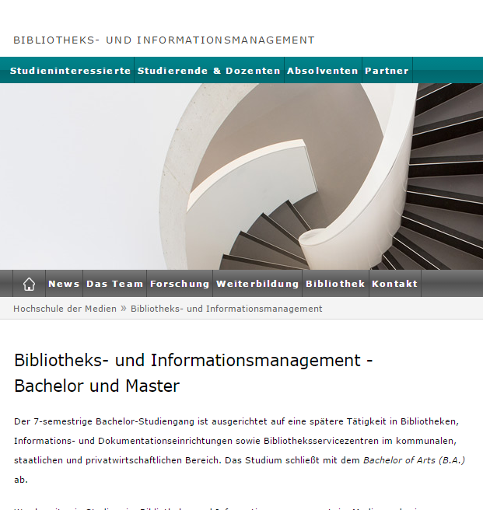
II Education in Informetrics
Methodology
Analysis of the Courses
2 Step analysis:
Google search on the university-website
„Informetrie Informetrics, Scientometrics Zitationsanalyse, Bibliometrics Bibliometrie site:www.uni-XXX.de“
If there are results, then I had a closer look into search engines result set, and analysed the course description and | or the detailed curriculum
Notes:
I have queried the websites of the institutions with the following Google query: Informetrie, Informetrics, Scientometrics, Zitationsanalyse, Bibliometrics, Bibliometrie site:www.uni-???.de. If there are results, then I took a closer look onto the search engines result set, and analysed the course descriptions and the detailed curriculum in more depth.

Slide 13
II Education in Informetrics
 | University | Course | Duration
Informationswissenschaften | Fachhochschule Potsdam | Master | 3 Sem.
Informationswissenschaft | Hochschule Darmstadt | Bachelor | 6 Sem.
Informationswissenschaft | Heinrich-Heine-Universität Düsseldorf | Bachelor | 6 Sem.
Informationswissenschaft und Sprachtechnologie | Heinrich-Heine-Universität Düsseldorf | Bachelor | 6 Sem.
Bibliotheks- und Informationswissenschaft | Humboldt-Universität zu Berlin | Bachelor | 6 Sem.
Informationswissenschaft | Universität Regensburg | Bachelor | 6 Sem.
Angewandte Informationswissenschaft | Fachhochschule Köln | Bachelor | 6 Sem.
Bibliotheks- und Informationswissenschaft | Hochschule für Technik, Wirtschaft und Kultur Leipzig | Bachelor | 7 Sem.
Informationswissenschaft | Universität Regensburg | Master | 4 Sem.
Bibliotheks- und Informationswissenschaft | Humboldt-Universität zu Berlin | Master | 4 Sem.
Bibliotheks- und Informationswissenschaft | Hochschule für Technik, Wirtschaft und Kultur Leipzig | Master | 3 Sem.
Internationales Informationsmanagement - Informationswissenschaft | Universität Hildesheim | Master | 4 Sem.
Bibliotheks- und Informationswissenschaft | Fachhochschule Köln | Master | 4 Sem.
Bibliotheks- und Informationswissenschaft | Humboldt-Universität zu Berlin | Master | 4 Sem.
Informationswissenschaft und Sprachtechnologie | Heinrich-Heine-Universität Düsseldorf | Master | 4 Sem.
Bibliotheks- und Informationsmanagement | Hochschule der Medien Stuttgart | Bachelor | 7 Sem.
Bibliotheks- und Informationsmanagement | Hochschule für Angewandte Wissenschaften Hamburg | Bachelor | 6 Sem.
Information und Kommunikation | Fachhochschule Münster | Master | 4 Sem.
Innovations- und Informationsmanagement | Hochschule Bonn-Rhein-Sieg, University of Applied Sciences | Master | 4 Sem.
Information Engineering | Universität Konstanz | Bachelor | 6 Sem.
Informationsmanagement und Informationstechnologie | Universität Hildesheim | Bachelor | 6 Sem.
Publizistik- und Kommunikationswissenschaft | Freie Universität Berlin | Bachelor | 6 Sem.
Informationsmanagement, internationales | Universität Hildesheim | Bachelor | 6 Sem.
Informationsverarbeitung | Universität zu Köln | Bachelor | 6 Sem.
Archiv | Fachhochschule Potsdam | Bachelor | 7 Sem.
Bibliotheksmanagement | Fachhochschule Potsdam | Bachelor | 7 Sem.
Medizinisches Informationsmanagement | Hochschule Hannover | Bachelor | 7 Sem.
Informationsmanagement | Hochschule Hannover | Bachelor | 7 Sem.
Technische Redaktion | Hochschule Hannover | Bachelor | 7 Sem.
Kommunikation und Medienmanagement | Hochschule Karlsruhe - Technik und Wirtschaft | Bachelor | 7 Sem.
Bibliothekswissenschaft | Fachhochschule Köln | Bachelor | 7 Sem.
Information und Dokumentation | Fachhochschule Potsdam | Bachelor | 7 Sem.
Informationsverarbeitung | Universität zu Köln | Master | 4 Sem.
Strategisches Informationsmanagement | Frankfurt University of Applied Sciences | Master | 4 Sem.
Archivwissenschaft | Fachhochschule Potsdam | Master | 6 Sem.
Digital Curation | Humboldt-Universität zu Berlin | Master | 4 Sem.
Technische Kommunikation | Universität Rostock | Master | 5 Sem.
Medizinisches Informationsmanagement | Hochschule Hannover | Master | 3 Sem.
Information Management | Hochschule Kaiserslautern (University of Applied Sciences) | Master | 3 Sem.
Electrical Engineering and Information Technologies | Karlsruher Institut für Technologie | Master | 4 Sem.
Notes:
Humboldt Uni and University Düsseldorf are the only on universities which are offering a special module or course in Bibliometrics
All other Information or Librarie Science Course
did not touch Bibliometrics
In Stuttgart there was a special Seminar some years ago which deals with Bibliometrics and

Slide 14
II Education in Informetrics
Verification
Starting point
WoS Analysis for the search query: TOPIC: (bibliometrics or webometrics or informetrics) OR TITLE: (bibliometrics or webometrics or informetrics)
Refined for Country= Germany
Time range 2000 – 2015
Notes:
These results where further verified with a Bibliometrics study. I used Web of Science as data source and searched the core collection for the search query:
Query 1: TOPIC: (bibliometrics or webometrics or informetrics) OR TITLE: (bibliometrics or webometrics or informetrics)

Slide 15
II Education in Informetrics
Verification
Verification of the results
Result: 21 different institutions where found
Some institutions with no impact for students education are
Max Planck Society
GESIS
COLLNET
Result: No additional courses were found!
Notes:
analysed the enhanced organisations.
In total 21 different organisation where found.
Among these were several institutions with no or small impact to university education (e.g. Max Planck society, COLLNET centre etc.)
The papers of the refined German results were analysed according to its institution.
I found for example that the papers from Leipzig University were published by a database group or a by a research group in the field of psychology, at University of Freiburg the bibliometrics papers were published by a political science seminar, at University Trier also from a medicine research group – hence from a research group with no direct impact in education. This insight was obtained for each other of the German institutions reflected in this survey.
So, finally only the above mentioned two universities were identified as cornerstones of Informetrics education.

Slide 16
II Education in Informetrics Explore other Sources
3rd step: Ask Google!
if there are educational opportunities beside the LIS-education institutions
The approach combines a literature research
with a Google query: bibliometrics, bibliometrie, scientometrics, scientometrie, ausbildung, modul, kurs, lehre
with a subject oriented search. The subjects are
researchers,
scientists and
other academics which are mentioned in the previously found paper subset.
Result: 3 more courses were identified

Slide 17



II Education in Informetrics Results of the Survey
The module “Aufbaumodul Informetrie” at University Düsseldorf is a special module in the course “Informationswissenschaft und Sprachtechnologie” with a duration of two semester and a total of 13 ECTS points at Bachelor level. It covers basics of Scientometrics, Patentometrics, success factors and analysis of information systems and user research as well as practical work like empirical analysis, evaluation- and usability studies.
The course “Bibliotheks- und Informationswissenschaften” at Humboldt University Berlin contains a special seminar “Bibliometrie, Informetrie, Scientometrie”. This seminar includes bibliometric studies and network analysis.
The Master course History, Economics and Philosophy of Science at University Bielefeld consists of a module which is entitled:”Ökonomie der Wissenschaft” (economy of science). One of the offered courses is “Bibliometriewerkstatt” (bibliometrics lab). Participants in the bibliometrics lab will be envolved in practical exercises with major databASE and gain experience with bibliometric methods, instruments and indicators.

Slide 18


II Education in Informetrics Results of the Survey
The Master course “Wirtschaftsinformatik” (Business Information Systems Engineering) at University Kiel consist of a module ”Grundlagen und Umwelt” (Basics and Environment). One special seminar is the “Bibliometrics and Altmetrics” course. The content covers the basics of science communication and –evaluation and bibliometrics as well as Informetrics 2.0, altmetrics and interconnections between bibliomtrics and social bookmarking services or Twitter.
At University Ulm students from five different master courses (e.g. Economics…) can choose a special module “Technology and Innovation Management – Technology Foresight”. Main aim of this module is to provide basics in technology foresight. This will be done with the help and support of a bibliometric analysis with a special toolset BibTechMon. Therefore it can be ranged in the category informetrics education.

Slide 19
II Education in Informetrics Summary of the results
University | Course | Module | Seminar | ECTS | Bac | Master | Duration | Form of academic instruction
University Düsseldorf | Informationswissenschaft und Sprachtechnologie | Informationswissen-schaft und Sprachtechnologie | 13-14 | Bac | 2 semester | Lecture, Seminar Tutorial
Humboldt University Berlin | Bibliotheks- und Informations-wissenschaften | Bibliometrie, Informetrie, Scientometrie | 10 | Master | 1 semester | Seminar
University Bielefeld | Ökonomie der Wissenschaft | Bibliometriewerkstatt | 12 | Master | 1 semester | Tutorial
University Kiel | Wirtschaftsinformatik | Bibliometrics and Altmetrics | 6 | Master | 1 semester | Seminar, Tutorial
University Ulm | Economics Economy of Physics Economy of Chemistry | Technology and Innovation Management – Technology Foresight | 7 | Master | 1 semester | Tutorial

Slide 20
III Informetrics Education: A Case Study of Japan Data
Web of Science
to identify universities, faculties, professors who understake informetrics-related research.
Universities’ syllabus websites
Japanese College and University Portraits (also called Daigaku Portraits)
a database of basic educational information on all Japanese universities, was used to identify informetrics-related undergraduate and graduate faculties and the content of their course offerings.
Notes:
The Web of Science database was used to identify universities, faculties, professors, or courses that offer informetrics-related educational content.
For educational data, the Japanese College and University Portraits (also called Daigaku Portraits), a database of basic information on Japanese universities, was used to identify informetrics-related undergraduate and graduate faculties and the content of their course offerings.
Data on national, public, and private universities in Japan was formally released on the website in 2015. For detailed information on specific courses, each university’s syllabus website was used.

Slide 21
III Informetrics Education: A Case Study of Japan Methods
Search on Web of Science
To compare with Germany, search query used is as follows
keyword = “bibliometric,” “scientometric,” “informetrics,” or “webometric” in the Topic field,
AND country = “Japan,”
And data source = core collection of “SCI,” “SSCI,” two conferences,
And year = 2000 to 2017.
This method involves much less work, but it omits those universities that do not publish papers.
Notes:
We sought to find bibliometric researchers and their institutional affiliations based on publications and then investigate whether these researchers have offered informetrics courses and whether there are any curricula concerning informetrics at their universities.
The Web of Science was the data source.
For the comparison with Germany, we used the following search query: keyword = “bibliometric,” “scientometric,” “informetrics,” or “webometric” in the Topic field, AND country = “Japan,” data source = core collection of “SCI,” “SSCI,” and two conferences, year = 2000 to 2017.
This method involves much less work , but it omits those universities that do not publish papers.

Slide 22
III Informetrics Education: A Case Study of Japan Methods
Search universities’ syllabus websites
find syllabi by particular informetrics researchers
Review the syllabi related to informetrics education to specify relevant Japanese keywords for further searches:
“ビブリオメトリックス (bibliometrics) or 計量書誌学 (bibliometrics) or 科学計量学 (scientometrics)”
Google search the university websites for relevant courses using the Japanese keywords
“シラバス (syllabus)” AND “ビブリオメトリックス (bibliometrics) or 計量書誌学 (bibliometrics) or 科学計量学 (scientometrics)”
Search the Digaku Portraits to collect database by using keywords possibly relevant to informetrics.
In Japan, there are more than 700 universities, including 85 national universities.
Unfortunately, there are no portals that allow for national searches of syllabi or courses.

Slide 23
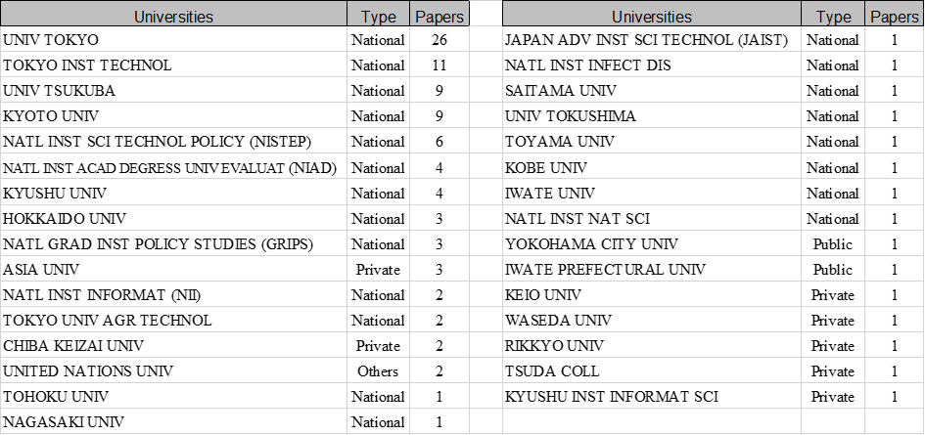
III Informetrics Education: A Case Study of Japan Results
The search of the Web of Science revealed 90 Japanese publications in the informetrics area during the period of 2000–2017. Based on these publications, 37 Japanese organizations, including 31 Japanese universities and national institutes, were identified.
Notes:
31 Japanese universities and number of their
However, most of these universities do not appear to offer informetrics courses.
Moreover, most of the authors of informetrics-related papers do not seem to have had regular informetrics education.
For example, one of the most productive authors in the field of informetrics in Japan is Yuya Kajikawa, who is affiliated with the Tokyo Institute of Technology, ranked second in Table 1 (Kajikawa, 2017). He holds a Ph.D. in Chemical System Engineering from the University of Tokyo.

Slide 24
III Informetrics Education: A Case Study of Japan Results
By keyword search
the programs identified can be roughly classified into two categories related to
(1) LIS
the Univ. of Tsukuba, NII …
(2) science policy and innovation
Tokyo Institute of Technology, National Graduate Institute for Policy Studies (GRIPS), Japan Advanced Institute of Science and Technology (JAIST), and Kyushu Univ …
Few universities provide courses for undergraduate students, except the Univ of Tsukuba.
Lots of universities offer the courses differently in irregular ways.
ask informetrics researchers to provide related courses for temporal periods when needed: Univ of Tokyo, Chiba Univ…
special seminars offered at business schools or for university research administrators (URAs): Hitotsubashi Univ, Kyoto Univ…
as part of courses in omnibus form
Univ. of Tokyo…

Slide 25
III Informetrics Education: A Case Study of Japan Summary of the results
University | Course | Module | Seminar | Number of Credits | Duration | Keywords
University of Tsukuba | Library Information and Media Studies (iSchool) (Graduate) | Informetrics | 2 | Semester | Bibliometrics, Citation Analysis, Network Analysis, Indicators, Statistical Analysis, Applications
National Institute of Informatics (NII | Information Environment Science (Graduate) | Bibliometrics | 2 | Semester | Bibliometrics, Indicators, Statistical Analysis
Tokyo Institute of Technology | Social and Human Sciences (Graduate) | Graduate Lecture in Science, Technology, and Society S1B | 1 | Quater | Scientometrics, Quantitative Research, Text Analysis
The National Graduate Institute for Policy Studies (GRIPS) | Science, Technology, and Innovation Policy (Graduate) | Bibliometrics and Its Applications | 1 | Semester | Technology Foresight, Scientometrics, S&T Policy
Japan Advanced Institute of Science and Technology (JAIST) | Management of Technology (MOT) (Graduate) | Scientometrics | 1 | Semester | Bibliometrics, Indicators, Statistical Analysis
Kyushu University | Center for Science, Technology, and Innovation Policy Studies (CSTIPS) (Graduate) | Special Skill Development Courses: Quantitative Analysis for S&T Innovation Policy | 2 | Semester (Omnibus form) | Quantitative Analysis, S&T Innovation Policy, Patent Data, Publication Data, Bibliometrics, Survey
University of Tokyo | Education (Graduate) | Topics in Higher Education Policy and Management (1) | 2 | Semester (Omnibus form) | Research Evaluation, Bibliometrics, Economic & Social Effect Measurement

Slide 26
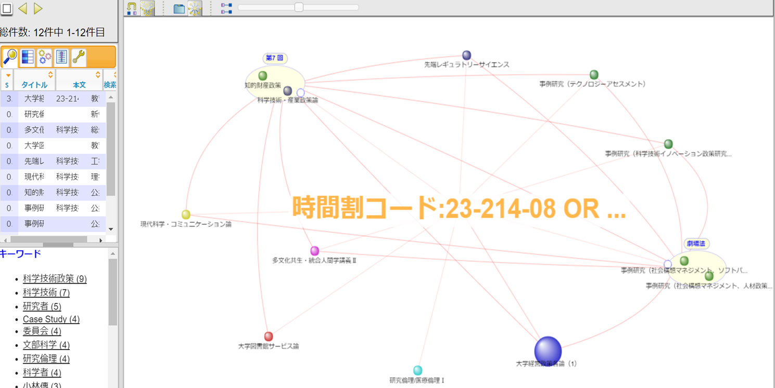
III Informetrics Education: A Case Study of Japan Keywords, courses related to informetrics Example from online course catalog of Univ. of Tokyo Keyword = “書誌計量学”(Bibliometrics)
Modern regulatory science
IP policy
S&T policy
Case study (Technology assessment)
Case study (S&T innovation policy)
Modern science & Communication
Multicultural Information and Assistance
Case study (Social design management, HR policy)
Univ library service
Research/medical ethics
Univ management policy (1)

Slide 27
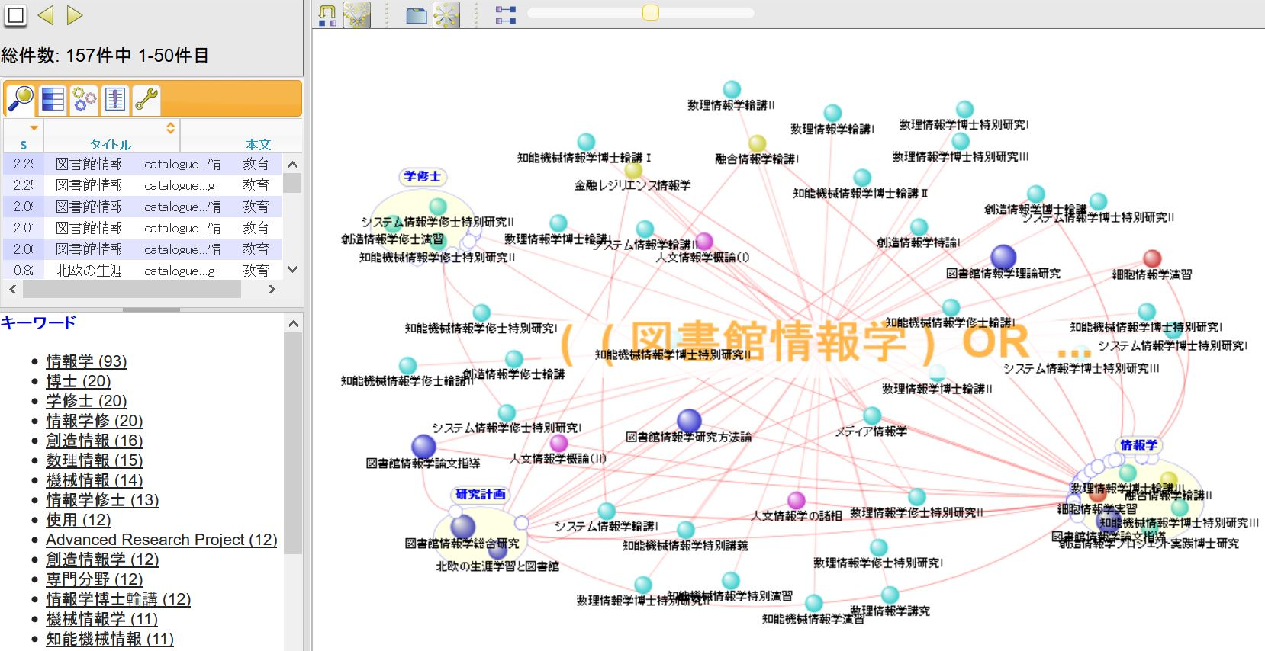
III Informetrics Education: A Case Study of Japan Keywords, courses related to informetrics Example from online course catalog of Univ. of Tokyo Keyword = “図書館情報学” (Library and Information Science)

Slide 28
III Informetrics Education: A Case Study of Japan Keywords, courses related to informetrics Example from online course catalog of Univ. of Tokyo Keyword = “図書館情報学” (Library and Information Science)
Information Science
(Master courses)
Mathematical Information Science
(PhD courses)
Information Science
(PhD courses)
Intergrated Information Science
Career learning
& Library
Finance resilience
Humanities Information Science
Library & Information Science

Slide 29
III Informetrics Education Comparison
The most obvious difference is the number of credits given as an equivalent for the workload and, therefore, for the importance within a course or study.
One Japanese credit is given for a workload of 45 h (one German credit is given for only 30 h, so one Japanese credit is comparable to 1.5 or 2 ECTS points).
The number of credits given for an informetrics seminar or lecture is significantly higher in the German educational system than in the Japanese one.
For example, the undergraduate course “Aufbaumodul I3: Informetrie” provides around 8% of the credits needed to complete LIS study at University Düsseldorf.
More detailed issues must be clarified for a comparison of the course content in the two countries. This will require a detailed analysis of the syllabi of selected courses.

Slide 30
III Informetrics Education Some Issues
How to define “informetrics education”
In this study, we use the keywords of “bibliometrics” or “scientometrics” or “informetrics” to identify the related courses, but how about the following situations?
Only part of the contents in the courses are bibliometrics related
Courses deal with other topics such as computation algorithms, or big data, with bibliometric data as structured network datasets to analyze
Also, how about those cases which can’t be identified by keywords search.
courses dealing typical bibliometric issues, such as patents, network analysis, but don’t have “bibliometrics” keywords appearing in syllabi.
How to design an effect and exhaustive course offering is one of the key issues for further investigation.
It is important to define “informetrics” as a subject and to find adequate keywords for relevant course searching in Japanese.
Examining informetrics-related courses is needed.
Keyword analysis can be a way to find the relationships and networks among different courses.

Slide 31
IV Summary Summary
The regular curriculum for informetrics education in Japan is very limited.
Only some courses provided by a few universities,
Most of them are taught depending on whether the universities have informetrics professors or have graduate students who demand the courses.
Moreover, most of the courses are taught by adjunct instructors or part-time professors.
Very few regular courses for undergraduate informetrics education
Although many universities are becoming increasingly concerned with research evaluation and bibliometric analyses, most of the analysis and evaluation work are done by URAs in institutional research offices, whose backgrounds are not related to informetrics.
To carry out research evaluation properly, researchers need more education and training courses on informetrics.
Improve the approaches to make more effective and exhaustive investigation.
Need to analyze informetrics and its related subjects to give a clearer definition for further research and consideration. Not only for status understanding, but also for reconsidering why and how to create informetrics curriculum
Notes:
for university research administrators (URAs):

Slide 32
IV Summary Future Work and Outlook
Carry out cross-national research!
Next team has started in Taiwan
Malaysia and Iran are in preparation
Further example that describes the changing challenges facing librarians education can be Data Science (as the “…multidisciplinary blend of data inference, algorithm development, and technology in order to solve analytically complex problems “) Frank Lo. “What is Data Science? What is analytics? What is a data scientist?”
In the The Federal Big Data Research and Development Strategic Plan the Big Data Senior Steering Group emphasizes librarians as one of the core specialists in data science to the successful management and analyses of digital data collections.
Education challenge will be to improve the skills in Data analysis, visualization competence, statistics and hacking skills

Slide 33

Thank you
for your
attention!
Questions?
Dr.-Ing. Bernd Markscheffel Chair of Information and Knowledge Management
Institute of Information Systems
Faculty of Business Economics
Technische Universität Ilmenau
POBox 100565
98684 Ilmenau
Bernd.Markscheffel@tu-ilmenau.de

