Slide 1
Digitization sharing in the Canton of Jura, Switzerland
ICRL 2018
Jaipur, 2 February 2018 – Jean-Marc Comment

Slide 2
Program
Introduction
Pilot project of the State Library
Pilot project of the State Archives
Project Metrikos
Comments and recommendations

Slide 3
Introduction
The Canton of Jura is a small state in the North-West of Switzerland.
The state has 72’000 inhabitants.
The Cultural Office of Jura decided in 2014 to build a digitization strategy for all patrimonial belongings of the Canton of Jura.
A digitization program called SIGMA was started with the State Library and the State Archives.

Slide 4
Introduction
The strategy was built in about six months and was accepted by the Ministry in December 2014.
The Ministry decided to prioritize access over preservation.
We run two pilot projects in 2015 to check the feasibility and to define a metric (resources, timeframe).
We are now implementing this digitization program for the next years in accordance with the strategy.
The first project is called Metrikos with the old maps of the municipalities in the State Archives.

Slide 5
Pilot project of the State Library
50’000 pages of paper documents.
Archive belongs to a scientific society.
Digitize in TIFF format with 300 dpi and 8 bits.
Search by volume, register, article.
Full-text search so we do Optical Character Recognition.
Online on the platform E-Periodica at the ETH-Library.
Use of Digital Object Identifier.

Slide 6
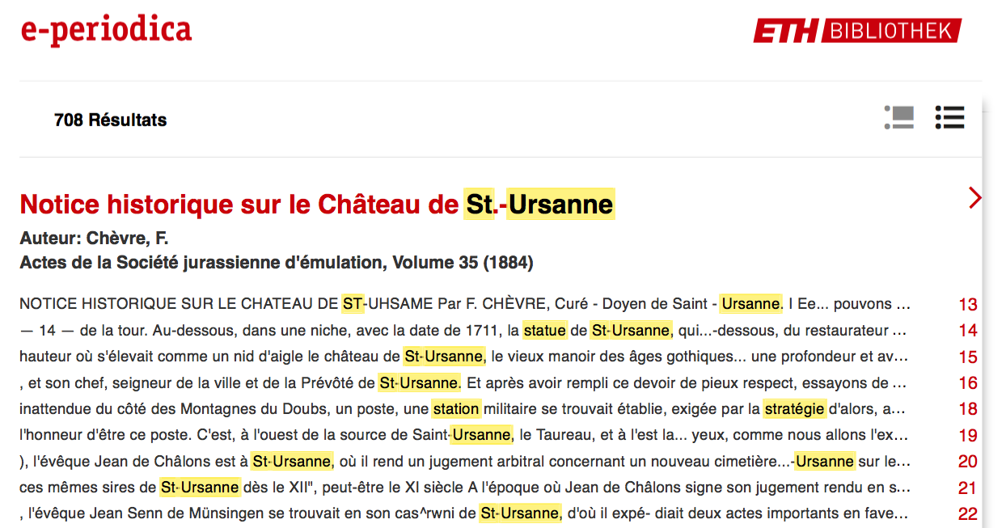
Pilot project of the State Library

Slide 7
Pilot project of the State Archive
3095 photographs on glass plate of Eugène Cattin.
Postman who lived in Les Bois between 1866 and 1947.
Photographs of houses, landscape, people and activities.
Paper copies done between 1987 and 2002.
Exhibition in 2001 in Les Bois with 263 photographs.
400 persons have visited the exhibition.
Digitize in TIFF format with 1200 dpi.
Online on the collaborative platform Wikimedia commons.
Propriety rights Creative Commons CC-BY-SA.

Slide 8
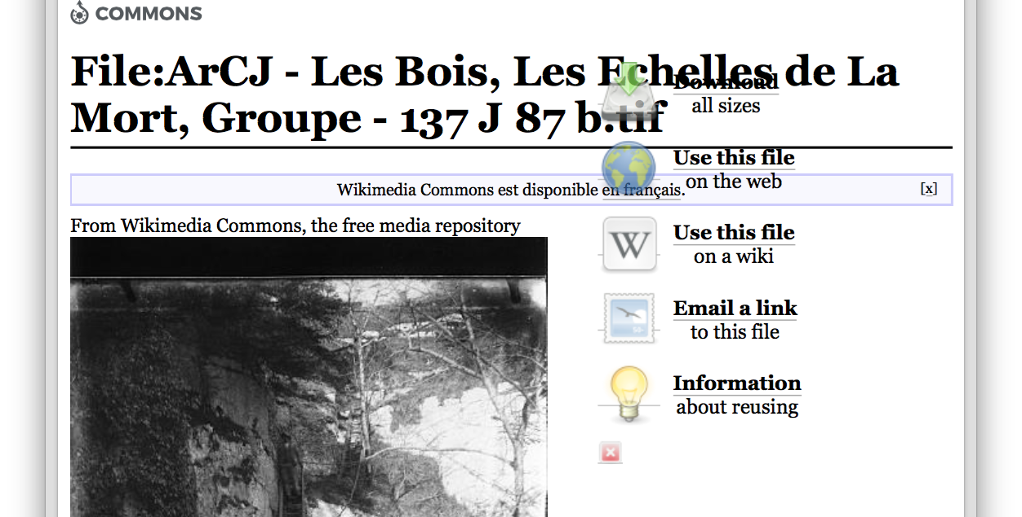
Pilot project of the State Archive

Slide 9
Project Metrikos.
Digitization of the old maps of the municipalities.
Pilot project with 25 maps of the municipality of Epiquerez.
Digitize in TIFF format with 600 dpi and 8 bits.
We have built a pilot geographical portal.
We start now with the about 5’000 maps.

Slide 10
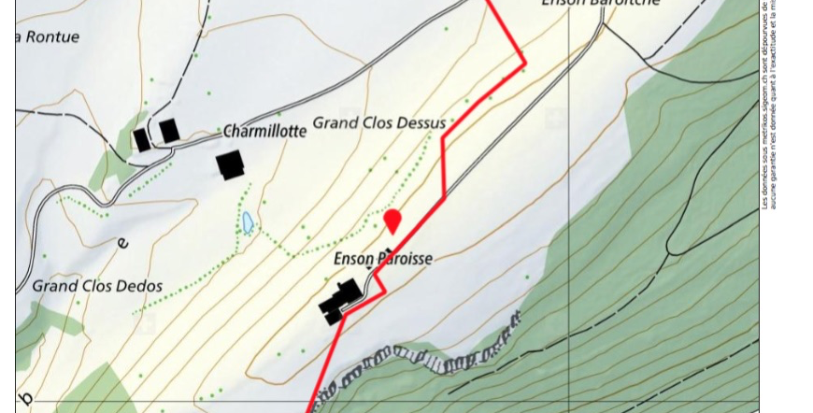
Project Metrikos

Slide 11
Comments
The digitization sharing was difficult because:
We don’t now the final users at the beginning of the digitization process.
When the data are accessible we must do a lot of marketing activities (research, exhibitions) to attract users.
And we offen don’t plan these activities in the project so we have no resources.

Slide 12
Recommendations
So the recommendations will be:
Plan marketing activities in the project.
Find at the beginning of the project users that can be sponsors for the project in their community.
We have try do do this by the photographs of Eugène Cattin.
Bring the data on a platform where the users still are. We try to do this by the project Mεtrikós.
Thank you for your attention !

