Slide 1
New Directions in Discovery
Content, Concepts, and Knowledge Discovery
Athena Hoeppner
Discovery Services Librarian
University of Central Florida, Orlando, Florida, USA
International Conference on Reshaping Libraries (ICRL 2018)
1 February 2018, Jaipur, India

Slide 2
Resource Discovery Services combine
a pre-harvested central index with a
richly featured discovery layer.

Slide 3
Discovery Index Metadata Sources
PsycInfo
OIAster
Gale OneFile
Central INDEX
arXiv
WoS
Free / Open Access
MEDLINE
ebrary
Subscription
Resources
DOAJ
CINAHL
Library Metadata
IRs
BIOSIS
MARC
INSPEC
Publisher Metadata
Digitized
ISI
Springer
Wiley
OUP
T&F
Elsevier
Notes:
Lots of different data sources are harvested into the central index
Free indexes and Open Access and Full Text
Libraries often include their MARC and IR Data
Many publishers supply basic TOC data, abstracts, and simple subject keywords
Subscription databases supply in-depth metadata
BUT can be searched and/or viewed only if the RDS has a license to load the content and the library has a subscription to access the content - Mutually Licensed Content
The exact deals between RDS vendors and publishers is not uniform
Library can customize which databases to include
No two WSD implementation alike

Slide 4

48% to 54% News

Slide 5

2% to 14% Magazines
16% to 19% Journals

Slide 6

3% to 7% Books

Slide 7
Content Types in Discovery

Slide 8
Discovery

Slide 9
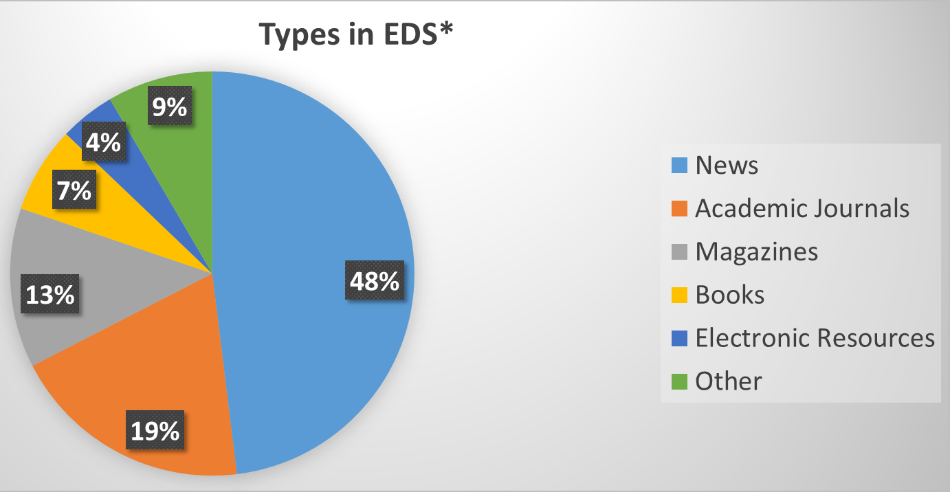

Slide 10
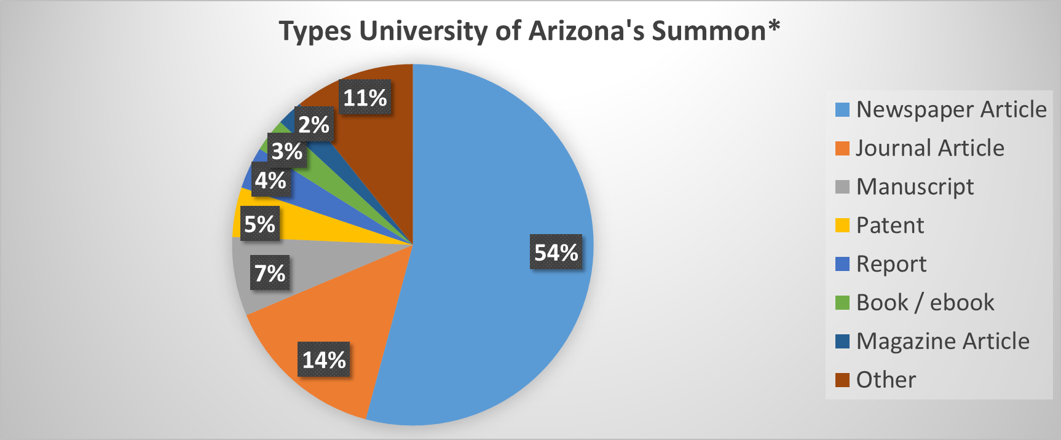

Slide 11

Mostly traditional library content.
…what about other types?

Slide 12

Diving for Data Sets

Slide 13
Data Sets Summon*

Slide 14
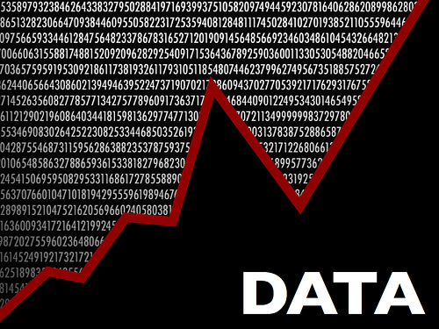
0.17% Data Sets

Slide 15
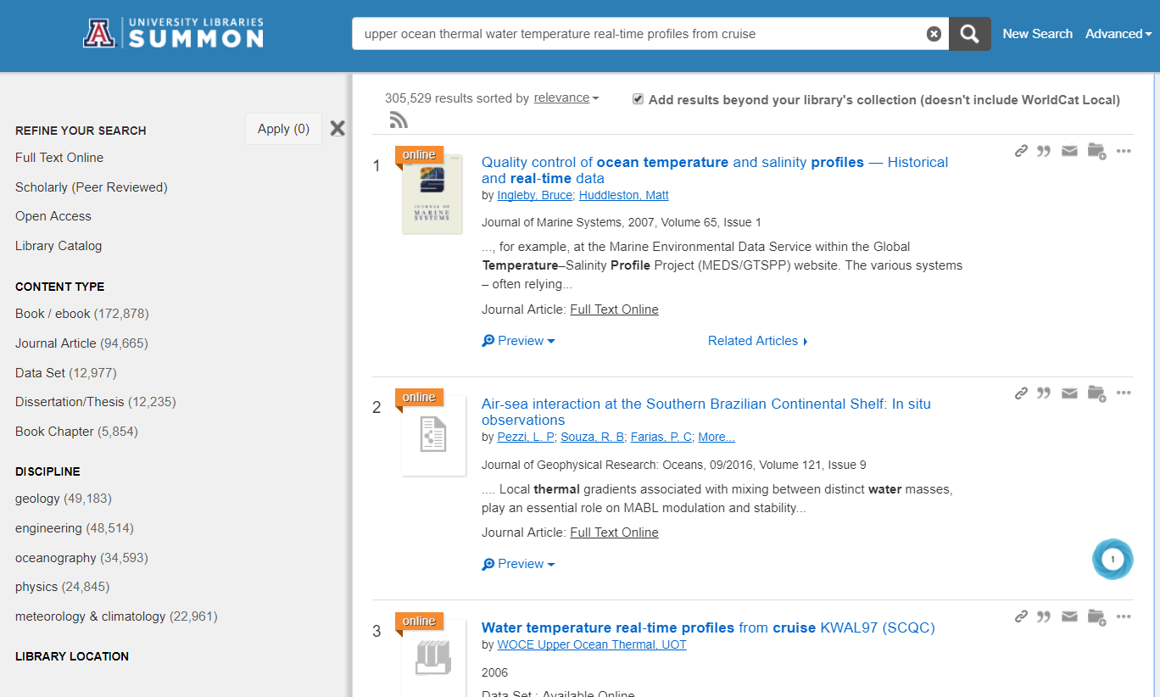
Topical search on ocean temps

Slide 16
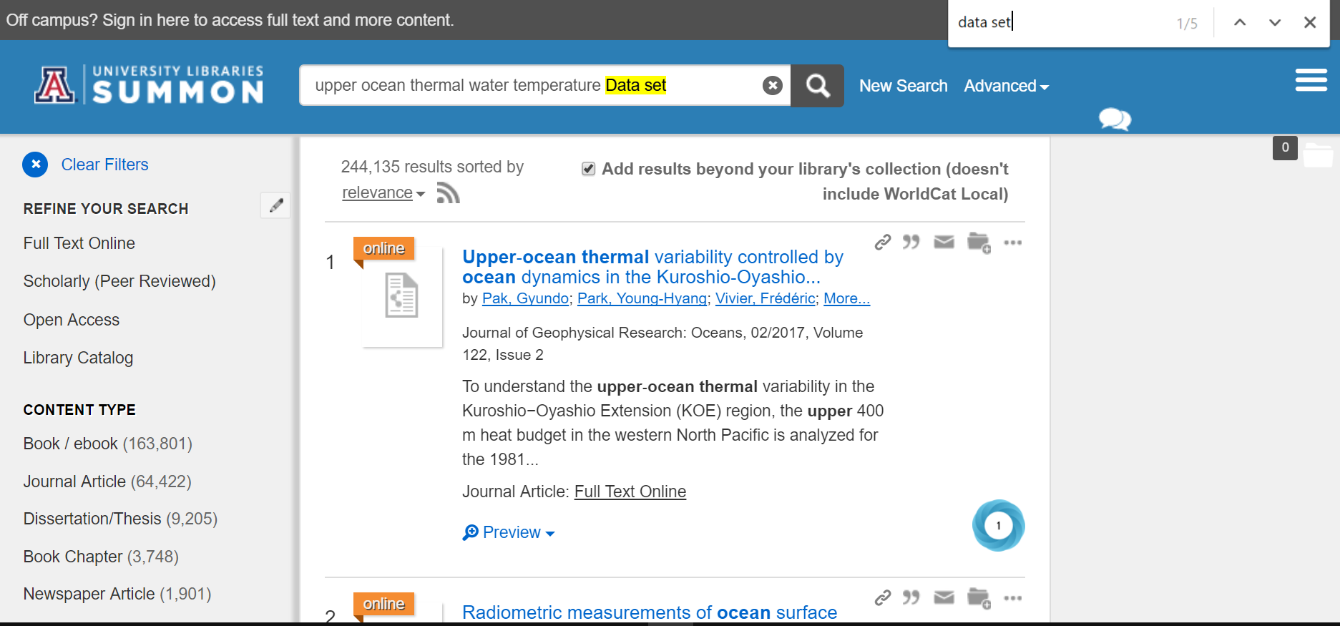
No Data Sets in the First 100 results
CTRL F “data sets”

Slide 17
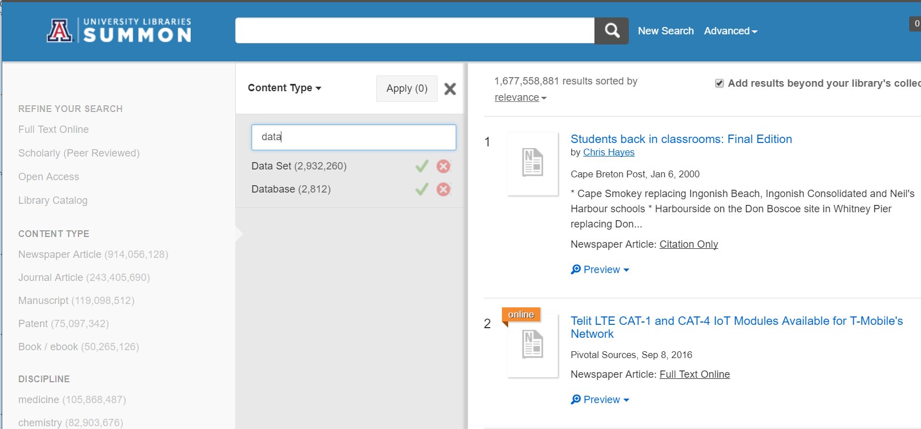
Content Type Filter for Data Set

Slide 18
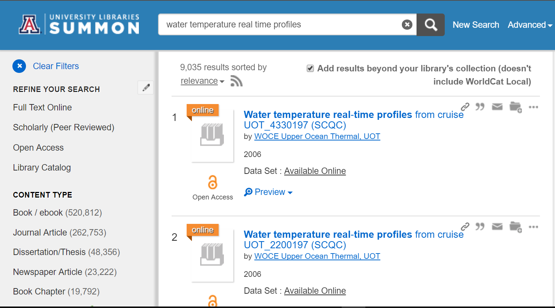
Ocean Temperature Data

Slide 19
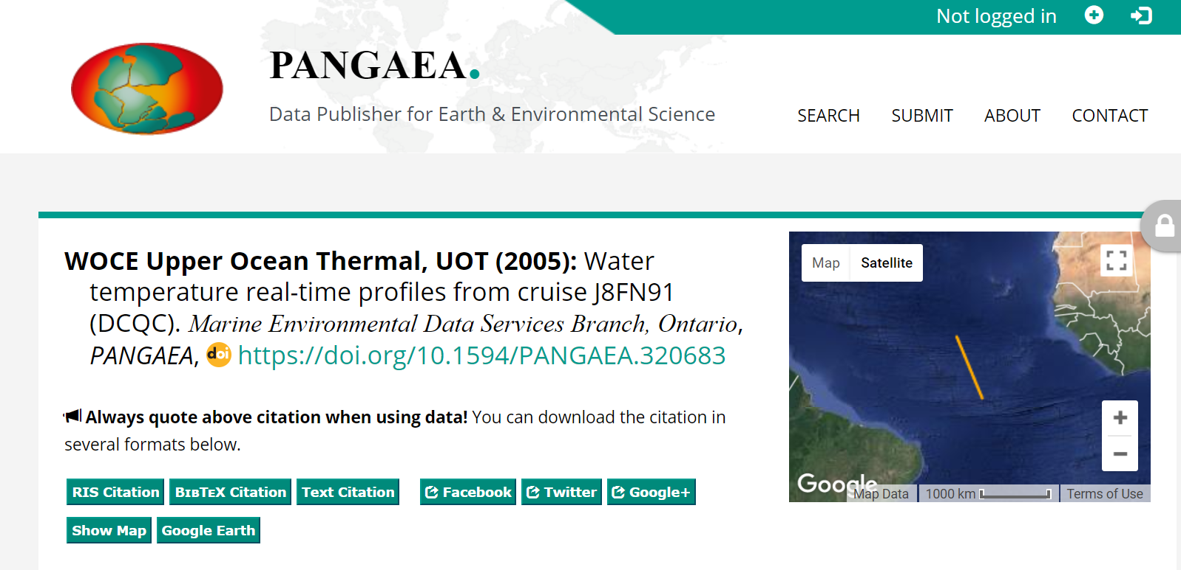
Pangea Repository Example

Slide 20
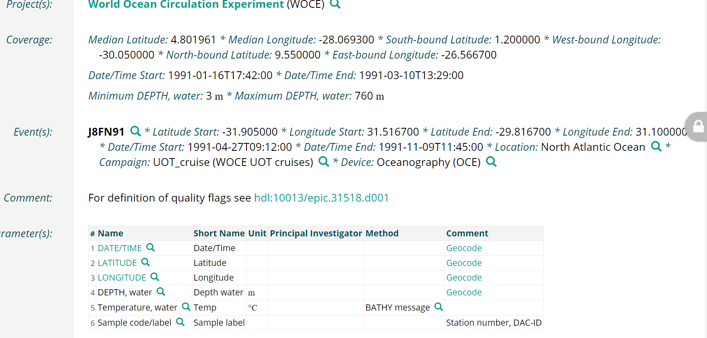
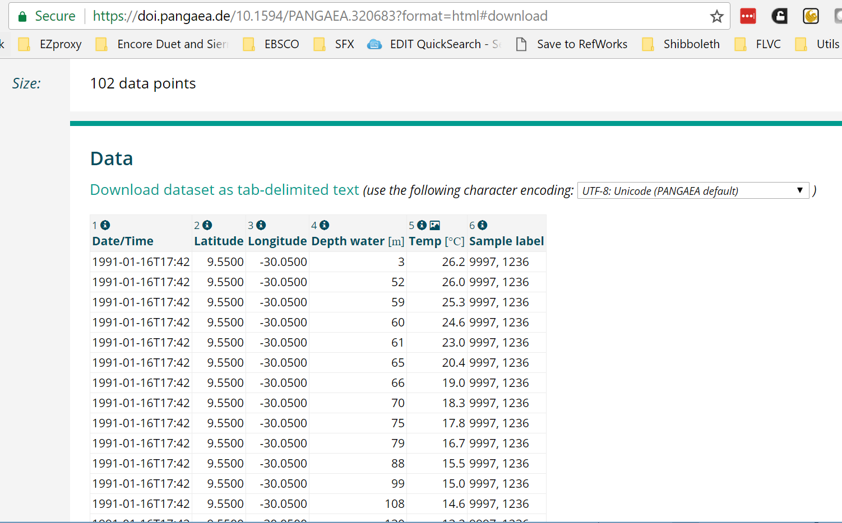
Rich Metadata and full Data Set

Slide 21
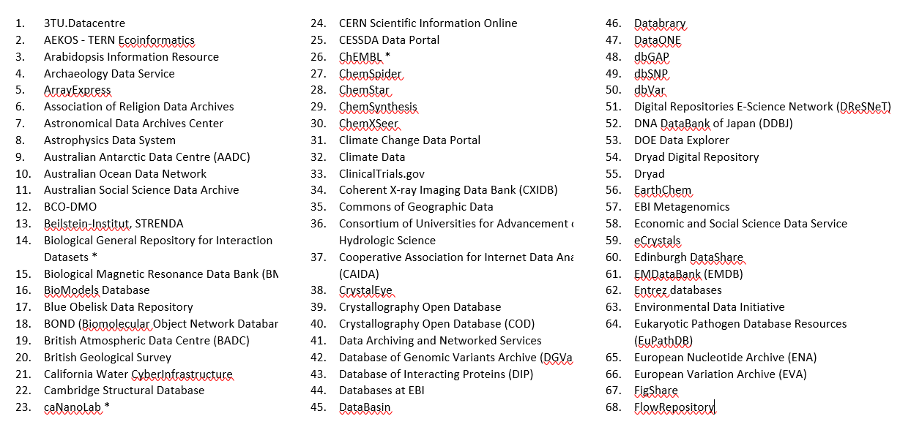
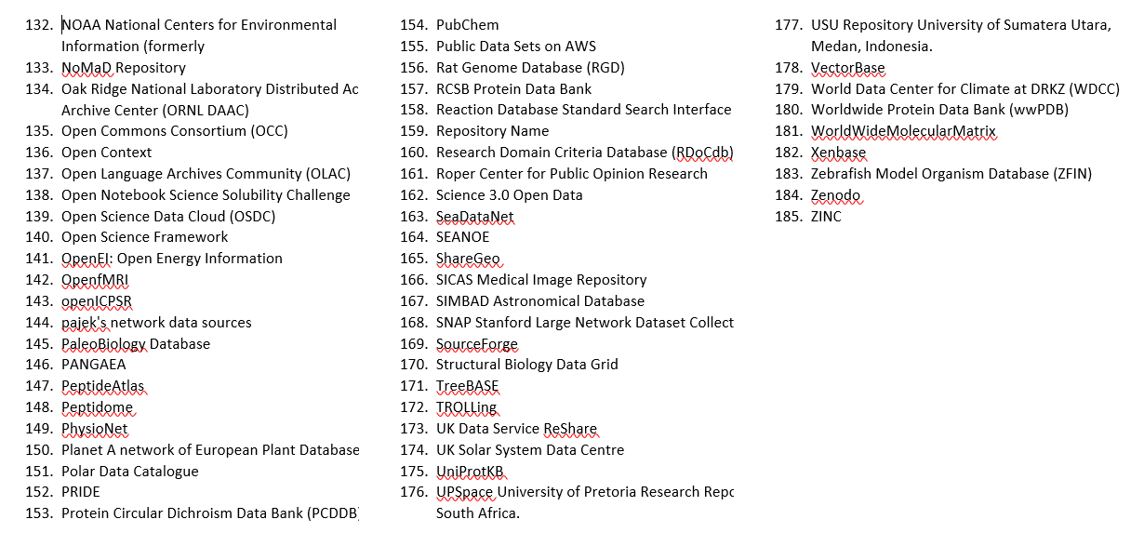
185 Repositories
(Nature + Open Data Lists)

Slide 22
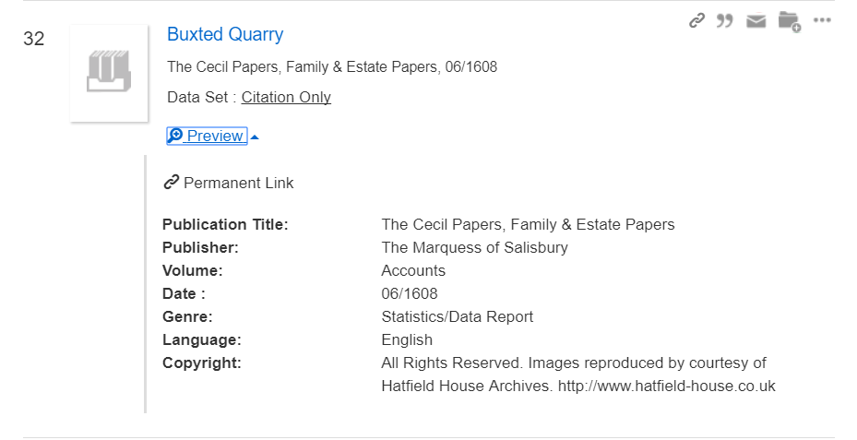
Household Accounts from 1608

Slide 23
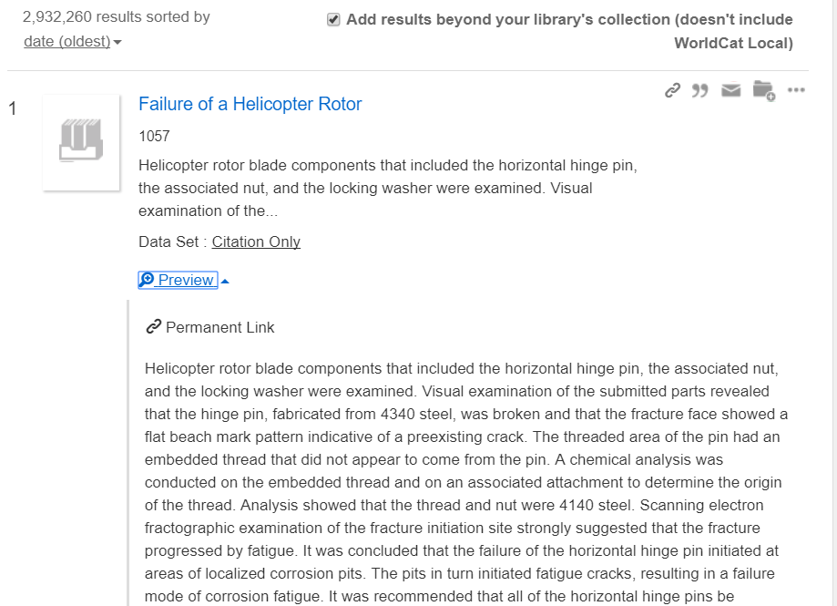
ASM International Standard
Should these be labeled as Data Sets?

Slide 24
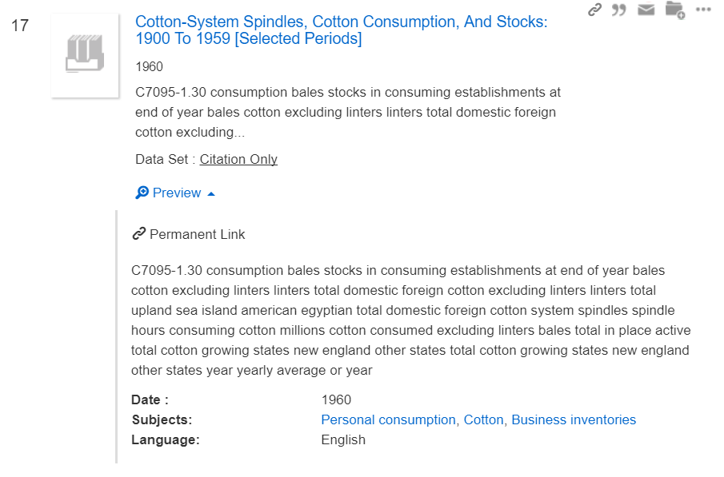
Inadequate Metadata

Slide 25
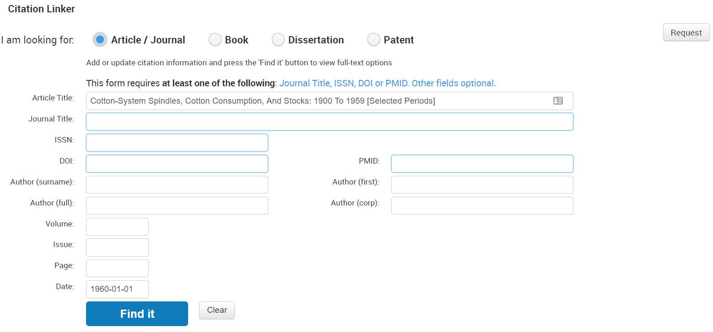
No Way to Find or Access the Data Set

Slide 26

Obstacles to Data Set Discovery
Scattered repositories
Not widely indexed
Inconsistent metadata
Inconsistent DOIs
Defining “data set” liberally
Few data sets relative to RDS index
Lots of Hurdles for Data Set Discovery

Slide 27
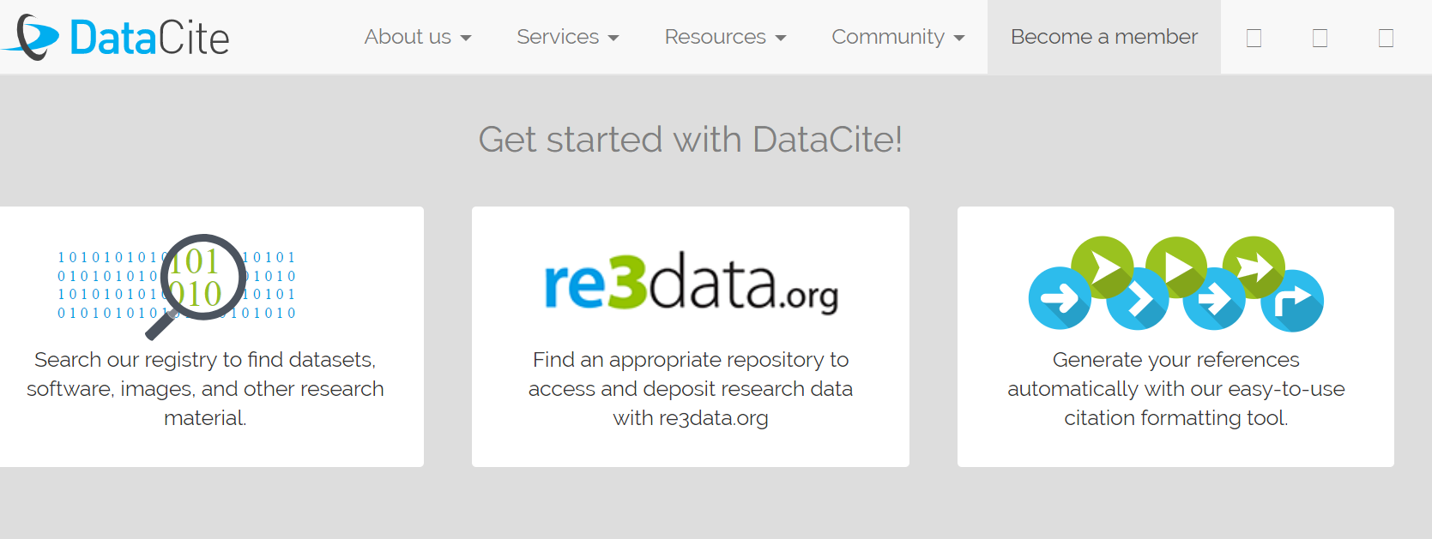
DOIs and Centralized Metadata
Locate, identify, and cite research data with the leading
global provider of DOIs for research data.

Slide 28
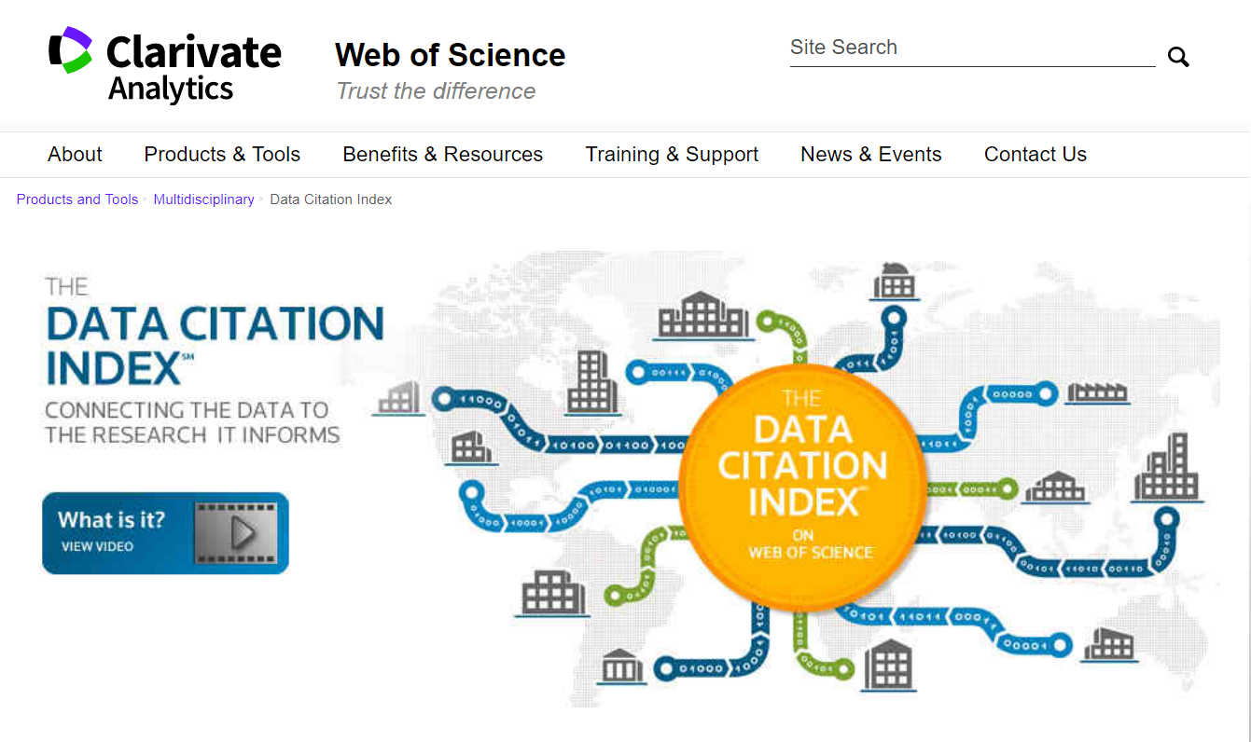
Connecting Data Sets to Papers to Data Sets

Slide 29


Yewno for Exploring Concepts
What concepts relate to this?
Are the interdisciplinary connections?
What conceptual relationships are not yet explored?

Slide 30
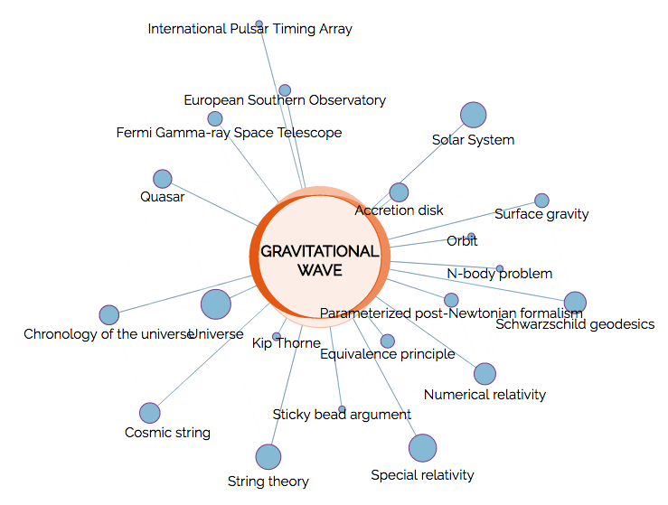
Yewno Concept Map
Nodes for related concepts
Not searching either the metadata or keyword of the documents
Notes:
Enter broad concept
Center node for entered concept
Other nodes for semantically related concepts
Size= number of related documents
Length= strength of relationship

Slide 31
Notes:
Wiki like summary of the topic
Snippets form documents
Over 100 million documents, many of which are scholarly journal articles at the core. Adding US federal documents

Slide 32

Yewno Uses Artificial Intelligence
Computational semantics
Graph theory
Machine learning
Inferred Meaning, Concepts &
Connections
100 million Documents
Notes:
computational semantics, graph theory, and machine learning to the full text of ingested documents. The AI is essentially reading the documents, similar to how humans read, infer meaning, and learn

Slide 33
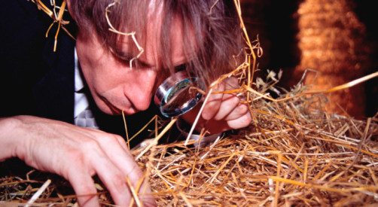
Knowtro for Extracting Findings

Slide 34
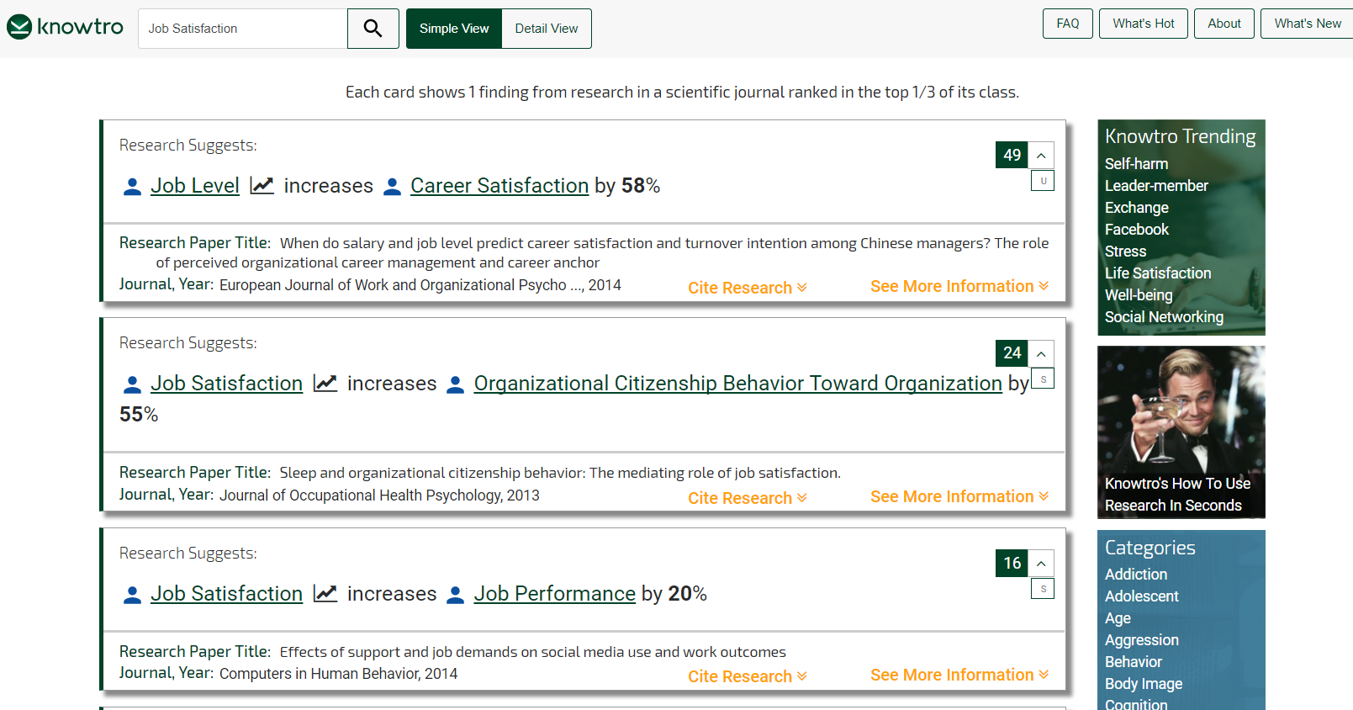
Knowtro Findings Cards
Each card reflects the results of an empirically tested causal relationship from a published article. These are articles’ FINDINGS.

Slide 35
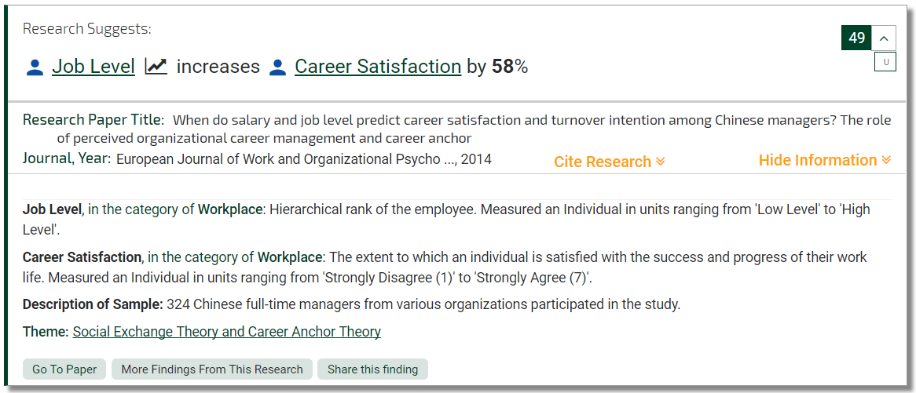
Knowtro Card Expanded

Slide 36
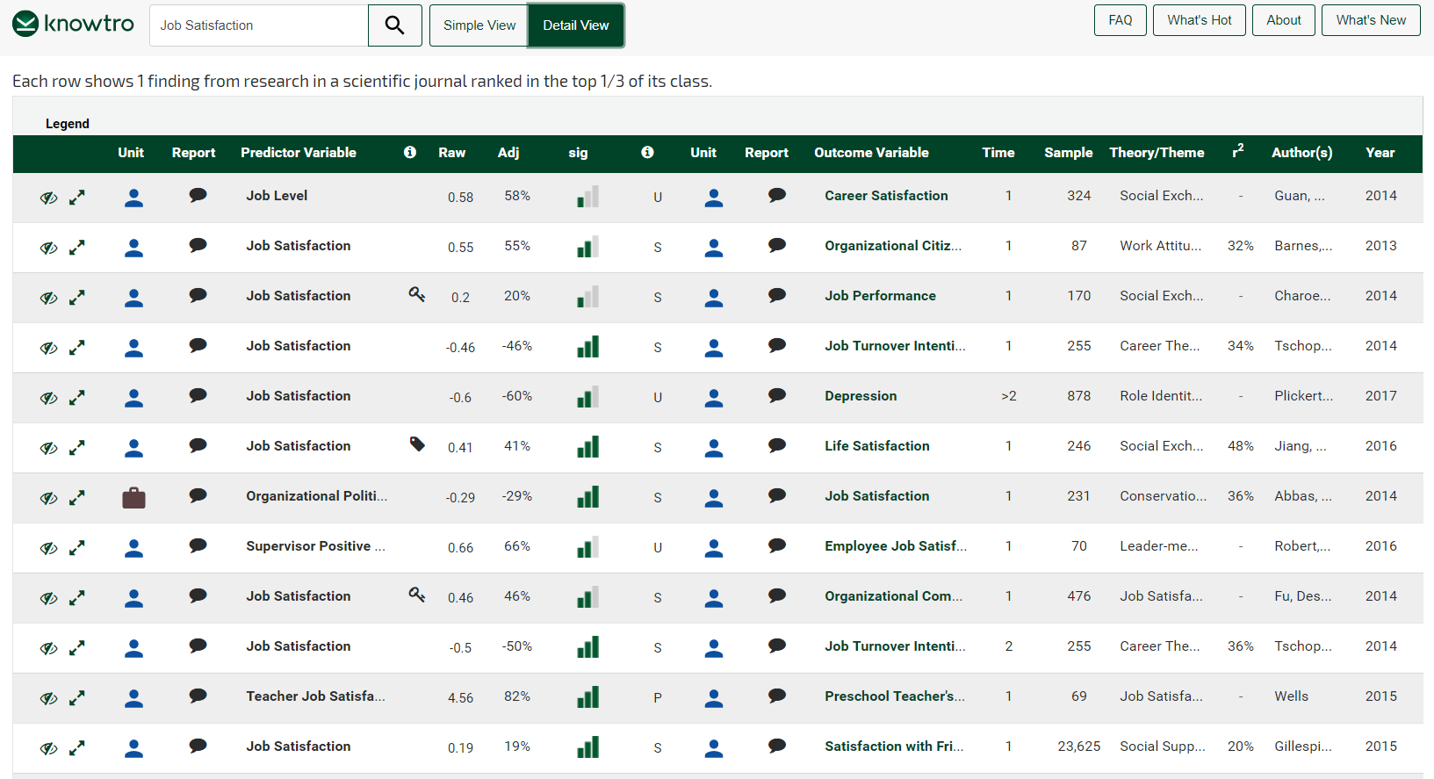
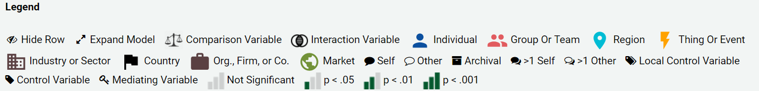
Knowtro Detail View

Slide 37
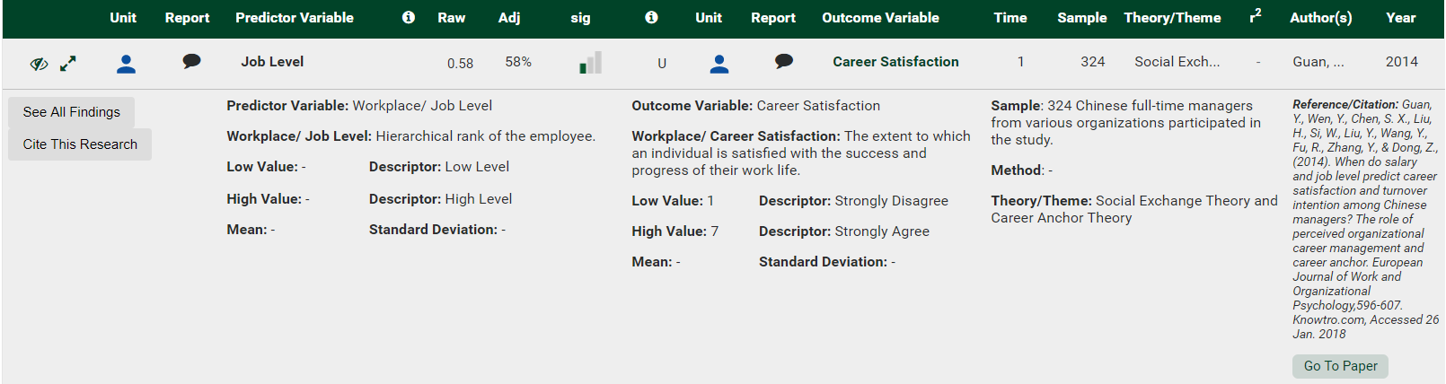
Knowtro Full Details for a Paper
Explanations for the specific variables
Brief summary about Methods, survey instrument, outcomes
Full citation
DOI link

Slide 38
Pulling it Together into RDS
Resource Discovery Services combine
a pre-harvested central index with a
richly featured discovery layer.
Plus a bunch of widgets and API calls, with metadata enhancements, please.

Slide 39
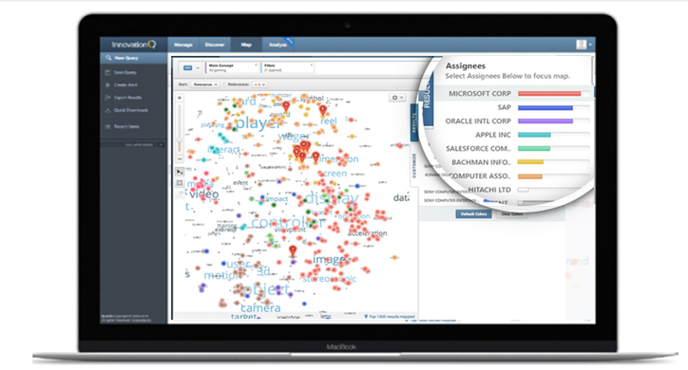
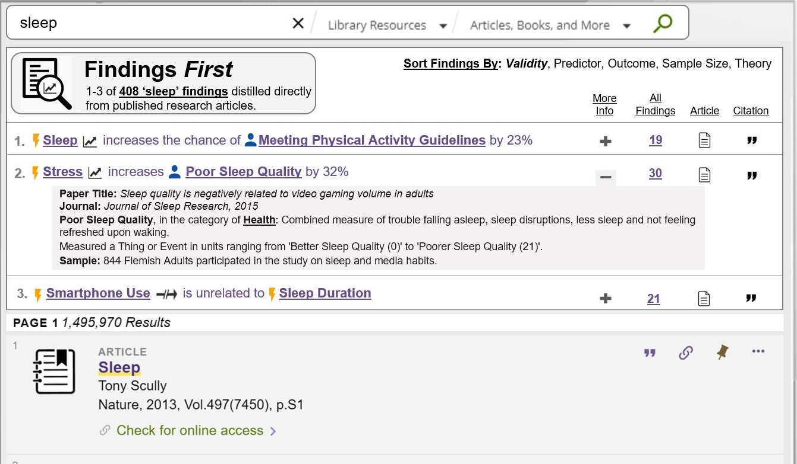

Slide 40
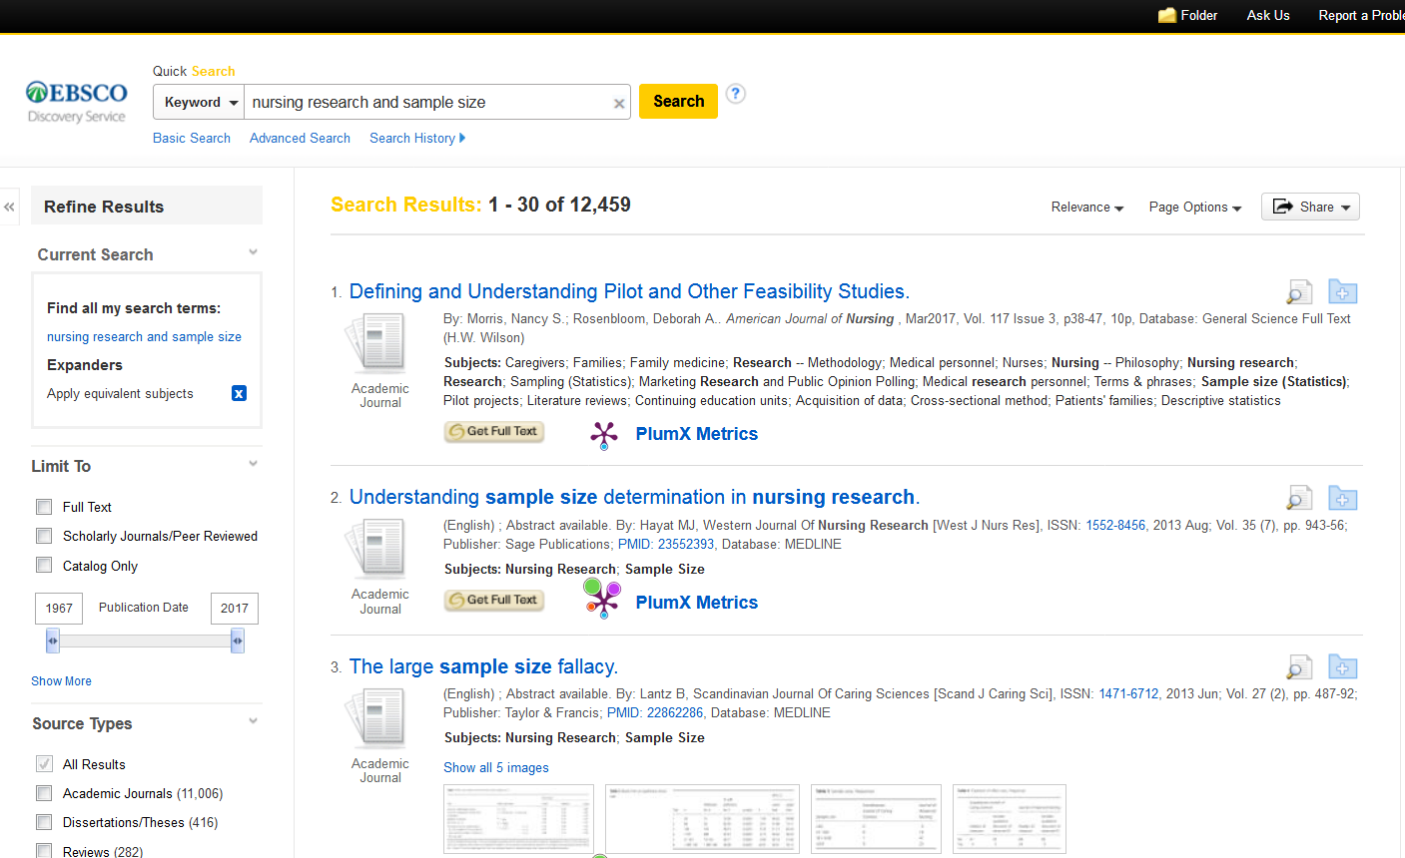



Slide 41
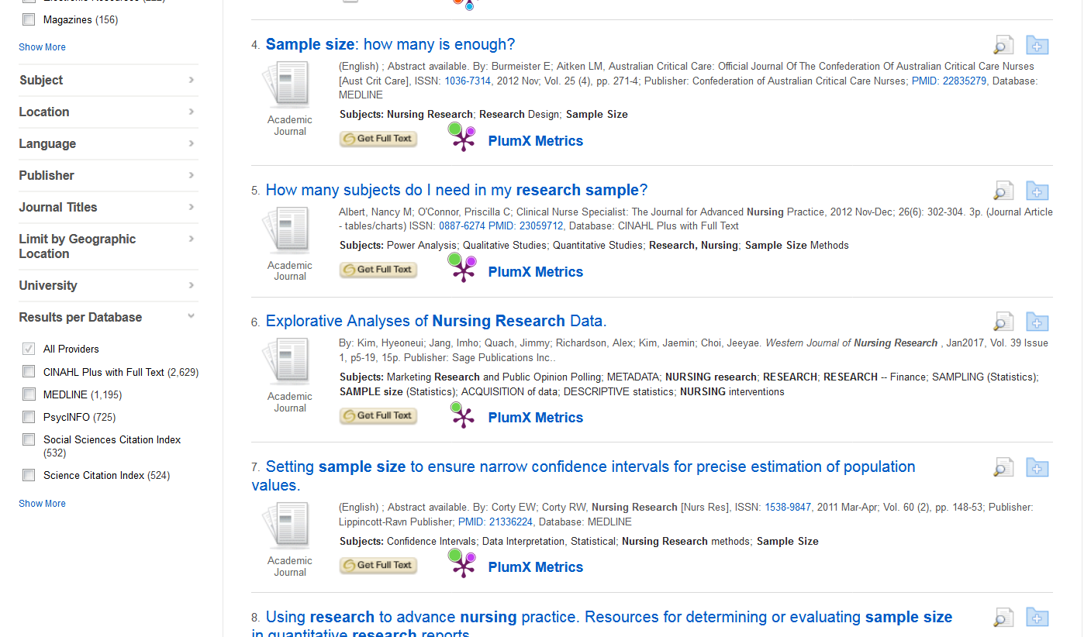

Slide 42


Articles that cite this data

Slide 43
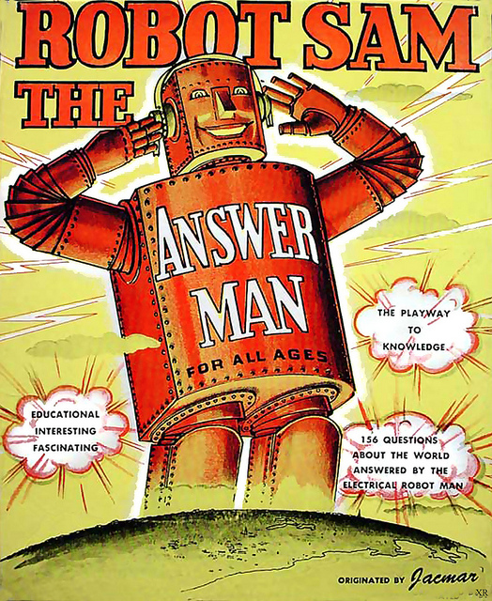
Can All The Elements Work Together?

Slide 44
Thank you.
Athena Hoeppner
athena@ucf.edu
Discovery Services Librarian
University of Central Florida, Orlando, Florida, USA

