Slide 1

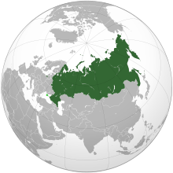


S&T Development Strategies to Meet the Challenges of Emerging Technologies
International Conference on Reshaping Libraries: Emerging Global Technologies and Trends
February 1-3, 2018 | Jaipur, Rajasthan, India
Dr. Vladimir P. Zavarukhin, Director of the Institute for the Study of Science of the Russian Academy of Sciences (ISS RAS), Moscow, Russia, v.zavarukhin@issras.ru

Slide 2
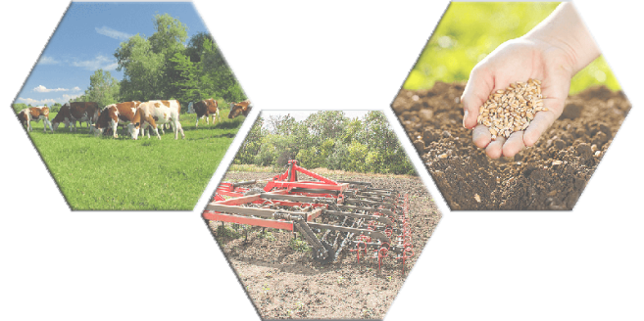
Strategic planning documents
Several strategic planning policy documents were issued to meet grand challenged facing the society, economy, and public administration in Russia: the Strategy of Social and Economic Development, the Strategy of National Security of the Russian Federation and other strategic documents.
The main strategic policy document defining priority vectors for the coming 10-15 years for creating new knowledge and technologies to revive economic growth is the Scientific and Technological Development Strategy of the Russian Federation (S&TD Strategy).
The necessity of the S&TD Strategy:
Despite substantial contribution of Russia to the world S&T breakthroughs it is still faced with problem of unresponsiveness of the economy and society to innovations what hinders practical application of R&D results – the share of innovative products in general output is just 8-9 per cent, investment in intangible assets is 3-10 times lower than in the leading countries.
In spite of the available potential and competitive advantages of the Russian science, negative factors and trends (including weak interaction between R&D sector and industry and lack of co-ordination between S&T priorities and supporting tools at national, regional, industry and corporate levels) do not allow the creation of value-added chains of high-tech products and services to ensure maximum multiplicative application effect of the created technologies.

Slide 3

Strategic planning documents
S&T priorities as defined in S&TD Strategy - directions or fields contributing to obtaining S&T results that would serve as a basis for the innovative development of the domestic market of products and services as well as for the country’s stable position in the world market:
1st.) the transition to advanced digital, intelligent production technologies, robotic systems, new materials and design methods, the creation of systems for processing large amounts of data, machine learning and artificial intelligence;
2nd.) the transition to environmentally friendly and resource-saving energy, increasing the efficiency of extraction and deep processing of hydrocarbon raw materials, means of transportation and storage of power;
3rd.) the transition to personalized medicine, high-tech health care and health saving technologies;
4th.) the transition to highly productive and environmentally safe farming and aqua farming, storage and efficient processing of agricultural products, creation of safe and high-quality foods;
5th.) the counteraction against technogenic, biogenous, sociocultural threats, terrorism, ideological extremism, cyber threats and other hazards to the society, economy and state;
6th.) the connectivity of the territory of the Russian Federation through the creation of intelligent transport and telecommunications systems, development and use of outer and air space, the World Ocean, the Arctic and Antarctic Regions;
7th.) the effective response by the Russian society to major challenges, with due regard to the interaction of man and nature, man and technologies, social institutions at the present stage of global development, including the application of methods of social sciences and humanities.

Slide 4

Efficient system of communication in science, technology and innovation
a) providing for the conditions that contribute to reciprocal influencing between science and society by involving the society in shaping demand for the research outcomes;
b) developing tools aimed at supporting translational research and organization of a technological transfer, protection, management and protection of intellectual property, ensuring a rapid transition of research results to a practical application stage;
c) providing a system support of interaction between major companies, the authorities of the Russian Federation and small and medium-size innovative, scientific and educational organizations, as well as their involvement in the technological renewal of the economic sectors and building up new markets;
d) creating a government support system for national companies to ensure their technological breakthroughs that would enable them to take a stable position in new emerging markets, inter alia, within the framework of the National Technological Initiative;
e) implementing an information policy aimed to develop technological culture and public responsiveness to innovation and to popularize important outcomes in science, technologies and innovations, achievements by distinguished scientists, engineers, entrepreneurs, and their role in ensuring social and economic development of the country.

Slide 5
The Role of ISS RAS
The Institute for the Study of Science of the Russian Academy of Sciences (ISS RAS, www.issras.ru), established in 2005, as one of its main activities, works out recommendations on perfecting mechanisms of formation and implementation of the governmental science, technology and innovation policy including S&T priority setting, elaborates methodologies of and participates in analysis, evaluation and forecasting in STI sphere.
ISS RAS provides analytical and statistical background for science, technology and innovation monitoring, form and keep databases containing statistical information on the Russian scientific, technological and innovation potential.
In close cooperation with the Russian Academy of Sciences ISS RAS for more than ten years carries out effectiveness assessment of research activities of academic organizations¸ provides coordination of their research, analysis and forecasting of the main S&T trends.
ISS RAS has worked out proposals on forming up complex scientific and technological projects within the defined strategic S&T priorities - from obtaining new basic knowledge up to the creation of innovative market products. These projects are supposed to include as participants academic scientific organizations, applied science organizations, industrial institutions, government corporations and government bodies.

Slide 6
The Role of ISS RAS
ISS RAS is engaged in continuous monitoring, collection and provision for governing bodies of statistical and analytical data characterizing scientific potential of the country, as well as the effectiveness of scientific activity of research organizations subordinated to the Federal Agency of Scientific Organizations.
The assessment of current state of science, basic science in particular, is being realized in the directions:
determination of organizational structure of science;
assessment of personnel, including the engaged in research and development by categories, skill level and branches of science;
R&D financing, structure of expenses by types and sources of financing;
state and level of development of material and technical resources of science;
assessment of R&D effectiveness: patent licensed, trade in technologies with foreign countries, creation and use of the advanced production technologies, publication activity.

Slide 7
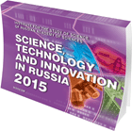
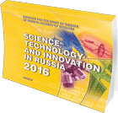
The Role of ISS RAS
In 2017 ISS RAS prepared and published the following statistical editions:
"Science in institutions of the Federal Agency of Scientific Organizations: 2016".
"Science, Technology and Innovation in Russia: 2016".
"Science, technologies and innovations in Russia: 2017“.
"Scientific capacity of Russia for 2006-2014".
"Training of research personnel of higher qualification in organizations of the Federal Agency of Scientific Organizations. Release 2".

Slide 8

Emerging technologies
An emerging technology is "a radically novel and relatively fast-growing technology characterized by a certain degree of coherence persisting over time and with the potential to exert a considerable impact on the socio-economic domain(s) which is observed in terms of the composition of actors, institutions and patterns of interactions among those, along with the associated knowledge production processes. Its most prominent impact, however, lies in the future and so in the emergence phase is still somewhat uncertain and ambiguous.“
Rotolo, D., Hicks, D., Martin, B. R. (2015) What is an emerging technology? Research Policy 44(10): 1827–1843, 2015.

Slide 9

ISS RAS and Emerging technologies
Emerging technologies are the subject of a number of ISS RAS latest research themes:
Formation of a scientific and technological base of the knowledge based economy: global trends.
Formation of a scanning and monitoring system for global challenges having substantial potential of influence on the economy and social sphere of Russia.
Development of approaches, models and procedures for the selection of perspective areas of the oriented basic research of the academic sector of science till 2030.

Slide 10

New technologies for dissemination of S&T results
Libraries around the world now strive to leverage new technologies to update service models in reference, instruction, and access service to meet their patrons’ point-of-need preferences in location, device choice, and information seeking behaviors.
Institute for the Study of Science of RAS:
develops models of applying composite, text and visual representation of information for promoting scientific and innovative activities, scientific knowledge as well as methods for promoting profiles of the Russian scientific organizations in the most popular social networks,
studies opportunities and methodologies of getting an effective feedback from potential audience in such social media. Information on publication activities of scientists and scientometrics are considered for such platforms as new source of information,
carries out a comparative analysis project of the efficiency of different types of social media, including public networks for communication (Relationship networks), networks for exchange of media content (Media sharing networks), networks for responses and reviews (Online reviews) and networks on interests (Interest-based networks).

Slide 11
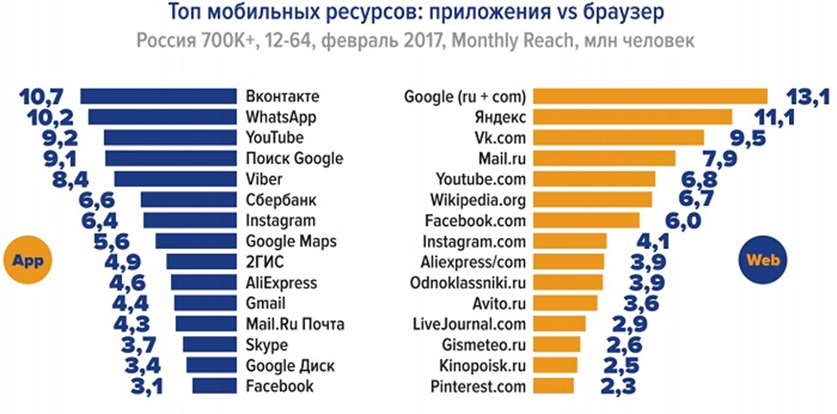
New technologies for dissemination of S&T results
Top mobile resources in Russia: applications vs browser, February 2017, mln. people

Slide 12

New technologies for dissemination of S&T results
In 2017 ISS RAS
studied the requirements and effectiveness of drawing attention to the Russian science through social platforms, evaluated what platforms are the best for science promoters and what technologies are necessary to start introduction of popular scientific multimedia projects to the sphere of Social Media,
developed ways of integration of the ready models of popular scientific projects already realized at the Institute (for example, digital TV channel about Russian science - Science-tv.ru, different types of information and analytical digests) into the largest in Russia social networks.
The research conducted earlier in ISS RAS have confirmed still insufficient coverage of activities of the Russian scientists in social media platforms.

Slide 13

Social networks
More than 100 000 social networks are now registered in the Internet
In Russia no more than 50 electronic media platforms are widely known
Practically all these social media can be referred to as Relationship networks group – public networks for communication and maintaining mini-websites.
Media sharing networks are also registered in media space – they are social networks for exchange of media content (Flickr, YouTube, Snapchat, Instagram).
Online reviews unite users of one general geolocation and local business (Foursquare, Yelp). The most known one in Russia are Uber and TripAdvisor a well the Russian service of comparison of cost and characteristics of goods - Yandex Market.

Slide 14

specialized social networks for scientists
1. SciPeople scientific network (http://scipeople.ru/) has been launched in 2009 and for today, according to the website statistics, it has 51170 registered scientists, 9546 groups and 6 official groups.
2. Scientists of Russia - https://russian-scientists.ru/ - is developed by the Russian Academy of Natural Sciences.
3. Habrakhabr - https://habrahabr.ru/. The subject of the project covers information technologies, business and Internet. The focus is made on IT developments and programming.
4. Scientbook scientific and information social network - http://scientbook.com - was launched in 2012.
5. Scientific information space of Sotsionet - https://socionet.ru. The project is one of the first examples of the Russian participation in the development of international social networks for scientists.

Slide 15

new model of social network for scientists
In the new model of social network for scientists it is expected to inform users online about Russian research and researchers, their publication activities in form of an illustrative digest adapted for the work in Facebook and Instagram.
Adding materials into a news line of a social network is based on a daily monitoring of new publications in the Web of Science/Scopus/RSCI.
A search for and selection of the most interesting articles in the open media space, preparation of short summaries for them. Ready material for posting in a news line of a social network includes the most compressed review of an article, name of the author, his scientific title and place of work, reference to the full text of the article as well as a thematic illustration and infographics, dynamics of publication activities of Russian scientists.

Slide 16
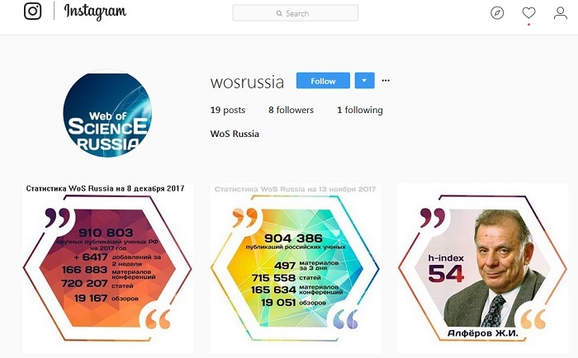
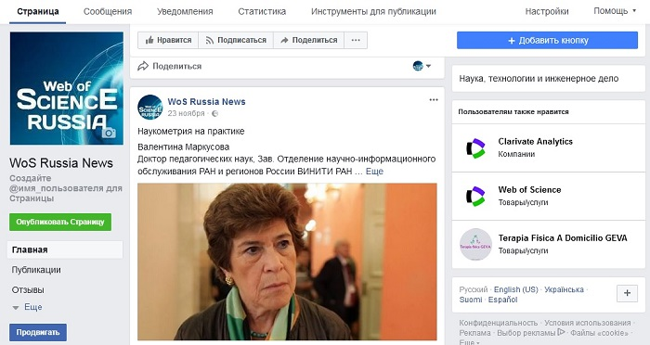
new model of social network for scientists

Slide 17

Conclusion
Creation of an efficient system of communication in science, technologies and innovations is of primary importance.
It is necessary to create mechanisms for the detection and updating major challenges caused by emerging technologies, develop and approve complex scientific and technological programs and projects that include all stages of the innovation cycle: from obtaining new fundamental knowledge towards its practical implementation, creation of technologies, products and services, and their introduction into the market.
The approach and models proposed in the case study of the Russian Institute for the Study of Science in applying composite, text and visual representation of information for promoting scientific and innovative activities and scientific knowledge as well as profiles of scientific organizations in popular social networks with the use of relative information on publication activities of scientists and scientometrics would be of interest for S&T libraries, scientist and scientific community in general as well as of governments.
Recommendation for libraries: if a library wants to be modern and focused on the user, if it wants to attract new users and not to lose old ones it has to pay serious attention to social media and work in them.

