Slide 1
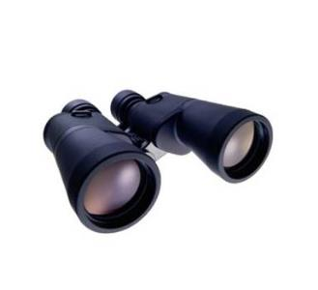

Information discovery based on an emerging technology: analysis of digital images
Created to support an invited lecture @ “International Conference on Reshaping Libraries: Emerging Global Technologies and Trends” (ICRL 2018) February 1-3, 2018, in Jaipur, Rajasthan, India
organized by
DELNET,
Ambedkar University Delhi,
Special Libraries Association (SLA)-Asian Chapter &
Society for Library Professionals (SLP)
by Paul.Nieuwenhuysen@vub.ac.be Vrije Universiteit Brussel B-1050 Brussel, Belgium

Slide 2


These slides should be available from the WWW site
http://www.vub.ac.be/BIBLIO/nieuwenhuysen/presentations/
(note: BIBLIO and not biblio)
The full text is published in the proceedings of this conference.

Slide 3
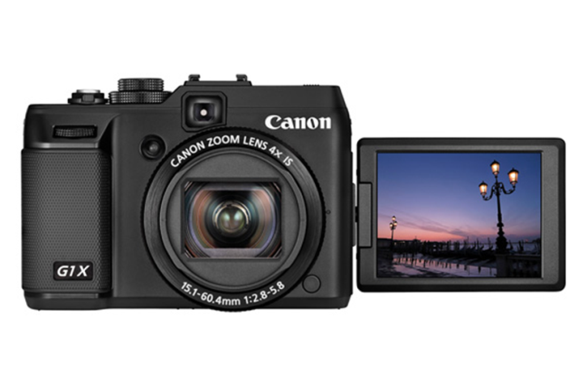
Searching for images, using text as query
Searching for information, using an image as query
Searching for information, using a query that includes words & an image.
Recommendations for practitioners / librarians
contents = summary = structure
= overview

Slide 4

Introduction / Context

Slide 5

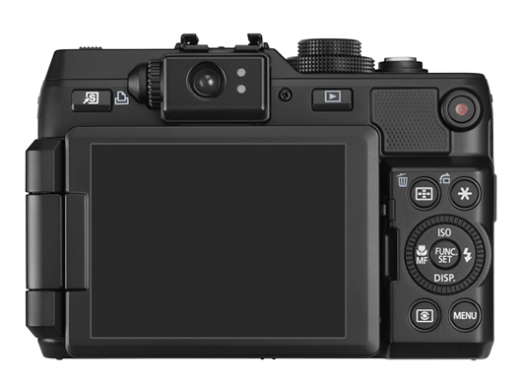
Introduction: images
Images become more important as information sources, due to
--increasing number of digital cameras
--increasing number of digital photos on the WWW, available in open access

Slide 6
Introduction: images
→ Searching for images becomes more important

Slide 7

Introduction: images
Difficult
Easy
Organize
Annotate
Find / Retrieve !
Produce
Store
Edit
Publish / Share
J
Cheap Expensive

Slide 8
Searching for images, using text as query

Slide 9


Introduction: finding images and information
Searching for images on the WWW has become an attractive starting point to discover information:
A search query with text can be submitted to an “image search engine”.

Slide 10

Introduction: finding images and information

Slide 11
Introduction: finding images and information
Searching for images on the WWW has become an attractive starting point to discover information:
A search query with text is submitted to an “image search engine”.
The results come as small “thumbnail images”.

Slide 12
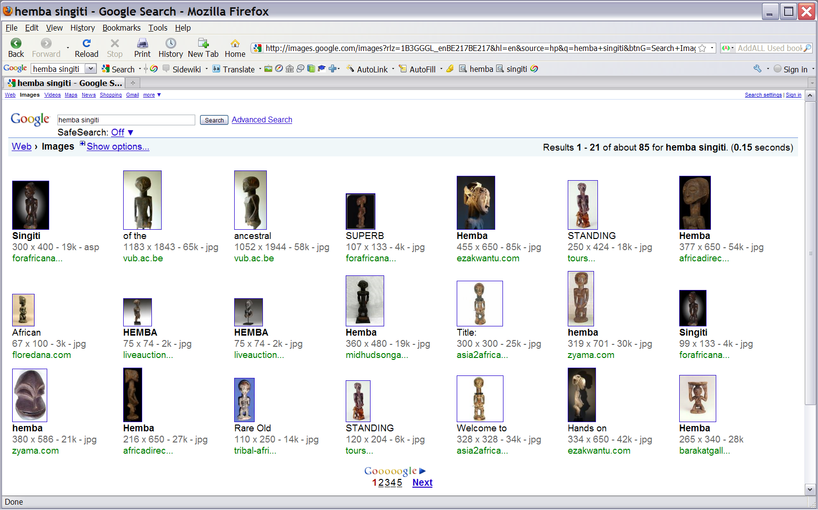
Introduction: finding images and information

Slide 13
Introduction: finding images and information
Searching for images on the WWW has become an attractive starting point to discover information:
A search query with text is submitted to an “image search engine”.
The results come as small “thumbnail images”.
Each small image links to the document where it occurs.

Slide 14
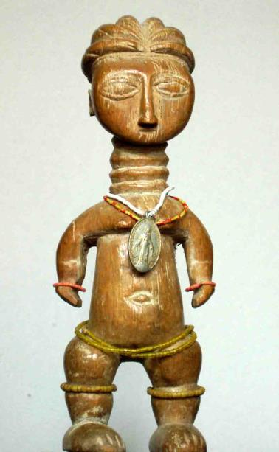
Searching for images: images & their context
Image found on WWW

Slide 15
Searching for images: images & their context
Image found on WWW (+ link to WWW file)

Slide 16
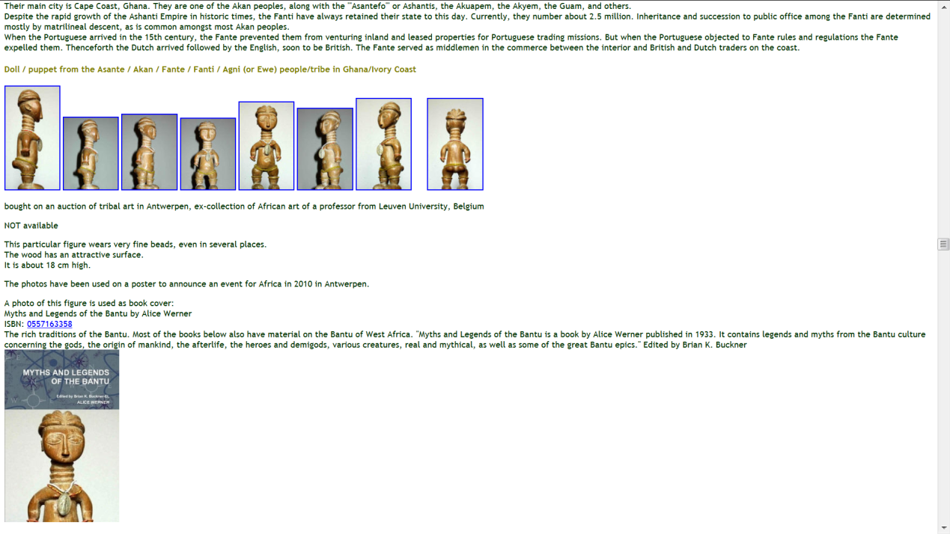

Searching for images: images & their context
Image & context on WWW

Slide 17
Introduction: finding images and information
J
Search for images is faster than search for texts.
When a relevant image is found, then also the context of that image is found, and that can yield relevant information.

Slide 18



Findings & Discussion
Comparison of WWW image search engines:
Good relevance ranking
Overlap in coverage and search results, as expected
Yahoo! & Bing quite similar, as expected

Slide 19
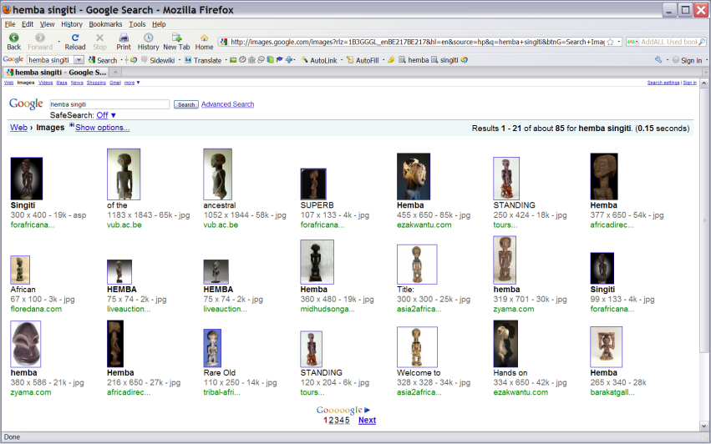
Conclusions L
- WWW image search delivers
a mixture of useful information with irrelevant information and even with mis­information

Slide 20
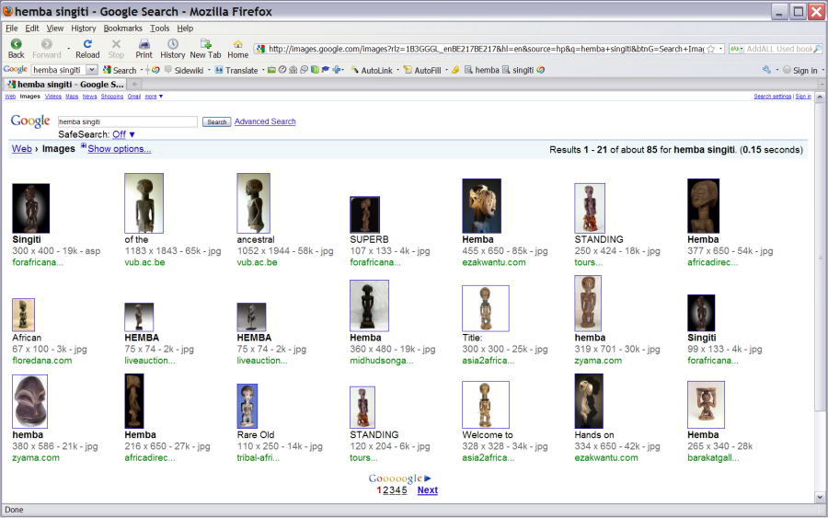
Conclusions J
+ Information retrieval from the WWW through image searching is attractive, simple and fast, AND can be efficient / productive.

Slide 21
Searching for information, using an image as query

Slide 22
Search(ing) by image: introduction
Besides searching for images with a query that consists of text, some systems allow us to use as query an image (file).
Search(ing) by example
Reverse image lookup = RIL
Backwards image search(ing)
Inside search(ing)
Content-based information retrieval = CBIR
Reverse image search(ing) (used by Google)
Search(ing) by image !

Slide 23
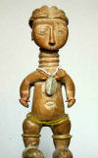
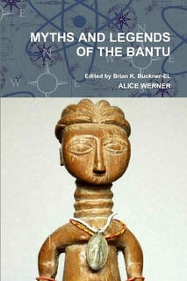
Searching by image: example
Search with the original image reveals a derived image
Original photo of a sculpture → Book cover

Slide 24

Research problem
Which systems are available free of charge for searching by image through the WWW?

Slide 25
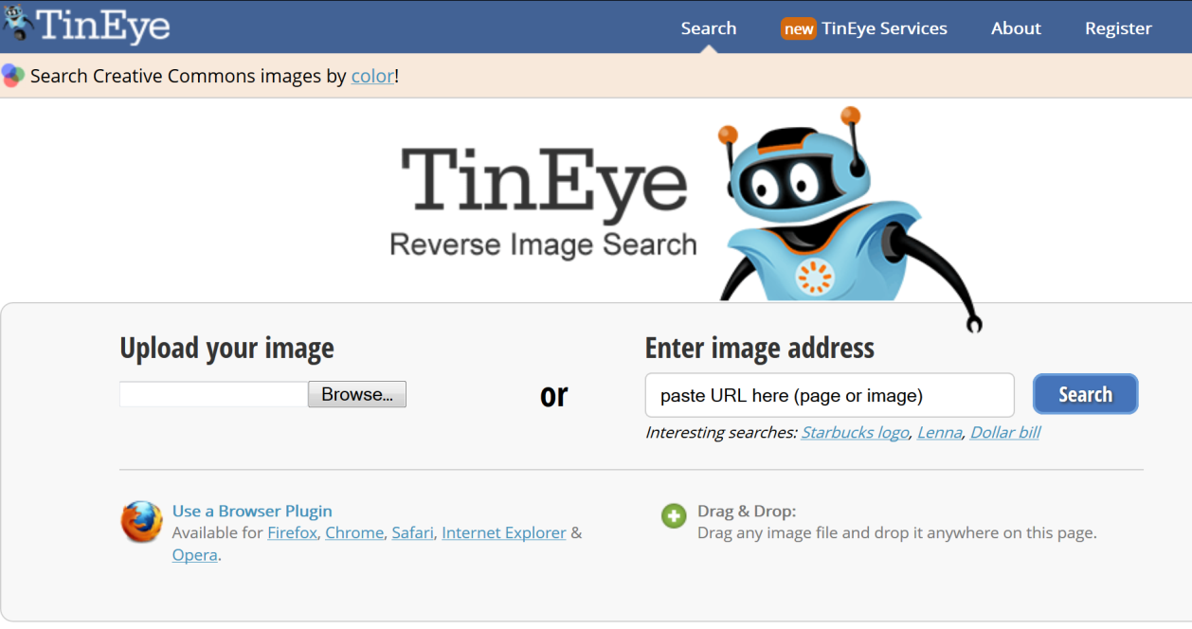
Searching by image: the user interface
A pioneer system, accessible free of charge:

Slide 26

Searching by image: number of images
TinEye states on their user interface, in 2016, that their search service deals with about 17 billion images.

Slide 27

Searching by image: search engines
Available WWW image search engines:
others…
since 2011

Slide 28
Research problem
Which differences among these systems are interesting for a user in practice?

Slide 29
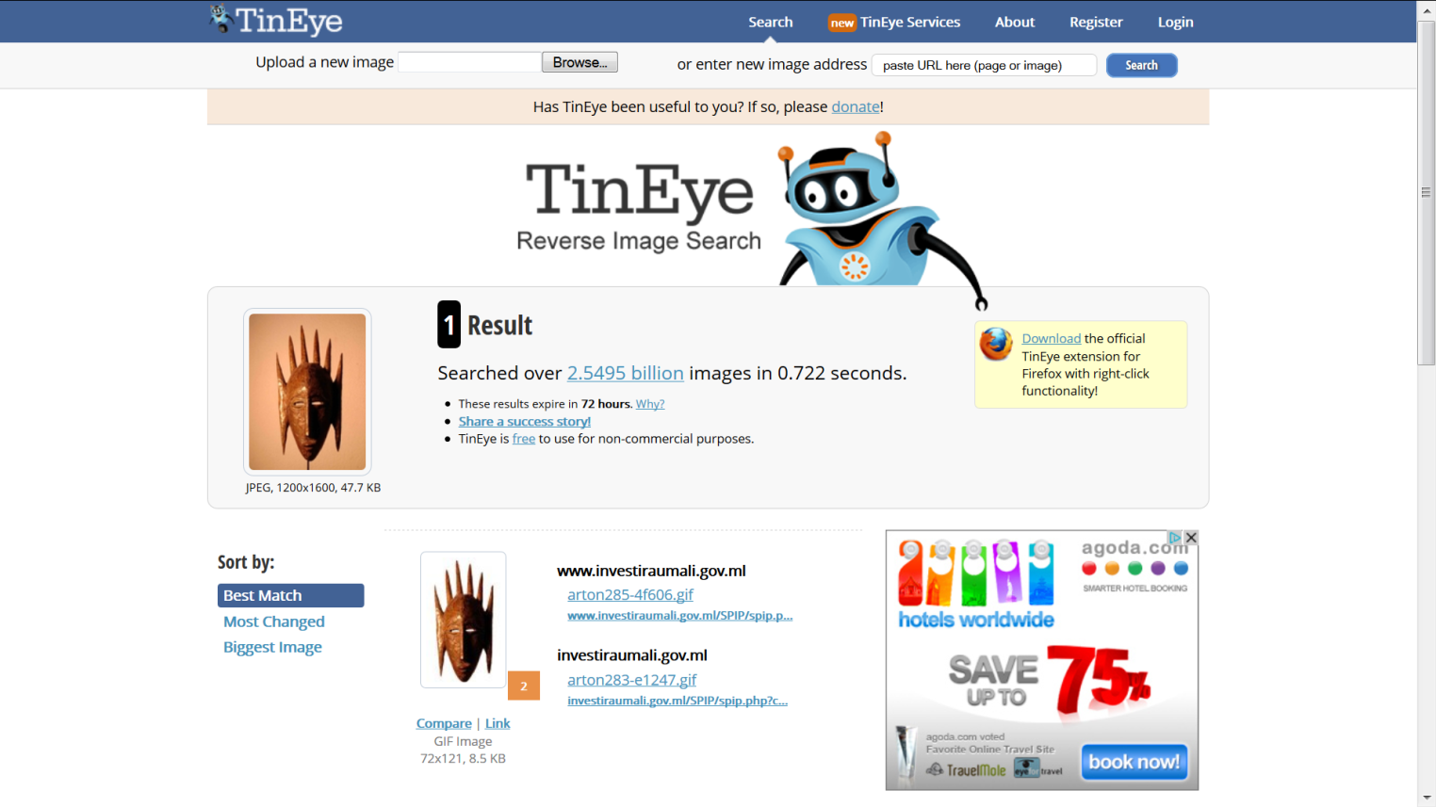
Searching by image: Findings & Discussion: TinEye
TinEye revealed NO duplicate image on the WWW.
L

Slide 30
Searching by image: Findings & Discussion: Google

Slide 31
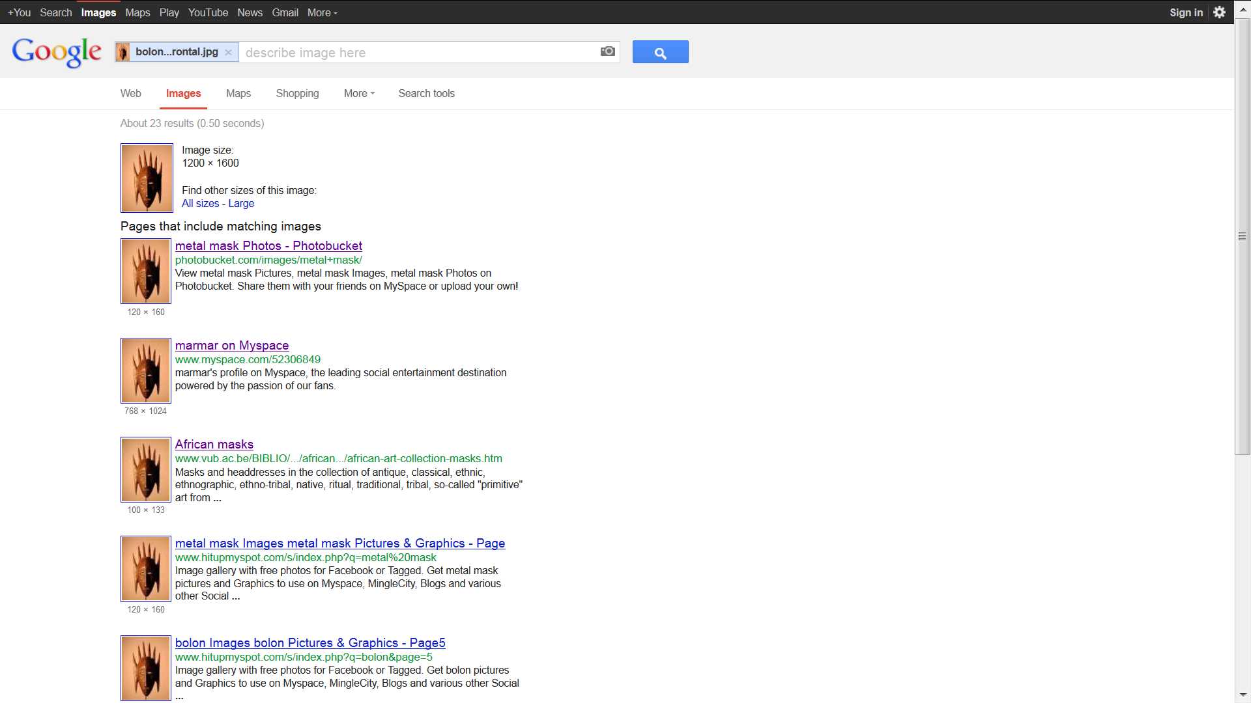
Searching by image: Findings & Discussion: Google
Google reveals numerous copies on the WWW.
J

Slide 32
Searching by image: Findings & Discussion: Google
Google reveals the original image on the WWW.
J

Slide 33

Searching by image: Findings & Discussion
10 images that have a duplicate / exact copy present on the WWW, were submitted as a query, to both systems:
TinEye revealed only 3/10.
Google revealed 7/10.

Slide 34

Searching by image: Conclusion
<

Slide 35
Research problem
To which extent can a system to search by image find an exact copy / duplicate that is present on the WWW ?

Slide 36
Searching by image: various types of results
Start from a particular source image & search for images that are
exact copies, duplicates
Easy
Difficult
based on the same master image, but not exact copies
not based on the master image, but visually similar
visually similar and also semantically similar/related
not visually similar, but semantically similar/related (from weak to strong)
← Width indicates expected success of a search →

Slide 37
Searching by image: searching for exact copies
Start from a particular source image & search for images that are
exact copies, duplicates
Easy
Difficult
based on the same master image, but not exact copies
not based on the master image, but visually similar
visually similar and also semantically similar/related
not visually similar, but semantically similar/related, from weak to strong
← Width indicates expected success of a search →

Slide 38
Searching by image: definition of ‘copies’
_{Master}
_{Master}
_{Master}
_{Master}
Generation 1
2
1
1
3
3
3
Generation 2
2,2
1,2
1,2
3,1
3,1
1,1
2,1
Generation 3
3,1,1
3,1,1

Slide 39
Searching by image: definition of ‘copies’
_{Master}
_{Master}
_{Master}
_{Master}
Similarity to the master image file
HIGH
LOW
Generation 1
2
1
1
3
3
3
Generation 2
2,2
1,2
1,2
3,1
3,1
1,1
2,1
Generation 3
3,1,1
3,1,1

Slide 40
Searching by image: definition of ‘copies’
_{Master}
_{Master}
_{Master}
_{Master}
Generation 1
2
1
1
3
3
3
Generation 2
2,2
1,2
1,2
3,1
3,1
1,1
2,1
Generation 3
3,1,1
3,1,1

Slide 41
Searching by image: Findings
25 images that have a duplicate / exact copy present on the WWW, were submitted as a query to images.google

Slide 42
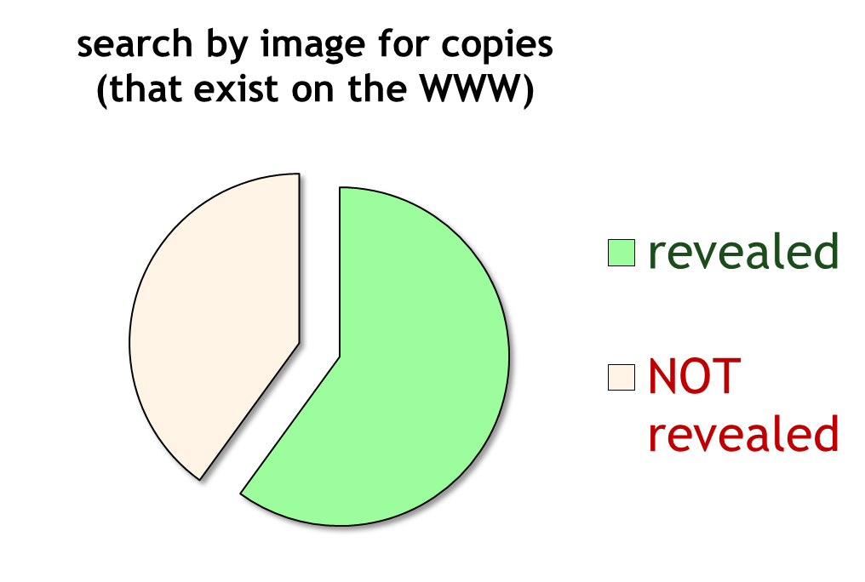
Searching by image: Findings
Successful but not completely

Slide 43
Research problem
How effectively can the search system find images on the WWW, which are NOT exact copies of a particular image, but which do have elements in common?

Slide 44
Searching by image: Findings & Discussion
Example:
Original revealed the derived image: →

Slide 45
Searching by image: searching for near-duplicates
Start from a particular source image & search for images that are
exact copies, duplicates
Easy
Difficult
based on the same master image, but not exact copies
not based on the master image, but visually similar
visually similar and also semantically similar/related
not visually similar, but semantically similar/related, from weak to strong
← Width indicates expected success of a search →

Slide 46
Searching by image: definition of ‘copies’
_{Master}
_{Master}
_{Master}
_{Master}
Generation 1
2
1
1
3
3
3
Generation 2
2,2
1,2
1,2
3,1
3,1
1,1
2,1
Generation 3
3,1, 1
3,1,1

Slide 47
Searching by image: Findings & Discussion: TinEye
In this case: derived images on the WWW were NOT revealed
L

Slide 48
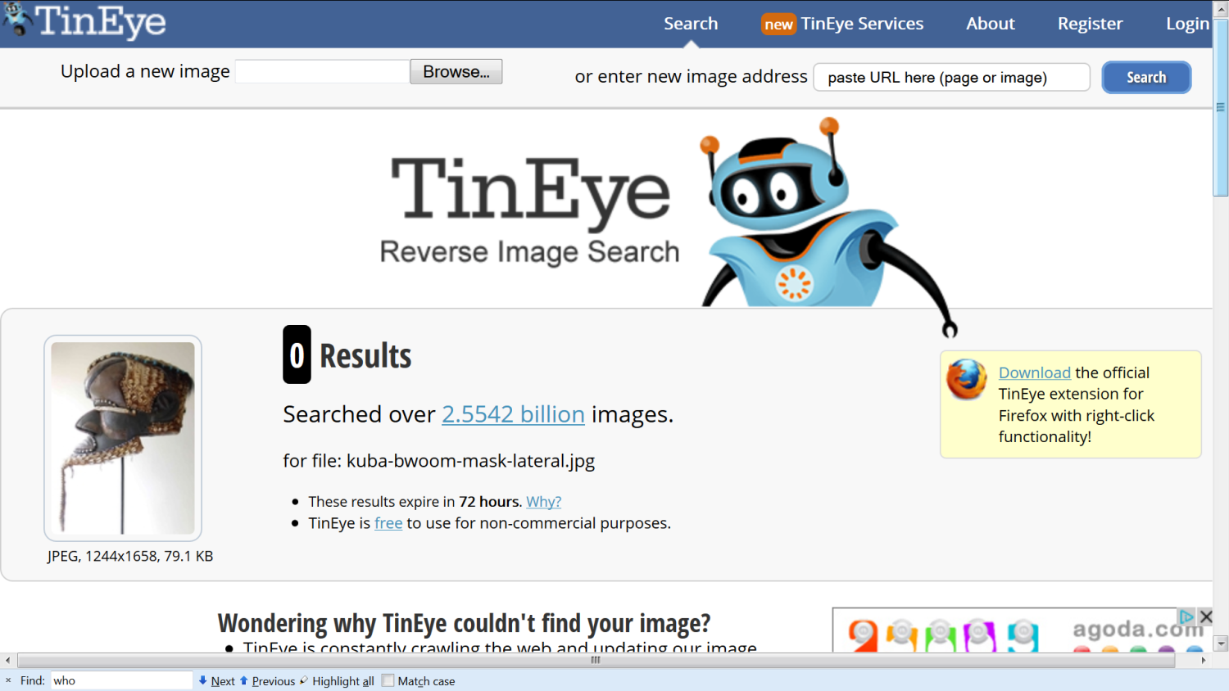
Searching by image: Findings & Discussion: TinEye
In this case: derived images on the WWW were NOT revealed
In this case: derived images on the WWW were NOT revealed
L

Slide 49

Searching by image: Findings & Discussion
10 images were submitted as a query to 2 search systems:
TinEye revealed NO images on the WWW, which include common elements, in any query.
Google revealed images on the WWW, which include common elements in 7 of those 10 queries.

Slide 50
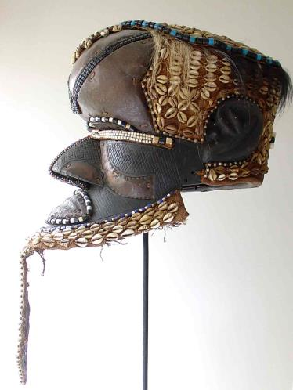
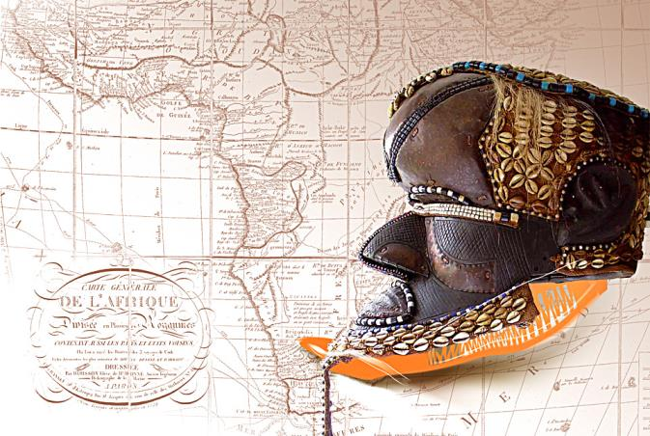
Searching by image: Findings & Discussion
Example:
Original revealed the derived image: →

Slide 51
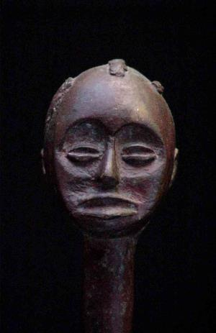
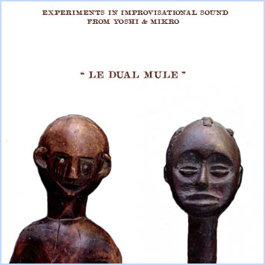
Searching by image: Findings & Discussion
Example:
Original revealed the derived image: →

Slide 52
Searching by image: Findings & Discussion
Example:
Original revealed the derived image: →

Slide 53
Searching by image: Findings & Discussion
Example:
Afterwards, the derived image revealed the original: →

Slide 54
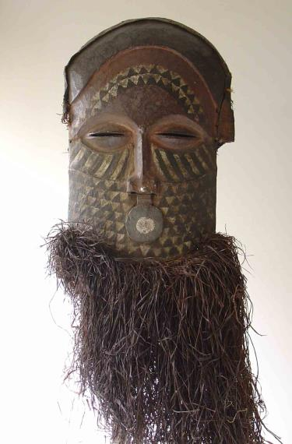

Searching by image: Findings & Discussion
Example:
Search by image, with the original image in colours revealed the derived image in black & white, on a poster →

Slide 55
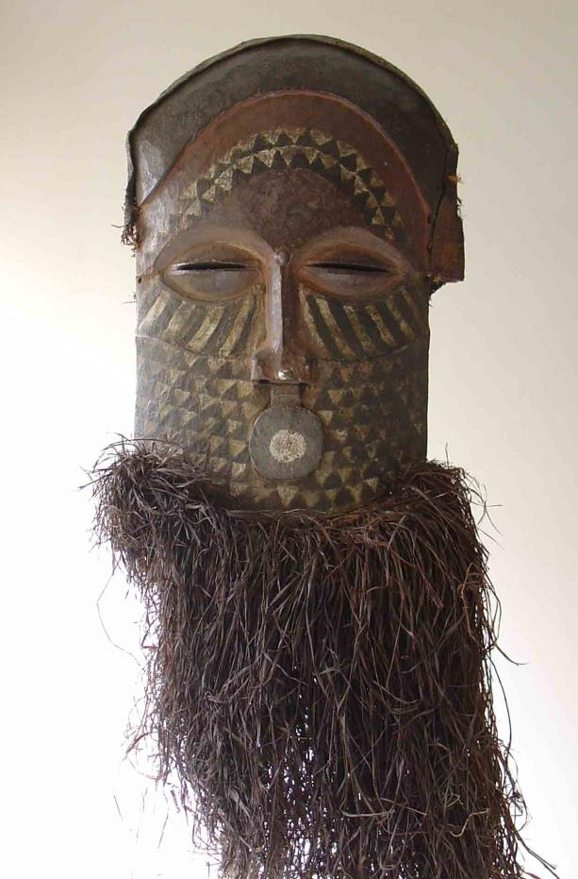

Slide 56
Applications of searching by image: Finding copies of your image
_{Master}
_{Master}
_{Master}
_{Master}
Generation 1
2
1
1
3
3
3
Generation 2
2,2
1,2
1,2
3,1
3,1
1,1
2,1
Generation 3
3,1, 1
3,1,1

Slide 57
Applications of searching by image: Finding copies of your image
This can be interesting in several ways:
Copyright infringements / plagiarism can be discovered.
In a more positive/constructive way: allows us to investigate the impact of some image ! For example: Curators or owners of a collection of objects can assess the impact and reuse of photos of the physical objects in their collection, on a worldwide scale.
J

Slide 58
Applications of searching by image: Finding other versions of an interesting image
We can start from an image that we consider as interesting, but that we did not create and that is perhaps not the original version and for which the creator/author is not indicated.
→

Slide 59
Applications of searching by image: Finding other versions of an interesting image
_{Master}
_{Master}
_{Master}
_{Master}
Generation 1
2
1
1
3
3
3
Generation 2
2,2
1,2
1,2
3,1
3,1
1,1
2,1
Generation 3
3,1, 1
3,1,1

Slide 60
Applications of searching by image: Finding other versions of an interesting image
Then searching by that image may allow us to find
a more suitable version of that image
the creator/author
another version of the image and in this way also its location on some WWW page and site that can provide us with more information about the image.
J

Slide 61
Applications of searching by image: Finding other versions of an interesting image
Then searching by that image may allow us to discover that the image that illustrates and supports a document is NOT real / authentic, but that is has been copied from another site, from another context and perhaps that it has even been modified / changed / doctored, to support the text, the claims of the author of the document.
J

Slide 62
Searching by image: Research problem
Can search by image reveal images that are ‘semantically’ or ‘theme’ or ‘content’ related to the image that is submitted as a query?

Slide 63
Searching by image: searching for information
Start from a particular source image & search for images that are
exact copies, duplicates
Easy
Difficult
based on the same master image, but not exact copies
not based on the master image, but visually similar
visually similar and also semantically similar/related
not visually similar, but semantically similar/related, from weak to strong
← Width indicates expected success of a search →

Slide 64
Searching by image: Findings: Example
→ ?

Slide 65
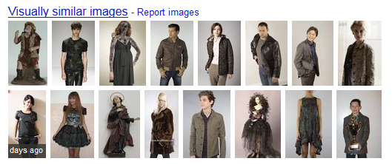
Searching by image: Findings: Example in 2013
→
→

Slide 66
Searching by image
“An image is worth a thousand words.”

Slide 67
Searching by image
“An image is worth a thousand words.”
“A word is worth a thousand images.”

Slide 68
Searching by image: Discussion
Semantic searching and the semantic gap in the case of searching for images
Search by text
Images as results
Search by image
Images & texts as results
User
High level concepts as search topics
Computer system Low level features extracted from texts (such as words) and from images (such as location and color value of each picture element)

Slide 69
Searching by image: Findings: Example in 2014
Source image:
Renamed to x.jpg to remove any relation in the form of text to images on the WWW

Slide 70
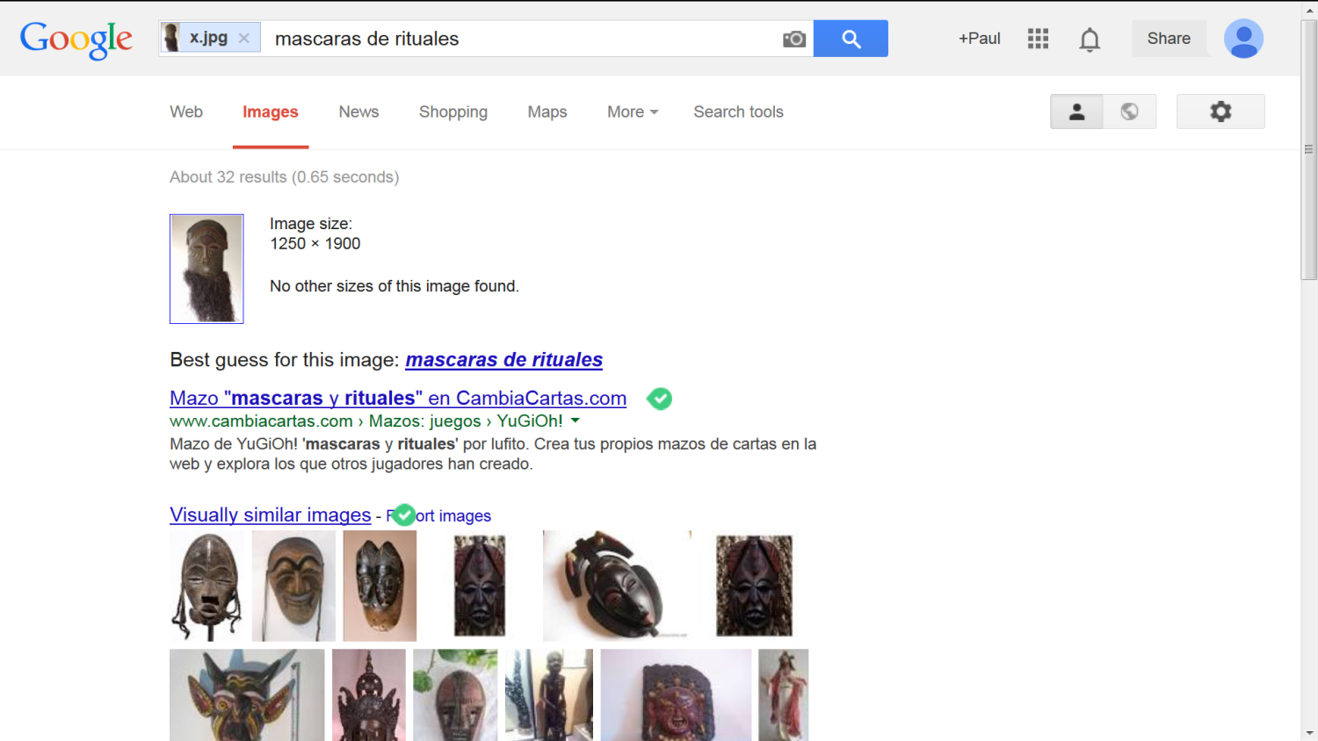
Searching by image: Findings: Example in 2014
Google finds a good description of the image !?
Google finds related images: masks

Slide 71
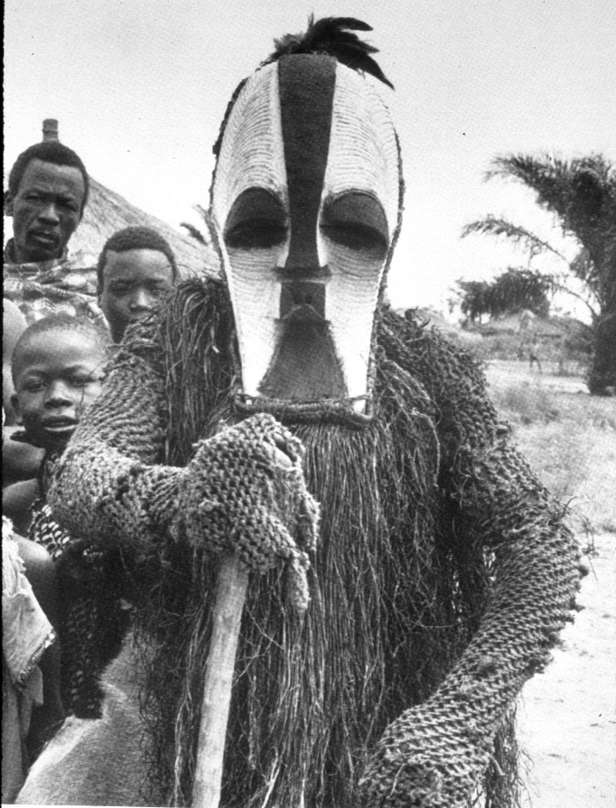
Searching by image: Findings: Example in 2014
Source image = famous photo of Congo Kifwebe mask
Renamed to x.jpg to remove any relation in the form of text to images on the WWW

Slide 72
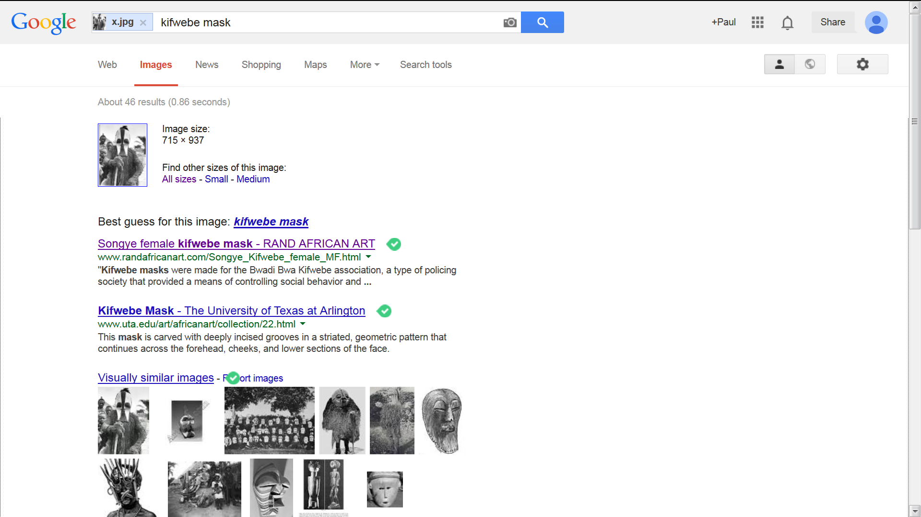
Searching by image: Findings: Example in 2014
Google finds a good description for the image !?
Google finds copies of the image !

Slide 73
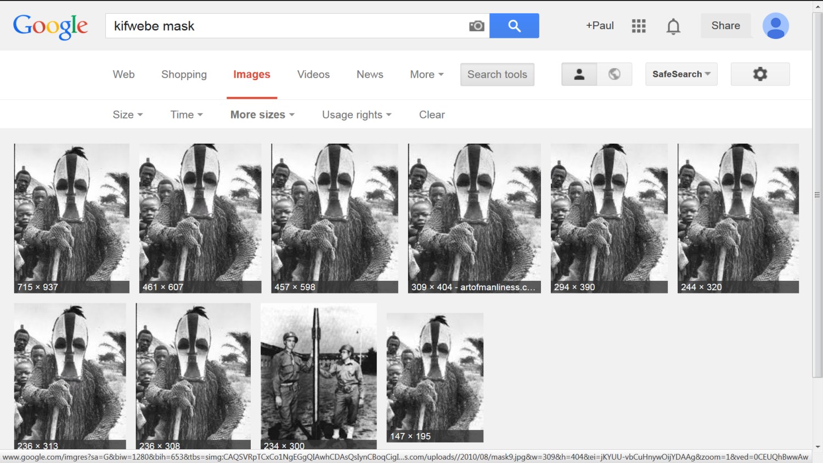
Searching by image: Findings: Example in 2014

Slide 74
Searching by image: Findings: Example in 2014
Google finds a good description of the image !?
Google finds copies of the image !
Google offers related images: masks of type Kifwebe

Slide 75
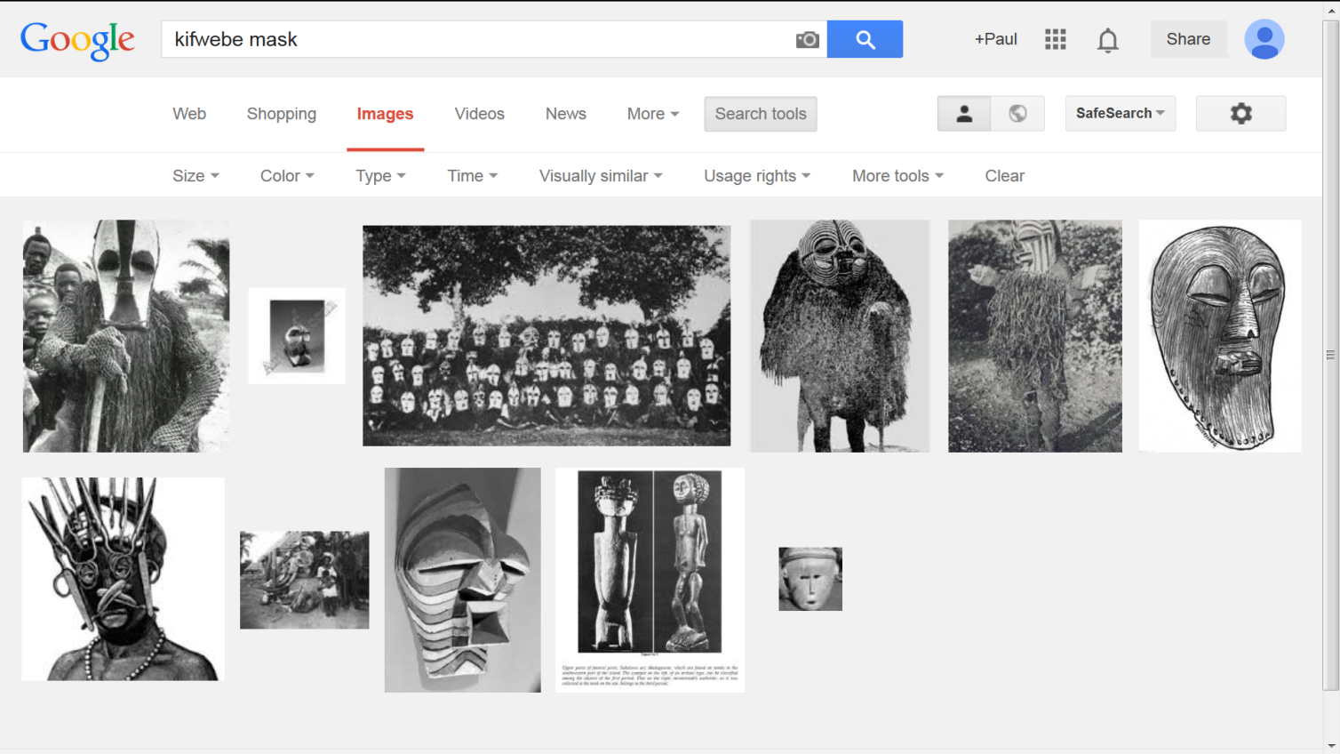
Searching by image: Findings: Example in 2014
= success !

Slide 76
Applications of searching by image: Finding semantically similar images
Starting from a source image, search by image can (even) be successful to find
! a suitable description in words of the image !
!! images that are semantically related !!
J

Slide 77
Information discovery on the Internet, using a search query that consists of text & image
Introduction

Slide 78
Using a search query that consists of text & image: Introduction
Besides pure, simple search with text only or with a source image only, the freely available search system offered by Google, offers also the possibility to use a search query that consists of a combination of an image with text / words.

Slide 79
Using a search query that consists of text & image: Research problem
In which way and in which cases can this method be useful to retrieve / discover information?

Slide 80
Searching by image: searching for information
Start from a particular source image & search for images that are
exact copies, duplicates
Easy
Difficult
based on the same master image, but not exact copies
not based on the master image, but visually similar
visually similar and also semantically similar/related
not visually similar, but semantically similar/related, from weak to strong
← Width indicates expected success of a search →

Slide 81
Using a search query that consists of text & image: Research method
The performance of the retrieval system is mainly measured / evaluated by considering the highest 20 ranked results & by counting the number of relevant results.

Slide 82
Using a search query that consists of text & image: Research method / Findings
A search query depends on the knowledge that the real user already has about the search topic. → In a test of a search system, we should take this into account.

Slide 83
Using a search query that consists of text & image: Research method / Findings
Knowledge about the search topic available to the user, BEFORE the search:
0 % 100 %
No knowledge at all Complete knowledge
Reality

Slide 84
Using a search query that consists of text & image: Findings
It seems reasonable to consider at least 2 scenarios: the user starts with knowledge about the search subject / topic, which is
only general, unspecific, limited, poor or
detailed, specific, advanced, rich

Slide 85
Using a search query that consists of text & image: Research method / Findings
Knowledge about the search topic available to the user, BEFORE the search:
Scenario “poor knowledge”: → only unspecific search query terms are possible
0 %
No knowledge at all
Scenario “advanced knowledge”: → highly specific search query terms are possible
100 %
Complete knowledge

Slide 86
Conclusions of the test cases
100 %
Precision (of search results)
0 %
Types of search query:
Specific word(s) AND image
Specific word(s)
Image AND unspecific word(s)
Image (only)
J
J
0 % Knowledge available before the search 100 %

Slide 87
Images in information discovery
Conclusion & recommendations for librarians

Slide 88
Searching by image: General conclusion
Searching by image is evolving to a powerful, additional method to meet information needs.
This method exploits the increasing number of images on the WWW plus the related texts.
J

Slide 89
Recommendation for librarians
To assist their clients, librarians and other information specialists can apply search by image to tackle some information problems.

Slide 90
Recommendation for librarians / teachers
Search by image can / should be included in teaching of information literacy.

Slide 91
Recommendations for developers of websites
For developers of websites and digital libraries, including
librarians,
scholars,
museums,
galleries,
publishers,
artists,
collectors…
…

Slide 92
Recommendations for developers of websites
In general: Optimize your WWW site for search services that can search for images, so that you reach your public better with the quality that you can offer.

Slide 93

Questions
Suggestions
Comments are welcome

Slide 94



You are free to copy, distribute, display this work under the following conditions:
Attribution: You must mention the author.
Noncommercial: You may not use this work for commercial purposes.
No Derivative Works: You may not change, modify, alter, transform, or build upon this work.
For any reuse or distribution, you must make clear to others the license terms of this work.

