Slide 1

Emerging Global Trends What is Relevant to Libraries and Why Should it Matter to You
Anjana H Bhatt
University Librarian
Florida Gulf Coast University, Fort Myers, Florida, USA
239-994-0547, abhatt@fgcu.edu
http://doi.org/cjjt

Slide 2

What Would You Learn Today
Top Global Trends identified by ALA & ACRL & LITA -- a brief introduction
What is my opinion
How do libraries add value to their services
Ideas to align with trends and implement new services
Trends exercise for library professionals
Example from other libraries
Reference list

Slide 3
Top Trends Initiatives…1 ALA: STEEPED: Center for the Future of Libraries http://www.ala.org/tools/future/trends/
SOCIETY
TECHNOLOGY
EDUCATION
ENVIRONMENT
POLITICS
&
GOVERNMENT
ECONOMICS
DEMOGRAPHICS
Notes:
Identified by ALA
Keep Developing new Trends and adding stuff to existing Trends
At this time Politics & Government Trends are not identified and it is just a place holder. They kind of overlap with Society trends.

Slide 4
Top Trends Initiatives…2
ALA Trends Cards in short: http://www.ala.org/tools/sites/ala.org.tools/files/content/LibraryoftheFuture/TrendCards/ALACenterfortheFutureofLibraries_TrendCards1_Duplex.pdf
ACRL: Top Trends in Academic libraries: A review of the trends and issues affecting academic libraries in higher education http://crln.acrl.org/index.php/crlnews/article/view/9137/10062
LITA Top Technology Trends 2017: http://www.ala.org/lita/ttt/2017midwinter

Slide 5
What Is My Opinion: Primary Concern
TECHNOLOGY
Environment Disaster Recovery
EDUCATION
SOCIETY

Slide 6
What Is My Opinion
Economics
Environment Disaster Recovery
Demographics
Politics & Government

Slide 7
How Do Libraries Add Value
Educate and help patrons write papers, complete assignments and win contracts/ grants
Contribute to an enhanced learning experience and collaborate with academic
departments
Promote Technology Infused spaces and promote new models of scholarly communications
Contribute to institution wide initiatives, create partnerships and promote library outreach
Provide dedicated study spaces and cater to modern human behavior and learning styles
Aim to exhibit a social collaborative community behavior

Slide 8
TRENDS
OPPORTUNITY
RETHINK YOUR MISSION
ANONYMITY
PRIVACY SHIFTING
RESHAPE YOUR LIBRARY
SWOT ANALYSIS
SOCIETY
CREATIVE & FLEXIBLE SPACES
COLLECTIVE IMPACT *
COMMUNITY BUILDING & COLLABORATION
CREATIVE PLACEMAKING*
FANDOM*
COLLECTION ANALYSIS
FAST CASUAL*
GRANTS
TRAINING OPPORTUNITIES
MAKERSPACES MOVEMENT*
CREATIVE LIBRARY INSTRUCTIONS
SHORT READING
UNPLUGGED SPACES

Slide 9
Society Trends: Opportunities….1
Don’t be a storehouse of books with minimum staff and be of no importance to your organization
Participate in collective impact projects and develop shared interests/strategies
Prioritize flexible spaces supporting user needs; challenges involved displacing traditional physical collections and introducing user friendly spaces
Invest in learning the impact of fandom on the nature of copyright laws, derivative and transformative works and fair use
Transform unattractive spaces into places that encourage, invite and promote quiet spaces, social engagement, collaborative learning, sharing and creating Examples:
A shift towards e-resources for freeing up valuable space
Collection Analysis Projects *
Media Rooms*
Quiet Study spaces, unplug zones or digital escape zones

Slide 10
Society Trends: Opportunities….2
Collaborate with local organizations and provide access to library's digital content for short reading experiences
Provide opportunity for deeper research and personal growth
LibGuides
Bibliographic instruction (BI)
Embedded Librarianship
Canvas & Curriculum Builders
Use of Haptics in BI activities enabling students to participate and teach students with visual or audio disabilities
Instruction programs aligned with the contemporary skills
Appropriate teaching strategies for youngsters, older groups and adults

Slide 11
Society Trends: Opportunities….3
Makerspaces: Provide open environment, space and tools
Take advantage of technology or improved communication and use it for a better cause
Adopt new functions, provide spaces and opportunities for group interaction, resource sharing, creating and co-creating content for individual or community use
Provide access to wide variety of software tools for hands-on-learning activities
Provide opportunities for collective learning in the science or medical or media discipline
Adopt strategies that establish your library as the center of community engagement that welcomes diversity and people from all walks of life and social status

Slide 12
TRENDS
OPPORTUNITY
RESPONSIVE WEB SITE DESIGN WITH HAPTICS
BLOCK CHAIN
BLOCK CHAIN
CONNECTED TOYS
CONNECTED TOYS
DISCOVERY SERVICES
OPPORTUNITIES FOR RESHAPING YOUR LIBRARY
TECHNOLOGY
OPPORTUNITIES FOR RESHAPING YOUR LIBRARY
DIGITAL LIBRARIES & IRs
DATA EVERYWHERE
DATA EVERYWHERE *
TECHNOLOGY BASED REFERENCE. MOBILE REF.
DRONES (UAV’S)
DRONES (UAV’S)
E-RESOURCES
HAPTICS
HAPTICS *
FREE INTERNET & Wi-Fi
INTERNET OF THINGS
INTERNET OF THINGS
TECHNOLOGY HUBS
ONLINE JOURNAL CLUBS
ROBOTICS & CoBOTS
ROBOTICS & CoBOTS
LEND TECH GADGETS
UNPLUGGED
SOCIAL MEDIA PRESENCE
UNPLUGGED
LEARNING COMMONS
VIRTUAL REALITY
VIRTUAL REALITY*
EMBEDDED TEACHING
VOICE CONTROL
EMBRACE ROBOTICS
VOICE CONTROL
FOSTER TECHNOLOGY LOVING STUDENTS

Slide 13
Technology Trends: Opportunities….1
Technology based Reference Service
Ask a Reference service
Online and text based reference services
OmniReference, Questionpoint, Vienova and Library H31p
Desktop sharing apps to provide reference service by co-browsing
Gamification based platforms for library orientations and classroom teaching (Kahoot, Socrative, Quizlet and Quizalize)
Learn more about Technology Trends identified by LITA in 2017
Distance Charging
Cloud Computing
Open Source Publishing
Open Source Licensing
eBooks innovations

Slide 14
Technology Trends: Opportunities….2
Library outreach via Facebook, Instagram and Pinterest
Haptics technologies for gathering feedback and providing BI for differently abled students
Educate users with new technologies, skills and hands on knowledge required for managing several devices
Use of robots to improve human experience in the workplace
Provide opportunities for learning alternative or improved skills for employees replaced by automation/robotics or CoBots
Collaborate with big companies for trial of new technologies

Slide 15
TRENDS
OPPORTUNITY
INSTRUCTION LABS
COLLABORATIVELIBRARY INSTRUCTION
EDUCATION
OPPORTUNITIES FOR RESHAPING YOUR LIBRARY
CONNECTED LEARNING
HANDS ON LEARNING
DISTANCE LEARNING
FLIPPED LEARNING
DESKTOP SHARING
TECHNOLOGY
GAMIFICATION
USE HAPTICS IN TEACHING
TECHNOLOGY BASED
TUTORIALS
TUTORING HUBS

Slide 16
TRENDS
ENVIORNMENT
POLITICS & GOVRNMENT
Economics
DEMOGRAPHICS
RESILIENCE
UNDER DEVELOPMENT
BASIC INCOME
AGING ADVANCES
POSSIBLE OPPORTUNITES FOR LIBRARIES
RECOVERY PLAN FROM DISASTERS: ACT OF GOD OR MAN
DATA WAREHOUSE & DATA MANAGEMENT SKILLS
COLLABORATE, SPACE SHARING, SHARED PROJECTS
EDUCATION FOR TECHNOLOGY DISPLACED, HANDS-ON EDU.
DISTANCE LEARNING, PREPARE FOR FAST & CASUAL
CREATIVE MAKERSPACES FOR ALL
ORIENT TOWARDS DIGITAL NATIVES & DIGITAL IMMIGRANTS
NEW APPROACHES TO MEET URBANIZATION
INCOME INEQUALITIES
DIGITAL NATIVS
EMERGING ADULTHOOD
SHARED ECONOMY
URBANIZATION

Slide 17

Final Ideas….1
AWARENESS HELPS: Turn outward, be aware and stay updated
PLAN: Engage in long-term outcome based strategic planning and be a collaborative social organization
MOVE WITH TIME: Prepare to serve Digital Natives and help Digital Immigrants
EVOLVE: Prepare for a purposeful evolution of the library from a stereotype to a happening place and create social spaces
DEVELOP: Skills to understand, analyze and use vast amount of data
EDUCATE: Required skills and core competencies
NASIG core competencies: http://www.nasig.org/site_page.cfm?pk_association_webpage_menu=310&pk_association_webpage=1225
E-resources librarians
Print Serials Management
Scholarly Communication Librarians

Slide 18
Final Ideas....2
EXERCISE:
Conduct a Trends Exercise for your library: http://www.ala.org/tools/sites/ala.org.tools/files/content/LibraryoftheFuture/TrendCards/FromFuturingtoInnovation.pdf
Focus on 1-3 Trends that are important for your library/community/patrons
Conduct a SWOT analysis and write down your results
Pick one or two services that might be improved upon or positively affected by these trends
Draft out a creative solution that includes selected trends and services
Finally, propose a specific service or program or partnership that is the outcome of your exercise and act upon it
Evaluate and improvise, if necessary
Move forward with next opportunity

Slide 19
Noteworthy Examples….1: FGCU Library
FGCU LibraryNext, Collection Analysis Project, Furniture Design & Results
297square feet of floor space from multimedia area
3435 square feet of floor space from periodicals area
Library Learning Common: 298 Seats, 22 computers, print stations & new furniture
FGCU library Makerspace for Media Room
Collaboration with Eagle Media and Student Union
Study Rooms: 30 rooms: 44,432 times reserved
Teaching Hub partnerships for collaborative learning and Tutoring department

Slide 20
Future Directions
Dedicate a complete floor to Silent Study space
Increase number of Individual Study Spaces, Study Pods/Cubicles
LibraryNext
Increase Collaborative Study spaces
Develop Techno Booth
Highly Visible & Accessible Round Information Common with potential partners
Tutoring Hub with whiteboards, computers & supplies
Research Consultation booths adjacent to the reference desk
Mini Computer Lab behind Information Common
Develop glass-enclosed combination of lab and instruction spaces
Develop leisure reading and display spaces

Slide 21
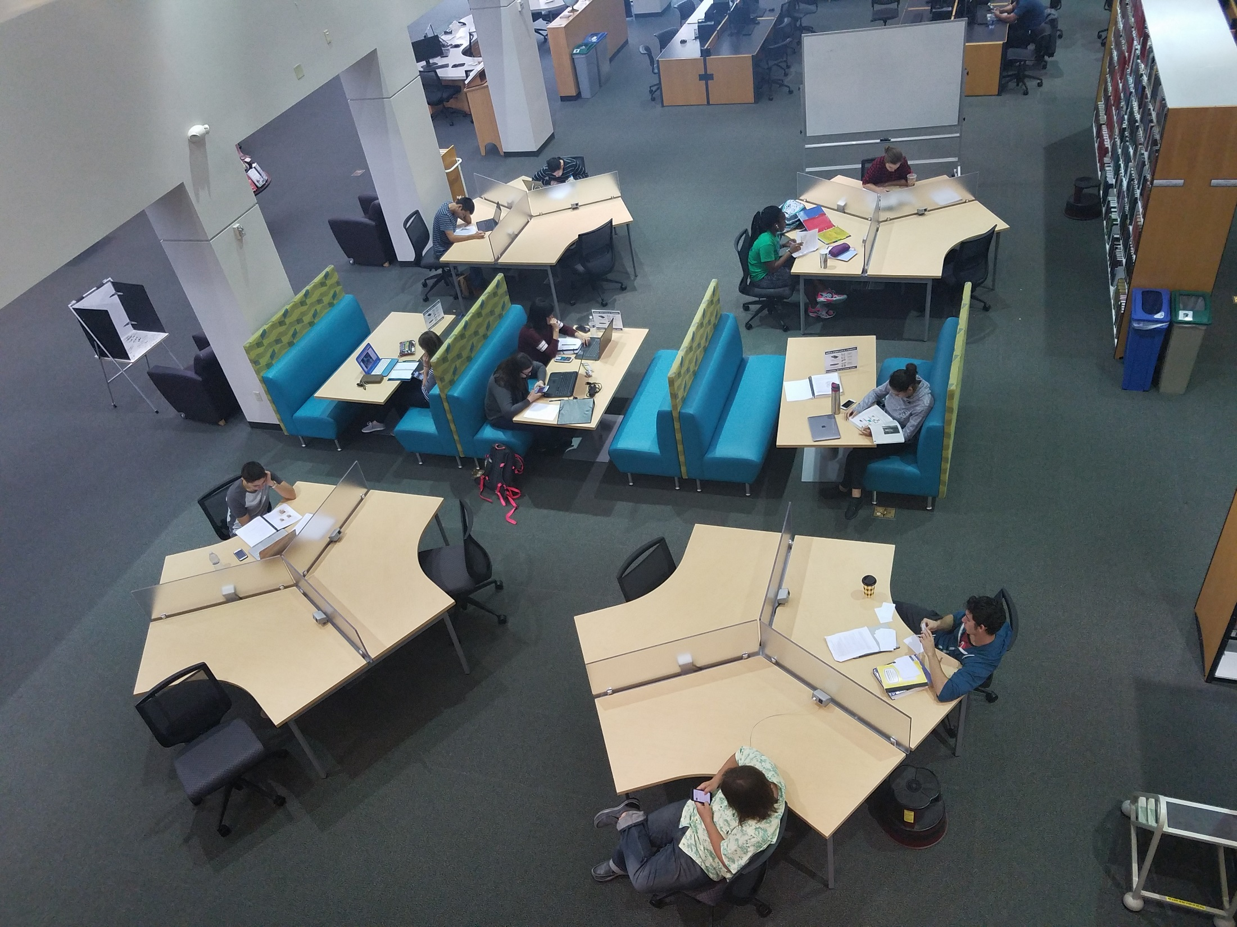

Slide 22
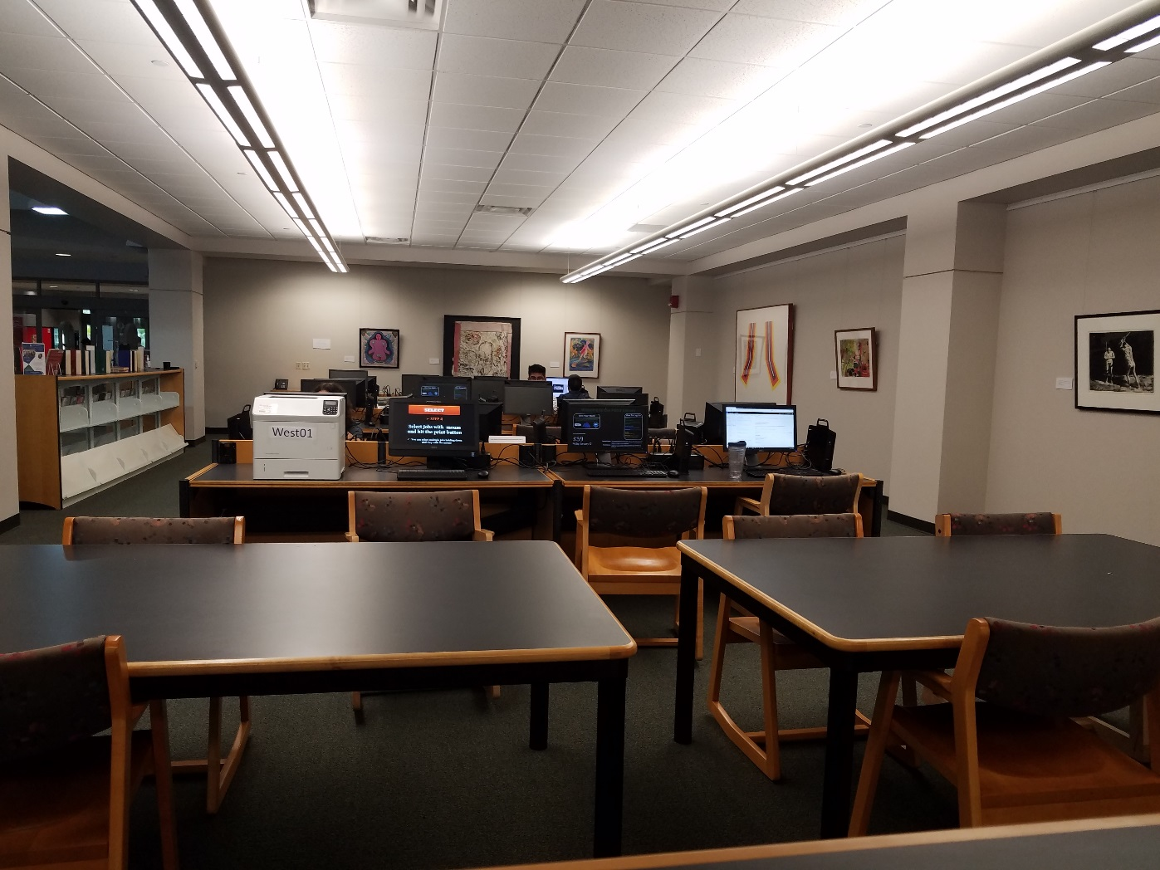

Slide 23
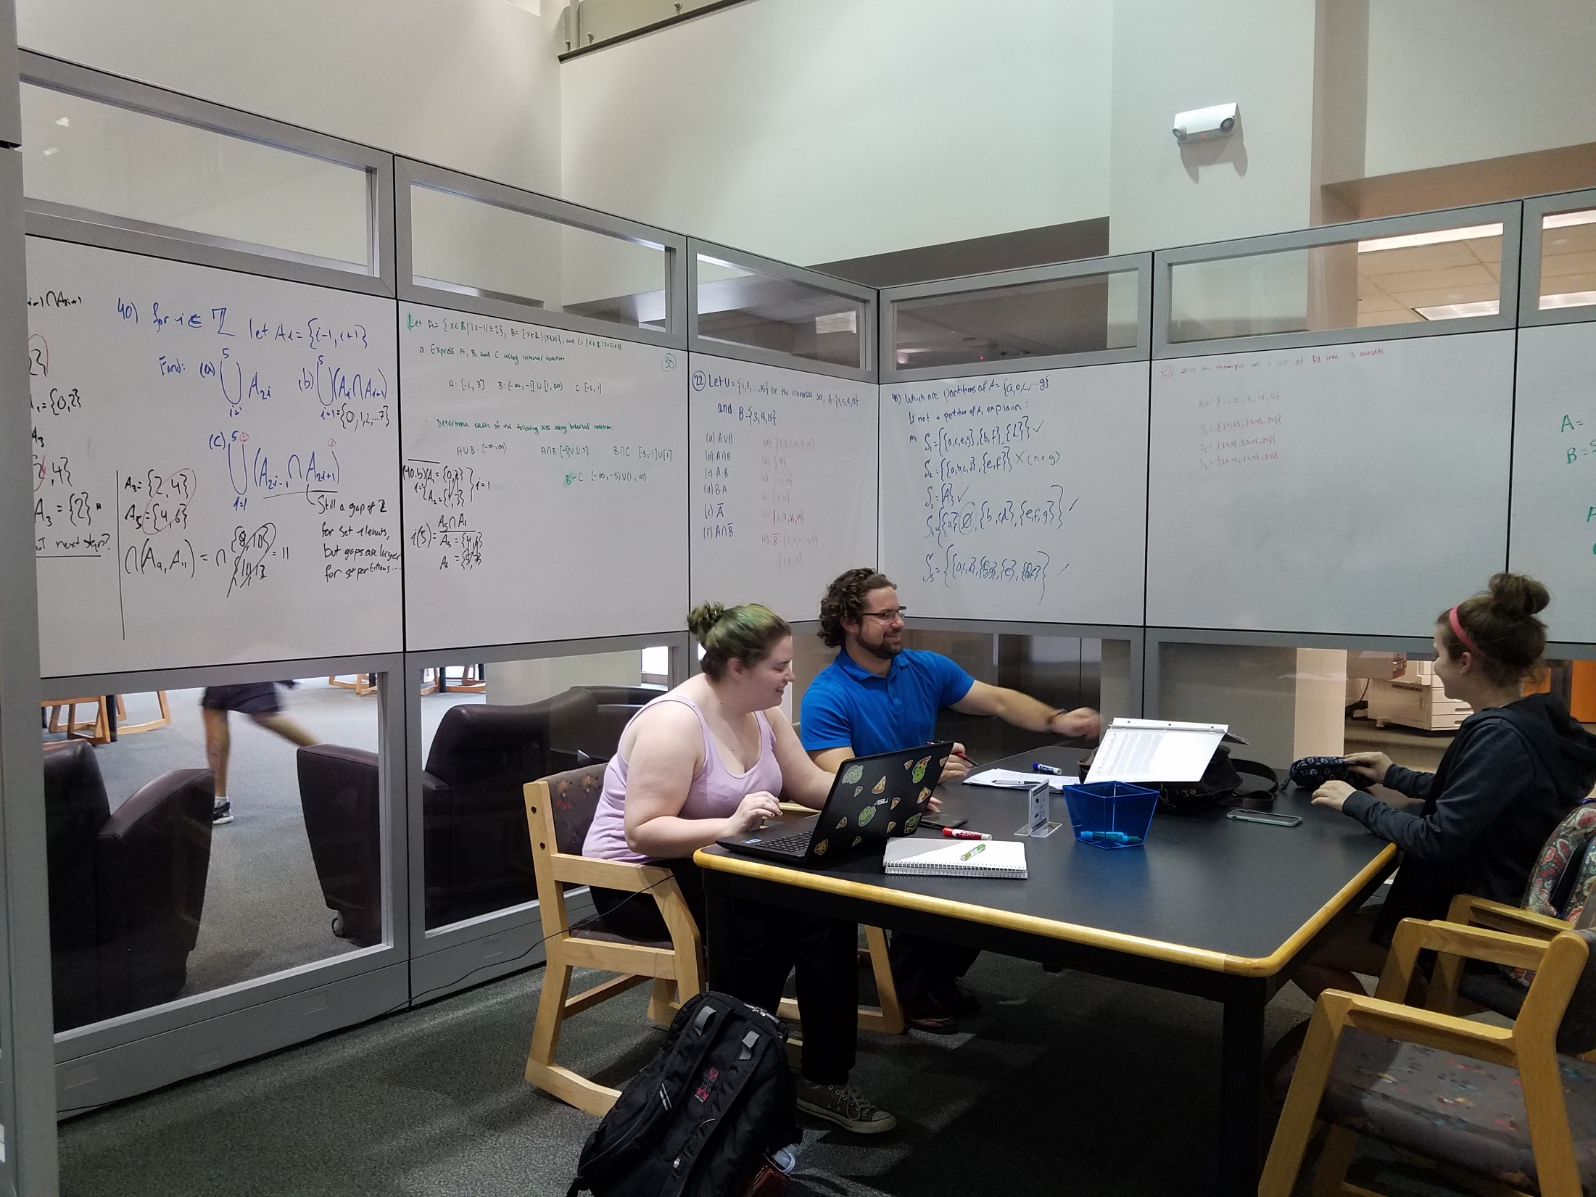

Slide 24
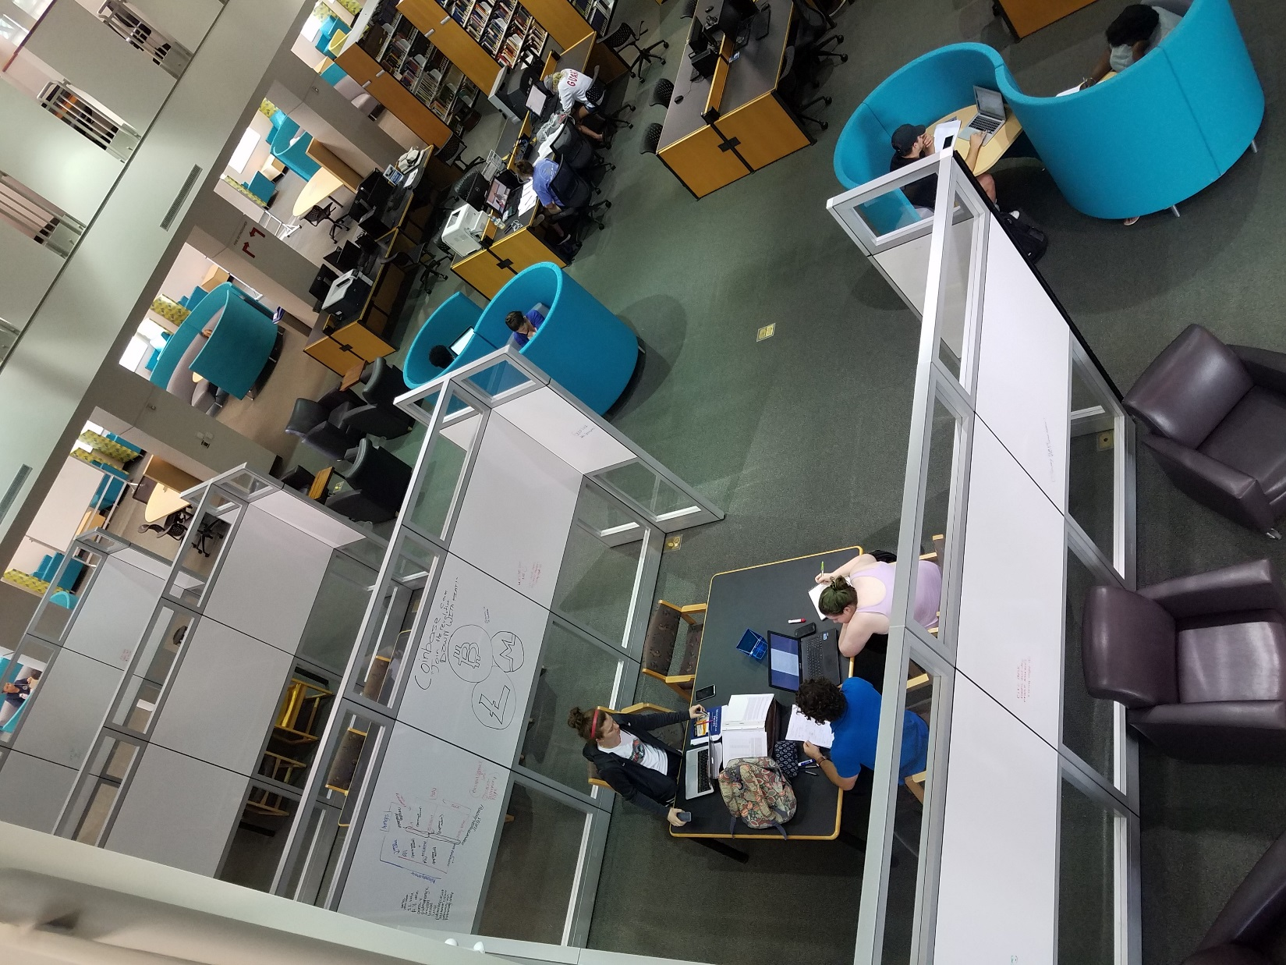

Slide 25
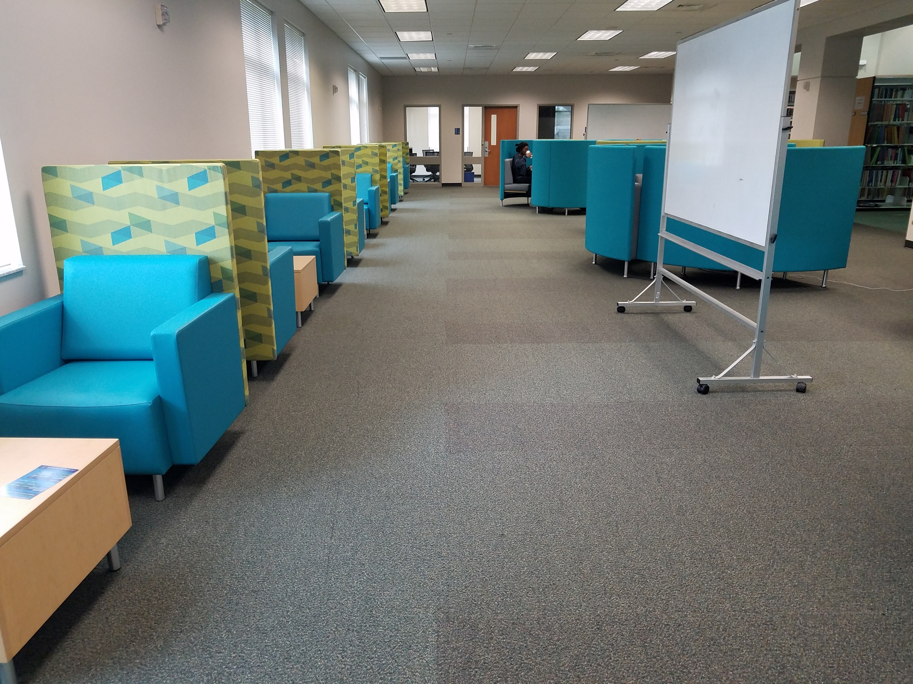

Slide 26
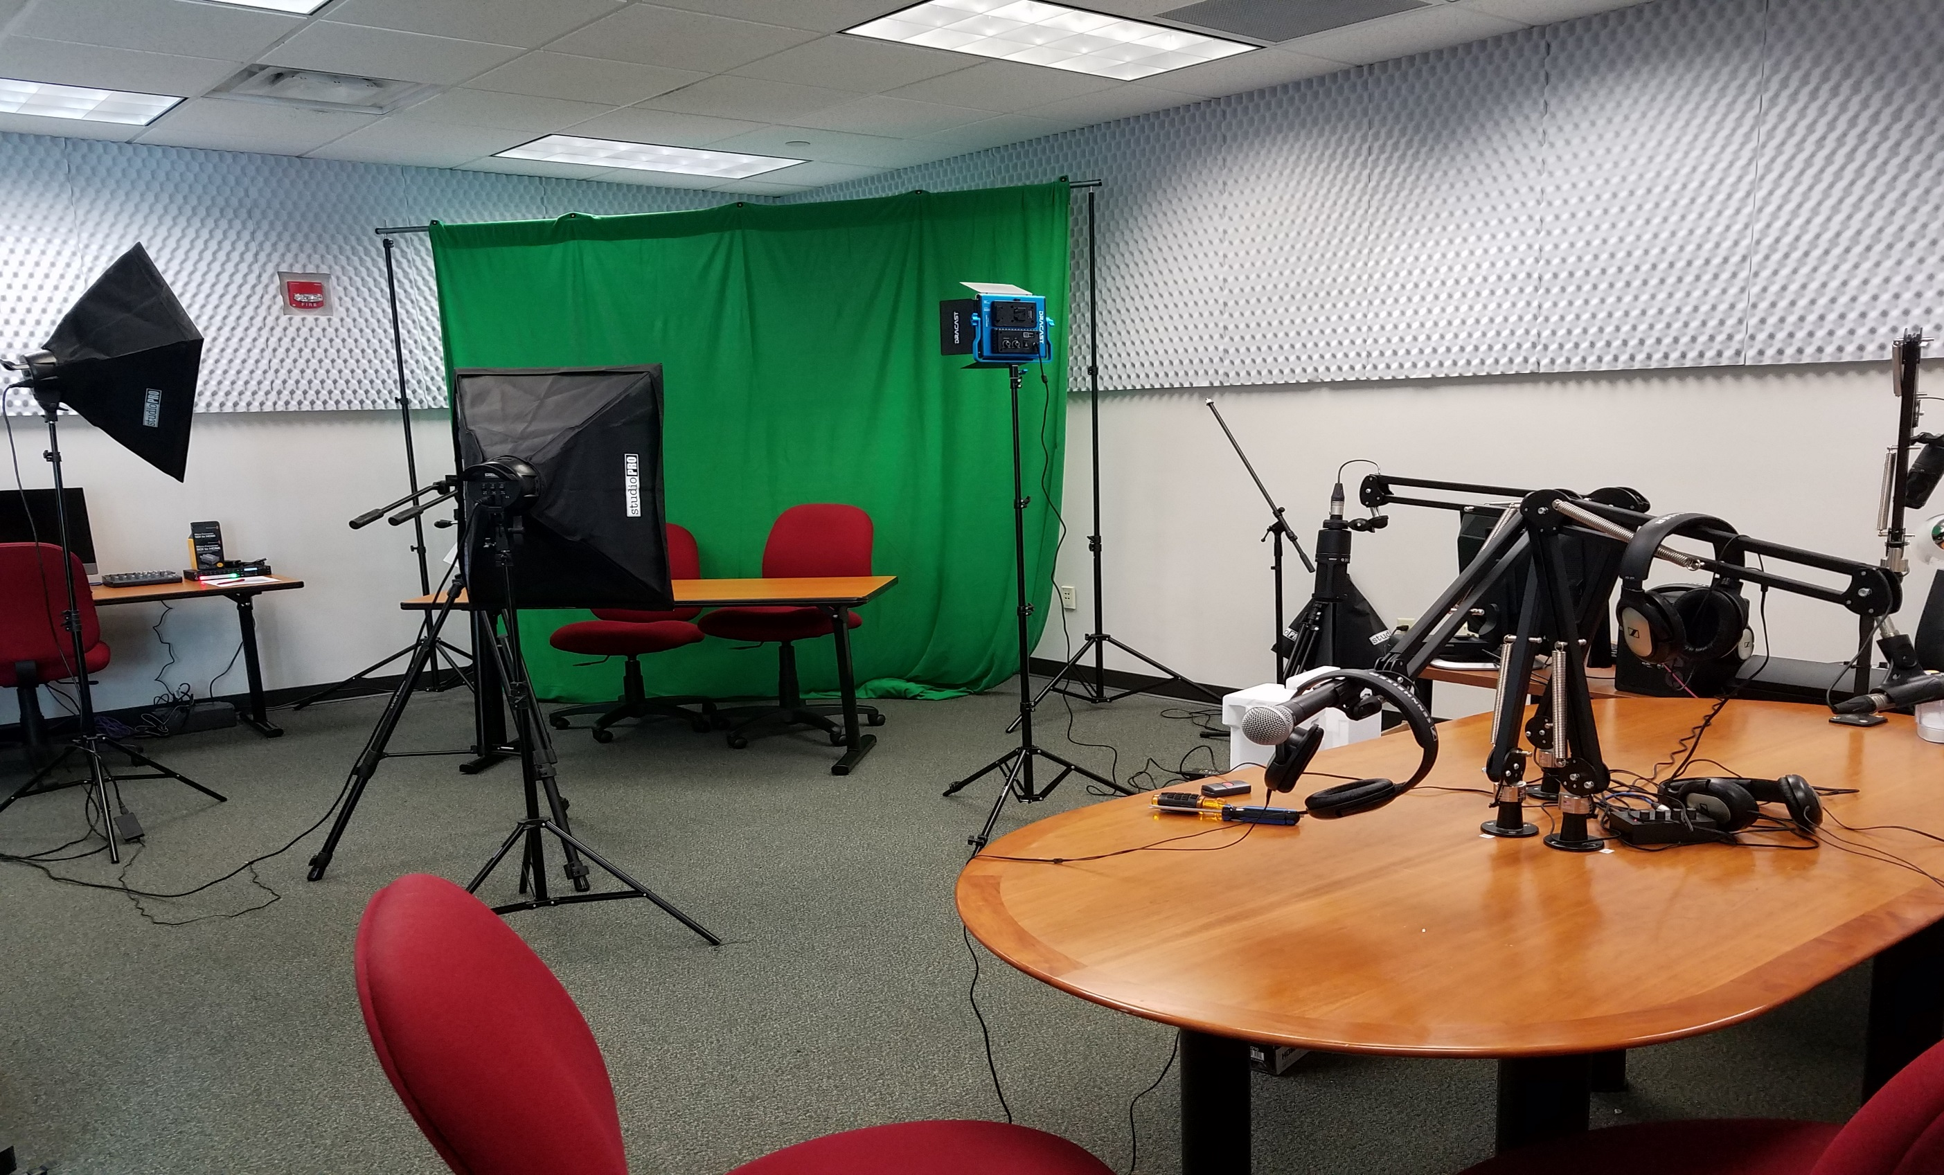

Slide 27
Library As a Learning Community Does it Add Value?
Door Count:
FY 13-14: 764,140, FY 14-15: 821,336
FY 15-16: 940,646, FY 16-17: 1,680,287
Website: 708,000 page views
Instructions: 474 classes, 5690 students
Study Rooms: 44,432
Reference: 30,096 questions
LibGuides: 204,006 views
Computer Lab: 275, seats: 223,069, 13,286 users
Collection usage: eBooks: 108,670, eJrs: 460,149

Slide 28
Noteworthy Examples ….2
Free Library of Philadelphia's Paschalville partnership between ten area organizations with a common interest for addressing high unemployment rate
Collaboration with local organizations and government departments (fisheries at FGCU, Research Triangle park at North Carolina)
Roving Nurses in Tucson, Arizona area libraries. They provide nutrition, wellness advise and assistance with screening and referral activities
Chicago Public Library and the city’s CTA have partnered to provide riders with access to the library’s digital content including e-books by Chicago authors, blog posts written about Chicago, and other city-focused content, all meant to help riders use transit time for quality reading instead of technological distraction

Slide 29
Noteworthy Examples ….3
Brooklyn Library: Tablet Lending Program
Ann Arbor Library:
Lend energy meters for testing the energy efficiency
Borrow original and reproduction artwork for a specific period of time to decorate their homes
62% of Public Library offer career and job-related resources (PEW Research)
33% offer programs for starting new business (PEW Research)
Florida Public Libraries offer tax filing services & Meet the Author Programs
Howard County Library, Maryland: A+Partners in Education
City/Community Reads Projects (New York, Chicago and around the country); Invite author, screen movies, provide demonstrations, arrange panel discussions
ALA offers a free 45 page “Planning Your Community-Wide Read” primer

Slide 30
Noteworthy Examples ….4
Fabrication Lab at Martin Luther King, Jr. Library: Laser Cutter, 3D printers, Soldering Tools, Computer Numerical Controlled Machines
Oculus Launched an initiative to provide their Rift Headset and VR ready computer system in 90 libraries throughout the state
Oculus foundation donated $ 31 million to the University of Maryland for virtual researchers working on projects related to healthcare, public safety and education
Librarian guide to Makerspaces: http://oedb.org/ilibrarian/a-librarians-guide-to-makerspaces/
Public Library of Cincinnati: Main Library Makerspace and 3D printers
Makerspaces are rooted in makerism, a movement geared towards creation and craftsmanship rather than consumption
Boston Public Library: Media lounge and Lab
Hennepin County, Minnesota: Best Buy Teen Tech Center
Fayetteville, New York: Free Library Creation Lab

Slide 31
References
Google Docs
https://drive.google.com/file/d/1Al06ETXCAh1ftzQHIMsT4TxdLISgqNAl/view?usp=sharing
THANK YOU
abhatt@fgcu.edu

